Slide 1
Allergy and Anaphylaxis: Follow the Evidence
Joseph Toscano, MD FCUCM
jtoscano64@ymail.com

Slide 2

Joseph Toscano, MD, FCUCM
Medical Director, Lawrence Berkeley National Laboratory Berkeley, CA
Urgent Care and Emergency Physician
East SF Bay area, CA
Clinical Content Advisor, UCA/CUCM/UCCOP

Slide 3
Financial Disclosures
None

Slide 4
Objectives
Describe the range of allergic reaction, from minor symptoms to anaphylaxis
Discern the features of anaphylaxis among other allergic presentations
Discuss evidence-based treatments for the range of allergic reactions which might be seen in urgent care
Explain the newest knowledge regarding the risk and benefit of corticosteroids in the treatment of allergic reactions
Determine the safest dispositions from urgent care for these patients
Strengthen the role of the urgent care clinician in treating patients with allergic reactions

Slide 5
Just another day at the office……
A mom of 3 children (ages 11, 9, and 7) arrives with them after picking them up from school after being called about them not feeling well. They all have low grade fever, runny noses, cough and one of them has an itchy rash…..
A 26 year old man with known peanut allergy accidentally took a bite of his girlfriend’s PB cookie and has gotten some progressive lower lip swelling and feels some tightness in his throat……
A 40 year old woman arrived with diffuse skin erythema, complaining of feeling lightheaded. You are called to triage because she just passed out…….

Slide 6
Basic pathophysiology
Mast Cell

Slide 7
Basic pathophysiology
Histamine-containing Lysosomes

Slide 8
Basic pathophysiology
Ig E Receptors

Slide 9
Basic pathophysiology
IgE
Notes:
IgE is made by plasma cells (B lymphocytes) in response to molecules – usually proteins but sometimes sugars – that are perceived to be foreign

Slide 10
Basic pathophysiology
Antigen

Slide 11
Basic pathophysiology

Slide 12
Basic pathophysiology
Degranulation and
histamine release
Notes:
The histamine goes on to have tissue effects

Slide 13
Basic pathophysiology
Degranulation and
histamine release
Urticaria
Angioedema
Anaphylaxis
Notes:
The histamine goes on to have tissue effects

Slide 14
Basic pathophysiology
H1 receptors are located:
ENT (also H2, H3, H4) and bronchial epithelium
Smooth muscle and vascular endothelial cells
Brain and adrenal medulla
Immune cells (mast, dendritic cells, lymphocytes, neutrophils)
H2 receptors are located:
Gastric mucosa
Cardiac muscle and vascular smooth muscle
Uterus
There are H3 (neuro, respiratory) and H4 (immune) receptors, too!
Notes:
Eyes (Ocular Surface):
H1: Responsible for itching, conjunctival edema, and hyperemia.
H2: Primarily localized to blood vessels, contributing to redness (vasodilation).
H4: Present on immune cells in the conjunctiva and involved in mediating allergic reactions.
H1-H4: All four types are present in conjunctival goblet cells, which contribute to mucus production, with H2 and H3 playing roles in secretion regulation.
Nose (Nasal Mucosa):
H1: Primary mediator of sneezing, nasal rubbing, and vascular changes.
H2: Involved in nasal congestion and secretion.
H3: Located on nerve terminals (prejunctional), influencing nasal congestion and inhibiting neuronal responses.
H4: Involved in mediating inflammatory responses in the nose.
Histamine modulate circadian rhythm, GI contraction

Slide 15
Basic pathophysiology
Type I hypersensitivity reactions – Histamine- and IgE-mediated
Notes:
Rapid

Slide 16
Basic pathophysiology
Type I hypersensitivity reactions – Histamine- and IgE-mediated
Type II – IgG or IgM – transfusion reactions, AIHA, Goodpasture’s
Type III – Ab-Ag complexes – serum sickness, post-Strep GN, SLE
Type IV – T lymphocytes – poison ivy/oak, PPD reactions, transplant rjx

Slide 17
Basic pathophysiology
Type I hypersensitivity reactions – Histamine- and IgE-mediated
Type II – IgG or IgM – transfusion reactions, AIHA, Goodpasture’s
Type III – Ab-Ag complexes – serum sickness, post-Strep GN, SLE
Type IV – T lymphocytes – poison ivy/oak, PPD reactions, transplant rjx

Slide 18
Basic pathophysiology
Type I hypersensitivity reactions – Histamine- and IgE-mediated
Type II – IgG or IgM – transfusion reactions, AIHA, Goodpasture’s
Type III – Ab-Ag complexes – serum sickness, post-Strep GN, SLE
Type IV – T lymphocytes – poison ivy/oak, PPD reactions, transplant rjx
Inflammation and edema
Superficial – urticaria/hives
Deeper cutaneous/mucosal – angioedema
Skin, facial skin, GI mucosa, airway mucosa
Vascular and cardiovascular system

Slide 19
Basic pathophysiology
Type I hypersensitivity reactions – Histamine- and IgE-mediated
Type II – IgG or IgM – transfusion reactions, AIHA, Goodpasture’s
Type III – Ab-Ag complexes – serum sickness, post-Strep GN, SLE
Type IV – T lymphocytes – poison ivy/oak, PPD reactions, transplant rjx
Inflammation and edema
Superficial – urticaria/hives
Deeper cutaneous/mucosal – angioedema
Skin, facial skin, GI mucosa, airway mucosa
Vascular and cardiovascular system
Anaphylaxis

Slide 20
Potential causes of any allergic reaction
Medication
  NSAIDs and antibiotics common
Food
Hymenoptera and horsefly stings
Other venoms - sting rays, jelly fish, venomous fish and snakes, fire ants
IV contrast
Heat and cold
Exercise
Latex

Slide 21
Food intolerance vs food allergy
Intolerance – gassiness, bloating, abdominal pain, diarrhea
Hard to tell if there’s only GI mucosal angioedema
Most common allergies:
  Cow’s milk
  Eggs
  Soy
  Wheat
  Peanuts
  Source: AMA News Wire. What doctors wish patients knew about food allergies. Feb 20, 2026. Accessed March 3, 2026.
  Tree nuts
  Sesame seeds
  Shellfish
  Other seafood
Notes:
#10 is alpha gal - galactose-α-1,3-galactose estimated that 500000 in US have this – think ticks – Lyme and other tick-borne disease more common
Head scratcher – tick bite history

Slide 22
Food intolerance vs food allergy
Intolerance – gassiness, bloating, abdominal pain, diarrhea
Hard to tell if there’s only GI mucosal angioedema
Most common allergies:
  Cow’s milk
  Eggs
  Soy
  Wheat
  Peanuts
  Source: AMA News Wire. What doctors wish patients knew about food allergies. Feb 20, 2026. Accessed March 3, 2026.
  Tree nuts
  Sesame seeds
  Shellfish
  Other seafood
  Red meat – “alpha-gal”
Notes:
#10 is alpha gal - galactose-α-1,3-galactose estimated that 500000 in US have this – think ticks – Lyme and other tick-borne disease more common
Head scratcher – tick bite history

Slide 23
Food intolerance vs food allergy
Intolerance – gassiness, bloating, abdominal pain, diarrhea
Hard to tell if there’s only GI mucosal angioedema
Most common allergies:
  Cow’s milk
  Eggs
  Soy
  Wheat
  Peanuts
  Source: AMA News Wire. What doctors wish patients knew about food allergies. Feb 20, 2026. Accessed March 3, 2026.
  Tree nuts
  Sesame seeds
  Shellfish
  Other seafood
  Red meat – “alpha-gal”
History of Tick Bite
Notes:
#10 is alpha gal - galactose-α-1,3-galactose estimated that 500000 in US have this – think ticks – Lyme and other tick-borne disease more common
Head scratcher – tick bite history

Slide 24
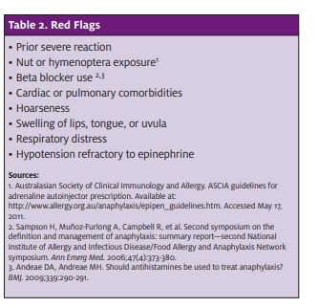
History and Exam
History
Onset, symptoms, organ systems involved (ROS)
Prior similar symptoms, diagnosis and any treatment
Known allergens, recent exposures
Medications, including beta-blockers, ACE-I’s, OTCs
Comorbidities – RAD, COPD, CHF, CAD
Recent illness
Exam
VS, general appearance – general or resp distress, LOC/MS, work of breathing/stridor/ wheezing
Eyelids/lips/oropharynx
Lungs
Skin
JUCM. June 2011. 9-15
Notes:
Grading system but risk factors and objective measures visible edema in an important place or drooling (functional), audible stridor or wheezing, objective changes in VS
vs subjective sensations

Slide 25
Testing
Almost always - none
Serum tryptase – recurrent, idiopathic, or severe anaphylaxis, Hymenoptera venom anaphylaxis, or suspected mastocytosis¹
Plasma histamine
Paraprotein
Complement testing – for angioedema
  C4
  C1-q
  C1-INH antigenic and functional levels
  1. Golden DBK, et al Ann Allergy Asthma Immunol. 2024 Feb;132(2):124-176.
Notes:
Golden 2024 = 2023 Practice Parameter

Slide 26
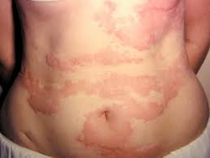
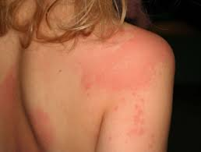
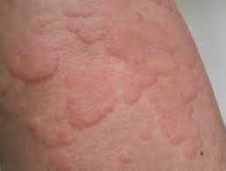
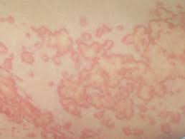
Clinical presentation - urticaria
Source: https://dermnetnz.org
Notes:
Start with the simplest involvement
Allergy phenotypes – what do we see clinically in terms of how patients express an allergic state
Pruritic, pinkish, blanchable rash, evanescent; beware pallor or mottling…..if you think it’s an allergy

Slide 27
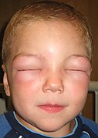
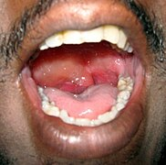
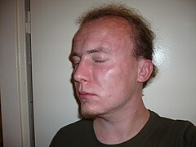
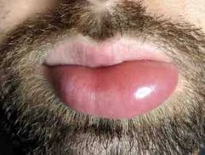
Clinical presentation - angioedema
Source: https://dermnetnz.org

Slide 28
Clinical presentation - angioedema
Stridor
Difficulty swallowing, drooling
Wheezing
Nausea and vomiting
Abdominal pain
Diarrhea
Notes:
Difference between pt feeling – SOB, globus, tight throat nausea vs visible edema or drooling (functional), audible stridor or wheezing, repeated vomiting

Slide 29
Anaphylaxis
Notes:
So what do we see with anaphylaxis
This really gets down to the “definition” of anaphylaxis
You’d think we’d have this figured out by now
The 2006 definition from NIAID was common for a while after it was published in 2006

Slide 30
Anaphylaxis
Anaphylaxis is highly likely when any 1 of the following 2 criteria is fulfilled:
Acute onset of an illness (minutes to several hours) with involvement of the skin, mucosal tissue, or both (eg, generalized hives, pruritus or flushing, swollen lips-tongue-uvula) AND AT LEAST ONE OF THE FOLLOWING:
  Respiratory compromise (eg, dyspnea, wheeze-bronchospasm, stridor, reduced peak expiratory flow, hypoxemia)
  Reduced blood pressure or associated symptoms of end-organ dysfunction (eg, hypotonia , syncope, incontinence)
  Severe gastrointestinal symptoms (eg, severe crampy abdominal pain, repetitive vomiting), especially after exposure to non-food allergens
Acute onset of hypotension or bronchospasm or laryngeal involvement after exposure to a known or highly probable allergen for that patient (minutes to several hours), even in the absence of typical skin involvement.
Notes:
From that paper – the WAO simplified it for us
Easier to diagnose, broader? So that it wouldn’t be missed
Difference between pt feeling – SOB, globus, tight throat vs visible edema or drooling (functional), audible stridor or wheezing, objective changes in VS
Start with the second and Second bullet – after exposure to possible Ag to distinguish from other causes
Infants – nonspecific – irritable, floppy, clingy

Slide 31
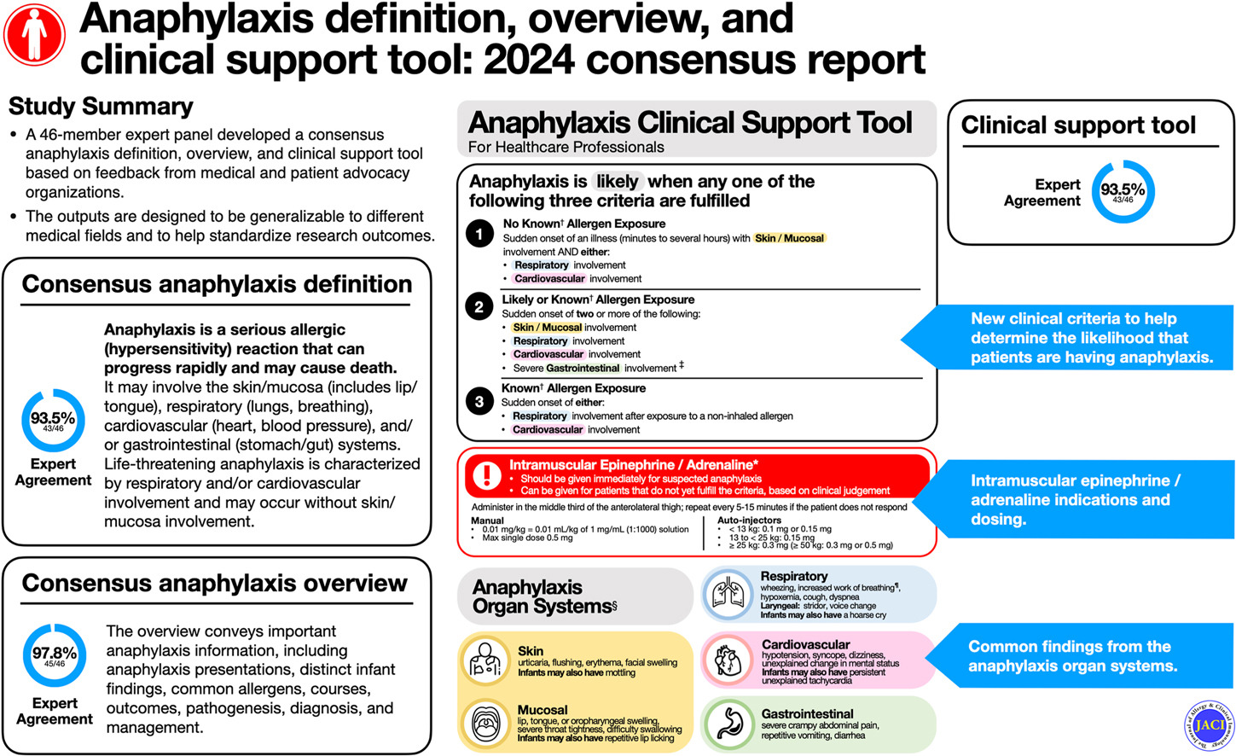
Source: Dribin TE et al. J Allergy Clin Immunol. 2025 Aug;156(2):406-417.e6. doi: 10.1016/j.jaci.2025.01.021
Notes:
Clinical support tool developed by a workgroup of the American Academy of Allergy, Asthma & Immunology
In their paper – end organ changes (nl BP) neuro – HA, confusion/ AMS, decreased LOC/drowsiness

Slide 32
Anaphylaxis
Potentially life-threatening
  1% risk of death
  ~ 500-1000 deaths in US annually
Lifetime prevalence of anaphylaxis – 2-5%
Treatment errors stem from lack of recognition and lack of use of epinephrine
Think “epi, epi, epi”

Slide 33
Anaphylactoid reaction?
Looks like anaphylaxis; pathophysiology is similar
Can occur after first exposure to what seems like it could be a potential allergen
More common with:
  Radiocontrast dye
  NSAIDs
  Opioids
  Certain antibiotics
  Dextran
Risk factors – prior anaphylaxis or anaphylactoid reaction
World Allergy Organization has recommended not using the term
Treatment is the same.
Notes:
…usually made in retrospect – proceed as you would with anaphylaxis

Slide 34
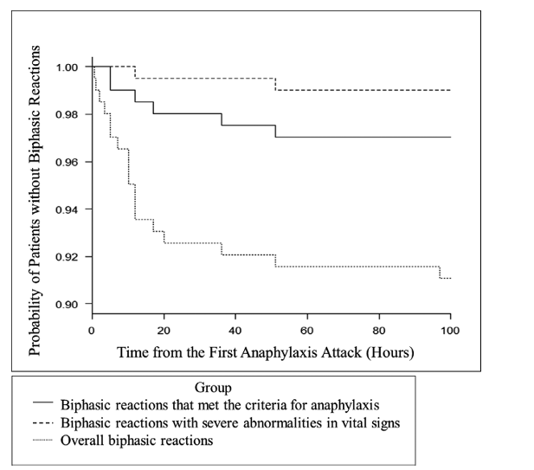
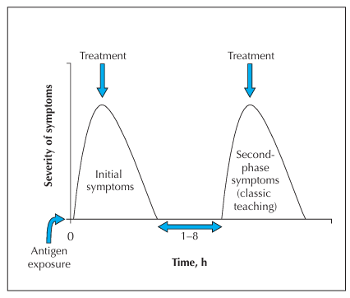
Biphasic allergic reaction^{1,2}
Occurs in 1.4% – 20% of cases
Classically 1-8 hour delay (reports of up to 24-38 hrs)
Second reaction may be more severe than the first
1. CMAJ. Aug 19, 2023. p 308 2. Acute Med Surg. 2021 Jul 30;8(1):e689. p 6
Notes:
Sometimes called rebound rejection
Obviously can’t observe people for 100 or 38 or even practically speaking, for 8 hours, but it’s the rationale behind obs for some times and also counselling and continuing meds and giving epi autoinjector promptly
Talk a little more about this in Dispo section

Slide 35
Initial allergic reaction
Degranulation and
histamine release
Notes:
The histamine goes on to have tissue effects

Slide 36
Quiescent period
Antigen and IgE
Notes:
Even without additional Ag; even with vomiting – still in blood stream

Slide 37
Biphasic allergic reaction
Recurrent degranulation and
histamine release

Slide 38
Differential Diagnosis - urticaria/angioedema
Nonallergic urticaria
  Viral and other infections
Nonallergic angioedema
  Types I, II and III Hereditary Angioedema
  ACE-inhibitor-mediated angioedema
  Other medications: gliptins, ARBs, sirolimus and similar meds
Asthma/COPD exacerbation
Chronic/“idiopathic” urticaria and angioedema
Other causes of localized edema – infection, venous obstruction
Notes:
In addition to anaphylactoid reaction…..
HAE defective level, function or not of complement
Tx: Complement, inhibiting Kallikrien, blocking bradykinin receptor, FFP
Long et al. Evaluation and Management of Angioedema in the Emergency Department. West J Emerg Med. 2019 Jul 2;20(4):587–600. doi: 10.5811/westjem.2019.5.42650

Slide 39
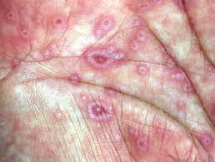
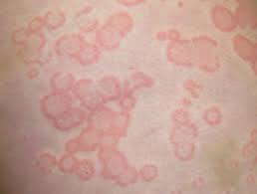
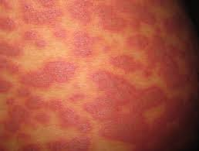
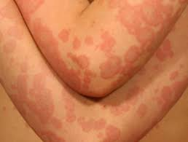
Differential Diagnosis - dermatologic
Notes:
Important to understand – urticaria txs don’t work but may help pruritis

Slide 40
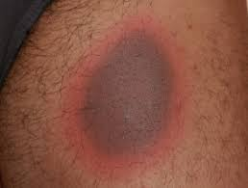
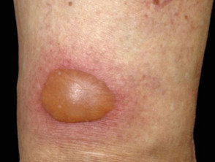
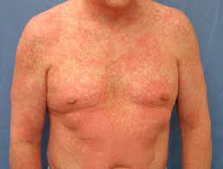
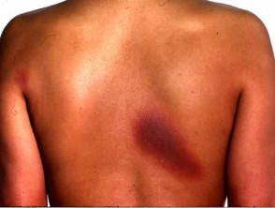
Differential Diagnosis - dermatologic
Notes:
Important to understand – urticaria txs don’t work but may help pruritic
Are these Type II, III, IV?

Slide 41
Differential Diagnosis - anaphylaxis
Other causes of respiratory distress and distributive shock
Other causes of hypotension/syncope
Asthma/COPD exacerbation
Pheochromocytoma
Carcinoid syndrome
Mastocytosis
Scombroidosis, MSG reaction

Slide 42
Treatment - Antihistamines
“H1” antihistamines
Lots of evidence in urticaria and angioedema, much less in anaphylaxis
First generation
  Chlorpheniramine, diphenhydramine (25-50mg q6-8h), hydroxyzine (25-200 mg qHS)
Second generation
  Cetirizine (5-10mg qD), fexofenadine (180 mg qD or 60mg BID), loratadine (10mg qD or 5mg BID)
Third generation
  Desloratadine (5mg qD), levocetirizine (5mg qD)
H2 antihistamines - little evidence except in urticaria
  Famotidine (20mg BID), cimetidine (200 mg BID), ranitidine
Notes:
The mainstay of treating minor allergic reactions is antihistamines but there are some nuances – all nonRx (levocetirizine off patent)
With each generation, higher histamine specificity and less anticholinergic specificity BB barrier
Problems – longer half-life – more time to reach higher steady state but seem OK
Back in the day – long been common practice and there is a refeence in the back – van den Elzen et al. Research for refractory urticaria has shown that increasing dose, up to 4 times “usual” can help and still be reasonable just more chance of sedation
Cetirizine is IV Diphenhydramine IV or IM

Slide 43
Treatment - Antihistamines
All are available PO
Most are available in pediatric formulations – chewable, elixirs, ODTs
Peds dosing applies – have a reference handy
Data from treating chronic urticaria indicates higher doses (up to 4x) can be given safely¹
Parenteral options in US
  diphenhydramine - IV or IM
  hydroxyzine - IM only
  cetirizine - IV only
1. van den Elzen et al. Clin Transl Allergy. 2017 Feb 14:7:4.

Slide 44
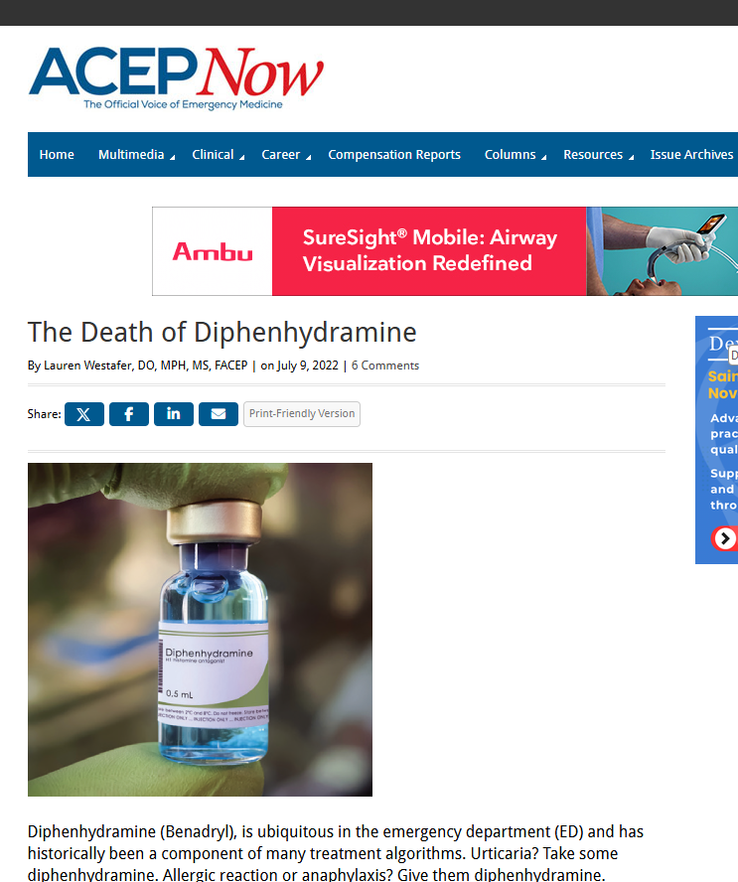

The buzz with diphenhydramine
https://www.acepnow.com/article/the-death-of-diphenhydramine/
https://www.bannerhealth.com/healthcareblog/teach-me/is-benadryl-safe-to-use-regularly-here-is-what-you-should-know
Notes:
Who’s seen any of the negative press – medical and lay - about diphenhydramine?
This affects us in 2 ways – what we we going to give in the clinic and what do we recommend for home

Slide 45
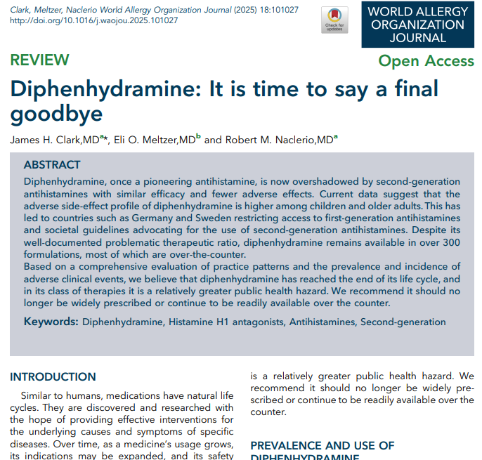
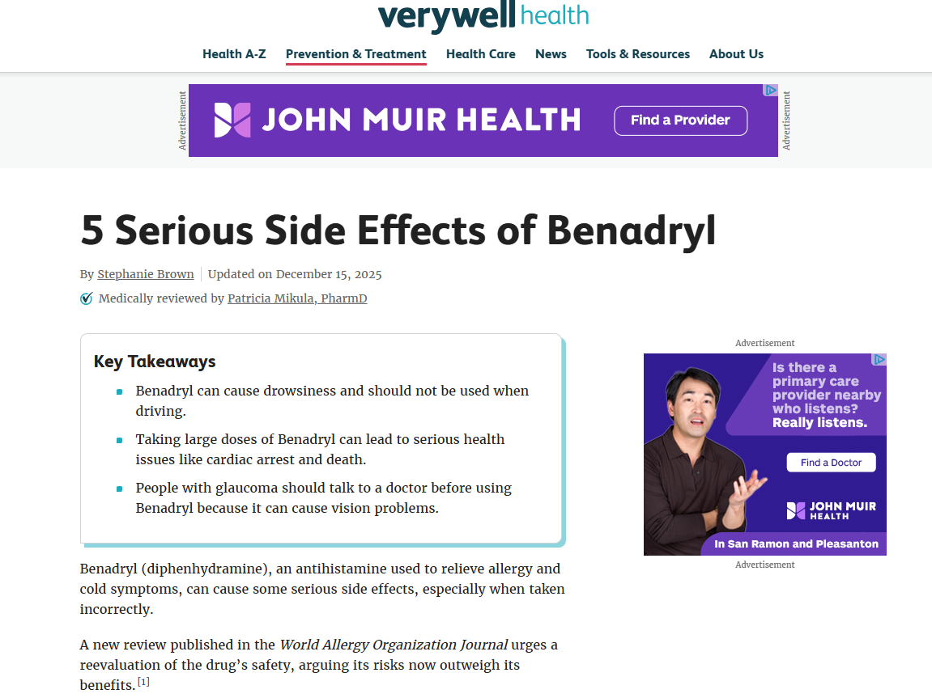
The buzz with diphenhydramine
https://www.verywellhealth.com/benadryl-side-effects-review-11786255
https://www.worldallergyorganizationjournal.org/action/showPdf?pii=S1939-4551%2825%2900002-X
Notes:
Citation is there. The paper is free to download and the authors declare no financial or other conflict of interest

Slide 46
Beers’ Criteria – Amer Geriatric Society
https://thecarepartnerproject.org/wp-content/uploads/The-Beers-List.pdf
Notes:
To be fair – it’s been on Beers list for a long time
If there were another IM second or later generation antihistamine, this would be easy but cetirizine is only approved IV
Upshot - use more selective agents (PO or IV) unless reason not to GI issues and no IV access

Slide 47
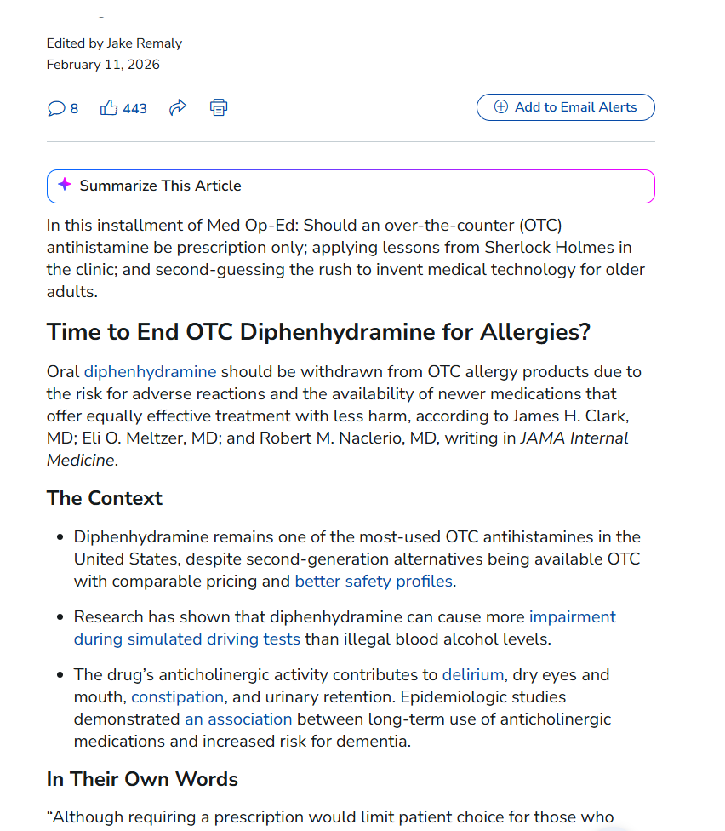
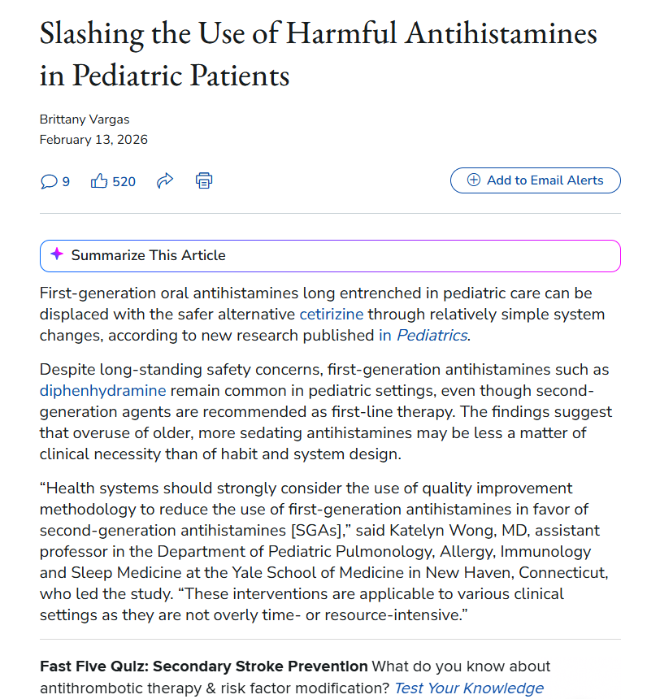
The buzz with diphenhydramine
https://www.medscape.com/viewarticle/med-op-ed-otc-drug-flagged-sherlockian-diagnosis-and-more-2026a10004cn
https://www.medscape.com/viewarticle/slashing-use-harmful-antihistamines-pediatric-patients-2026a10004lj
Notes:
This is not going away

Slide 48
Antihistamines – what to do…….
Pharmacokinetics – shorter acting, but faster onset of first (30-60 m) vs later generation (1-3 h)
Begin to get experience using the second- and third-gen medications
Talk to patients about it
Slater et al. 1999 - “For urticaria, cetirizine and mizolastine demonstrate superior suppression of wheal and flare at the dosages recommended by the manufacturer.”
Devillier et al. 2008 (only looked at the 3) - “Based on these pharmacological characteristics, as well as clinical endpoints such as symptom scores, quality-of-life surveys, inflammatory cell counts and investigators' global evaluations, we conclude that desloratadine, fexofenadine and levocetirizine are all efficacious treatments for AR and CIU. However, differences among the antihistamines in relation to a lack of significant interaction with drug transporter molecules and somnolence in excess of placebo may provide some advantages for the overall profile of desloratadine compared with fexofenadine and levocetirizine.”
Watch for more developments and recommendations
Notes:
Rebel EM IV cetirizine vs diphenhydramine – cetirizine noninferior Abella BS et al. Intravenous Cetirizine Versus Intravenous Diphenhydramine for the Treatment of Acute Urticaria: A Phase III Randomized Controlled Noninferiority Trial. Ann Emerg Med 2020.
Devillier – only looked at those 3
If it goes off the OTC shelves – it will likely go away from our formularies and we will have no choice
What I’ve started to do is….
Some head-to-head clinical trials, mostly chronic AR or urticaria and atopic dermatitis - extrapolate to acute situations? But it’s the best we’ve got
Slater – metaanalysis of 10 of the available adv gen antihistamines, including several not available in the US and terfenadine which was the first one I believe and was taken off the market due to proarrhythmia risk – it is a prodrug, metabolized to fexofenadine
Devillier – review – it was also noted that desloratadine has the highest binding affinitity for the H1 receptor – did they review cetirizine and loratadine?
Brand names often helpful – Loratadine – Claritin/ Desloratadin Clarinex/ Fexo – Allegra/ cetirizine Zyrtec/ levocetirizine - Xyzal

Slide 49
Antihistamines – other nuances
Lowest approved age differs between meds and, sometimes, indications
  6 mos and older: cetirizine, desloratadine, levocetirizine
  2 years and older: loratadine, fexofenadine (6 mos for CIU), diphenhydramine
Package dosing for many tablet forms: “Consult a physician” for < 6yo
Have a ready pediatric medication reference
Pregnancy “category” - allergies occur in 20-30% of women during pregnancy¹
  B = diphenhydramine, cetirizine, loratadine, levocetirizine¹
  C = hydroxyzine, desloratadine, fexofenadine¹
  Always weigh risk and benefit
Lactation – cetirizine and loratadine preferred (www.sps.nhs.uk and www.breastfeedingnetwork.org.uk)
1. Kar S, et al. J Pharmacol Pharmacother. 2012 Apr-Jun;3(2):105–108

Slide 50
Treatment - epinephrine
IM and consider inhaled (racemic)
Alpha and Beta-adrenergic receptor agonist – heart, airway, blood vessels, other tissues
Consider glucagon if no effect and patient takes beta-blocker
Stabilizes mast cells
Dose: 0.01 mg/kg, max dose 0.5 mg for adult; repeat q 5-10 mins, if/as needed
  0.1 mg (or 0.15mg autoinjector) for those < 15kg¹
  1-5 years old - fixed/max dose 0.15 mg
  6-12 years old – fixed/max dose 0.3 mg
Doses of 0.5 mg less likely to lead to escalation of care than 0.3 mg (Jackson, et al, 2025)
Have a plan for quick administration in the UC
1. Golden DBK, et al Ann Allergy Asthma Immunol. 2024 Feb;132(2):124-176.
Notes:
Works for everything
Jackson – retro 254 @ 0.3 84 @ 0.5 29.5% vs 7.1% escalation

Slide 51
Treatment - epinephrine
Many identified patient and clinician barriers → delay, underuse, nonuse
  Fear, lack of experience, lack of recognition of anaphylaxis
  Not having the medication available, needing someone’s help
  Stigma, cost/insurance, expiration
Alternative to IM – intranasal
  Approved summer 2024
  2 mg/0.1 ml spray into one nostril; one spray per device
  May repeat in 5 minutes in same nostril
  OK in children down to 30 kg bodyweight
Sublingual epi is in Phase 3 trials
Notes:
Would IN ever be used in clinic – have epipens vs injectable ampules

Slide 52
What’s the scoop with corticosteroids?
Waljee, et al. BMJ 2017;357:j1415. http://dx.doi.org/10.1136/bmj.j1415
2022: https://urgentcareassociation.org/uca-cucm-position-on-corticosteroid-stewardship/
Alqurashi and Ellis, 2017 – review of 31 studies – “Because of the potential detrimental adverse effects of corticosteroids and lack of compelling evidence demonstrating an effective role in reducing anaphylaxis severity or preventing biphasic anaphylaxis, we do not advocate for their routine use in anaphylaxis.”
GA²LEN 2024 – list corticosteroids as adjunct – comment period “…the role of and evidence for use of corticosteroids is anaphylaxis is very limited. I would be in favor of caveating the corticosteroid mention - perhaps - limited evidence for the effectiveness of corticosteroids in the management of anaphylaxis outside biphasic and refractory anaphylaxis.”
Notes:
Akbar Waljee and several others from U Michigan Medical and the VA there and UT Southwestern
Reserve it for recurrence/biphasic and the patients where all your other interventions don’t seem to be working

Slide 53
What’s the scoop with corticosteroids?
Notes:
Published 2020 – these 6 references were published 2015 – 2019

Slide 54
Putting it all together………

Slide 55
Treatment – urticaria
ABCs, remove allergen if still present
Observe for worsening/anaphylaxis
Antihistamines – H1 and H2
Corticosteroids?
Notes:
OK, lets put it all together

Slide 56
Treatment – urticaria
ABCs, remove allergen if still present
Observe for worsening/anaphylaxis
Antihistamines – H1 and H2
Corticosteroids – only for truly refractory cases

Slide 57
Treatment – angioedema
ABCs, remove allergen if still present
Observe for worsening/anaphylaxis
Epinephrine IM if airway in jeopardy, stridor, wheezing
Consider inhaled racemic epi, as well, for visible or symptomatic airway edema (Stone et al, 2018)
Bronchodilators for wheezing
Antihistamines – H1 and H2
Corticosteroids – for RAD/wheezing or truly refractory or severe cases
Keep head elevated
Observation period?
Notes:
No data on obs period; older GLs recommend 6 hours; if you think it’s allergic (vs hereditary or ACEI related) nad involves the eyes, lips, not the oropharynx or tongue/sublingual area – I think most of us observe for improvement or stability for an hour or so

Slide 58
Treatment – anaphylaxis
ABCs, remove allergen if still present
Observe for worsening/anaphylaxis
Epinephrine IM
Consider inhaled racemic epi, as well, for visible or symptomatic airway edema (Stone et al, 2018)
Bronchodilators for wheezing
If possible, IV crystalloid for hypotension, poor perfusion
Antihistamines – H1 and H2
Corticosteroids – for RAD/wheezing or truly refractory or severe cases
Notes:
Stone et al – 2 cases

Slide 59
Treatment – Activate EMS?
Activate EMS for abnormal or unstable VS, critical airway or respiratory issues, worsening course, LOC, syncope, cyanosis, true voice change, other severe reaction, if second dose of epi needed
Golden DBK, et al, 2023 – no need for patients to activate EMS or go to the hospital if there is a “prompt, complete, and durable response” to the first dose….biphasic anaphylaxis is unlikely if anaphylaxis is not severe and the patient remains symptom-free for one hour of observation following resolution.”
Dribin, et al 2025 (7717 pts, 30 EDs, retrospective, 6 mos to 17yo) – 2 hour obs is “probably safe” after epi; 4 hours in those with CV involvement who appear well (time = time from first/only epi dose)
Dribin et al 2026 (expert consensus/Delphi method) – affirmed Golden DBK, et al, 2023 stay home (if caregiver and second epi dose available, < 30 mins to nearest hospital) and Dribin et al 2025 < 2 hour obs if in medical setting
Notes:
Save an ED visit EMS – sick or going to be too long obs in UC – 4-6 hours?
Dribin 2026 Epinephrine and emergency medical services activation recommendations during acute allergic reactions in community settings: International consensus report – ScienceDirect
Dribin 2025 Timing of repeat epinephrine to inform paediatric anaphylaxis observation periods: a retrospective cohort study - The Lancet Child & Adolescent Health

Slide 60
Disposition/Discharge plan
Observe for improvement/lack of worsening
Home - urticaria, angioedema without life-threat, anaphylaxis (1-2 hr)?
Avoid known/suspected allergens
Continue H1 and H2 blockers for several days
Rx: 2 or more epi autoinjectors (0.1 mg, 0.15 mg or 0.3 mg) vs. nasal
Discuss return precautions – call 911
Recommend allergist referral for idiopathic, severe, recurrent, refractory cases
+/- Corticosteroids – not never, but NOT routinely

Slide 61
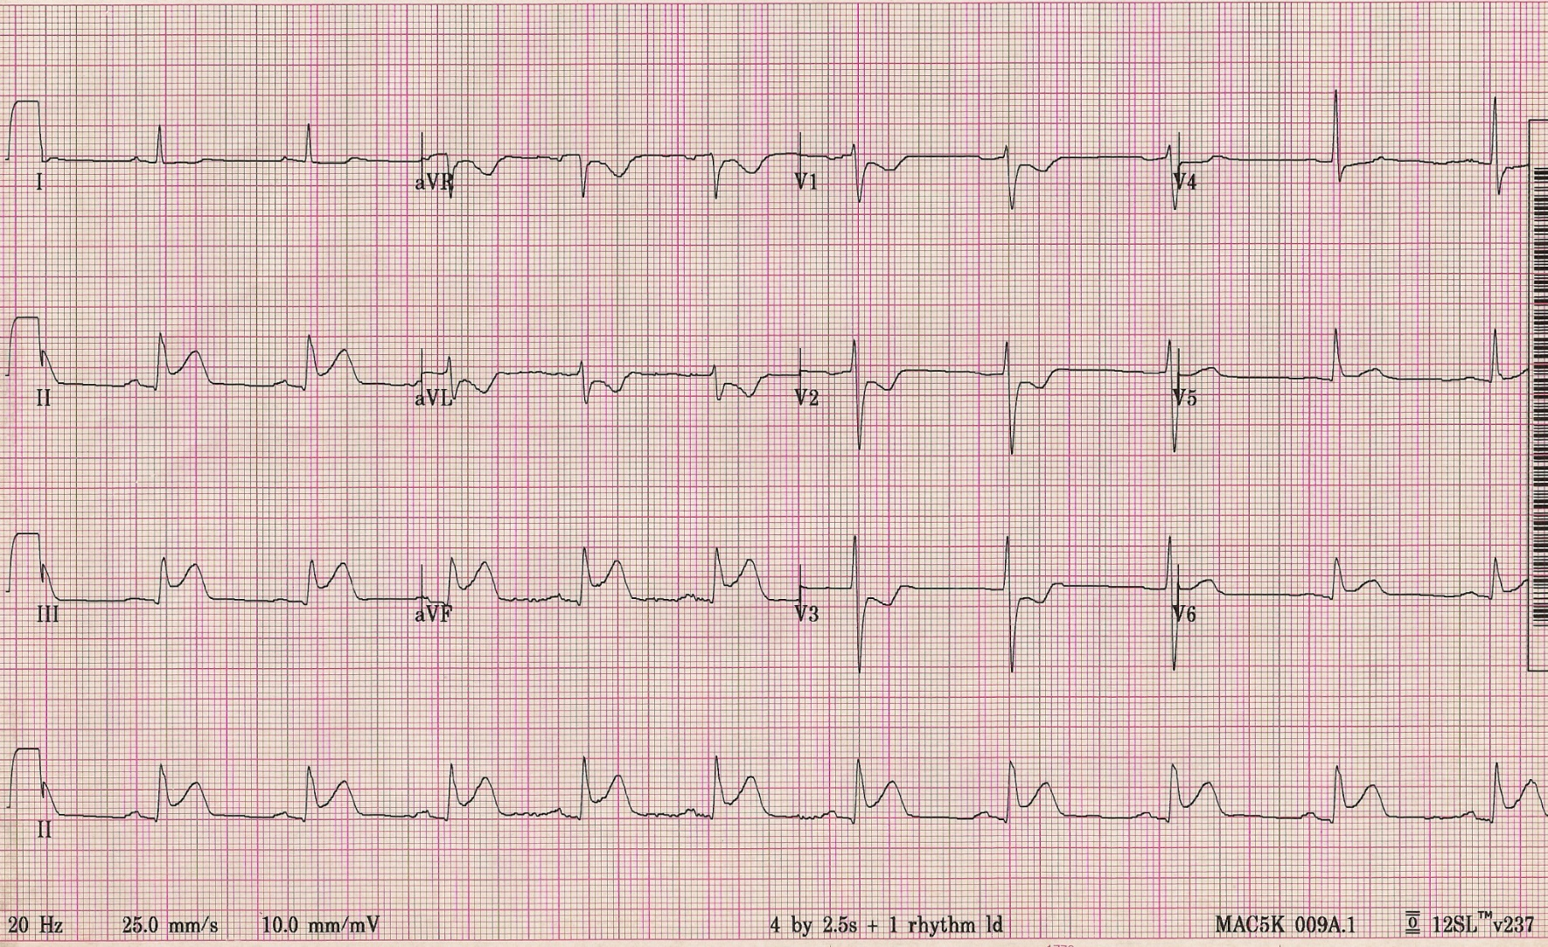
Allergic reaction and MI?
Notes:
57 yo itchy red diaphoretic SOB CP

Slide 62
Kounis’ syndrome
Anaphylaxis can include distributive shock, ? cardiogenic
Inflammation affecting coronary arteries, hypotension
CP, SOB, syncope, hypotension → 12-lead EKG
Concurrent time-sensitive emergencies - treat both issues - ASA, 911…
Maybe 0.3 vs 0.5 mg epi IM?
Cardiac issues and EKG changes often resolve with treating anaphylaxis
Three “Types” described
  Adverse cardiovascular effects of anaphylaxis can affect anyone - Type I
  Someone with known CAD could have an allergic reaction - Types II and III
Notes:
No RCTs
Hypotension -> decreased coronary perfusion
Serial assessment important – EKG, troponin
Aspirin and epi

Slide 63
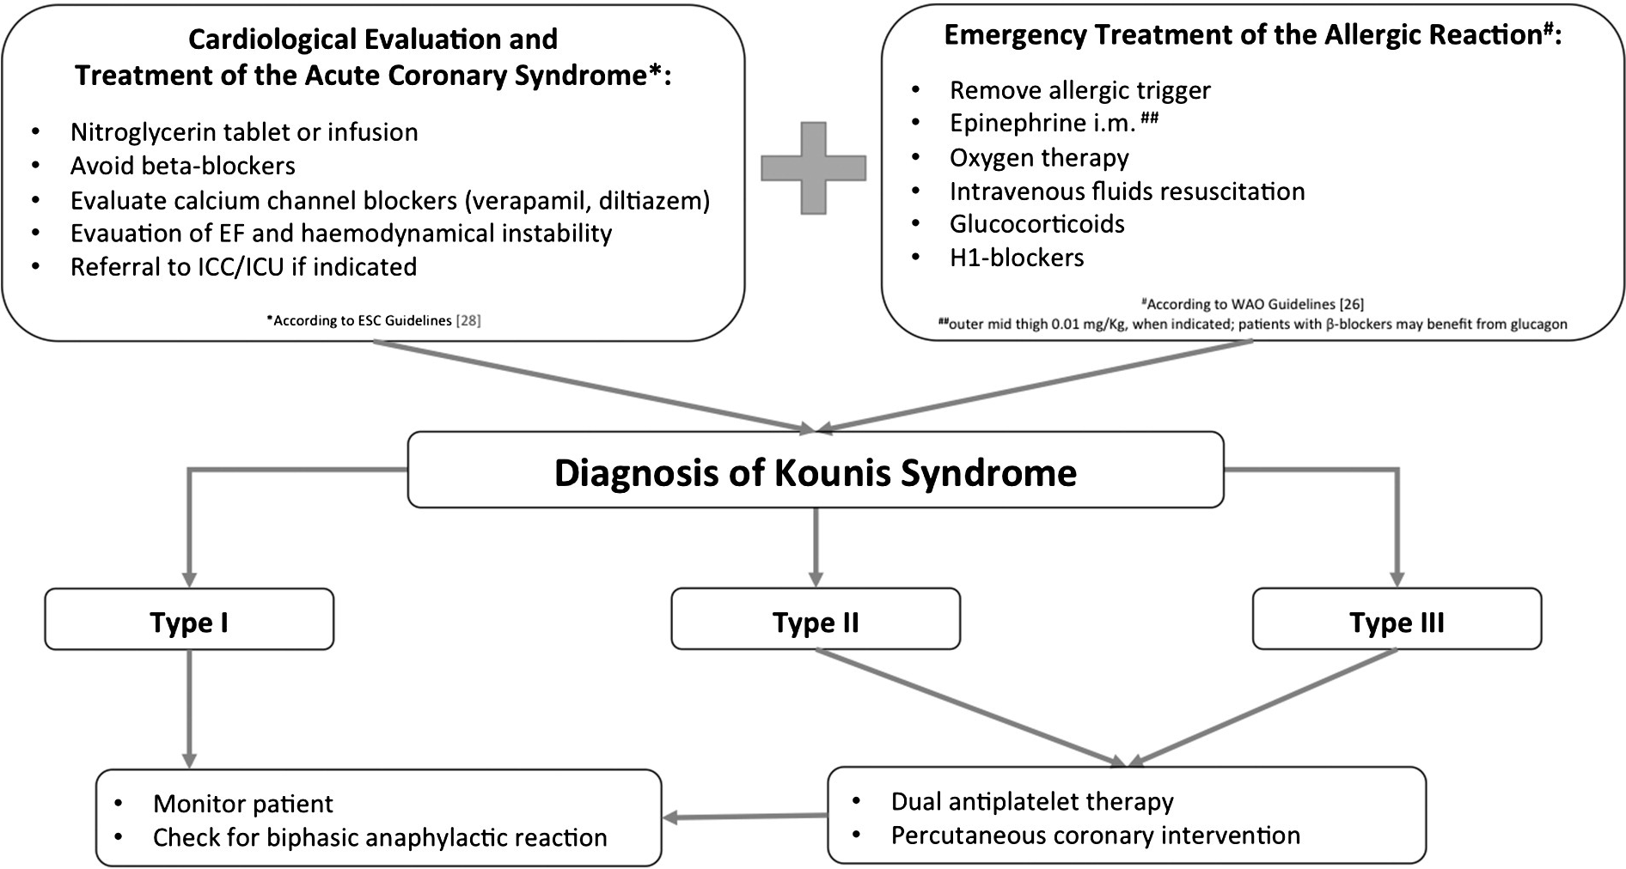
Kounis’ syndrome
From: Fassio F et al. Eur J Intern Med. 2016 May:30:7-10
Notes:
No RCTs
Hypotension -> decreased coronary perfusion
Serial assessment important – EKG, troponin
Aspirin and epi

Slide 64
Take Away Points
Anaphylaxis → Epi (in the UC and for home) – IM, nasal
Consider observing nonsevere, resolved, stable patients after single-dose epi
911, stabilize, and treat the severe, unstable, or worsening patient
Don’t forget bronchodilators for wheezing
Consider inhaled racemic epi for symptomatic airway mucosal edema
Become more familiar with the more selective antihistamines
Continue antihistamines for several days
If you’re prescribing steroids for all of these patients – STOP
Use steroids for associated RAD/COPD or severe or refractory cases only

Slide 65
References
AMA News Wire. What doctors wish patients knew about food allergies. Feb 20, 2026. Accessed March 3, 2026.
Wein D and D Dixon. Anaphylaxis: Clinical Guidelines for Diagnosis and Management. JUCM. June 2011. 9-15.
Dribin TE, et al. Anaphylaxis definition, overview, and clinical support tool: 2024 consensus report-a GA²LEN project. J Allergy Clin Immunol. 2025 Aug;156(2):406-417.e6. doi: 10.1016/j.jaci.2025.01.021. Epub 2025 Jan 27.
Johnson, L. Evidence-based management of angioedema in urgent care. Evidence-Based Urgent Care. May 2024. Volume 3, Issue 5.
Mehta P, et al. Angioedema in the emergency department: and evidence-based update. Emergency Medicine Practice. October 2022. Volume 24, Issue 10.
Zeke A and A Sudhir. Management of allergic reactions and anaphylaxis in the emergency department. . Emergency Medicine Practice. July 2022. Volume 24. Issue 7.
Notes:
57 yo itchy red diaphoretic SOB CP

Slide 66
References
Mustafa SS. Anaphylaxis. Medscape. https://emedicine.medscape.com/article/135065. Updated August 16, 2024. Accessed March 18, 2026
Ellis AK and JH Day. Diagnosis and management of anaphylaxis. CMAJ. Aug 19, 2023. 169(4): 307-12
Cardona V, et al. World Allergy Organization Anaphylaxis Guidance 2020. World Allergy Organ J. 2020 Oct 30;13(10):100472. doi: 10.1016/j.waojou.2020.100472. eCollection 2020 Oct.
Golden DBK, et al. Anaphylaxis: a 2023 practice parameter update. Ann Allergy Asthma Immunol. 2024 Feb;132(2):124-176. doi: 10.1016/j.anai.2023.09.015. Epub 2023 Dec 18.
Ichikawa M, et al. Incidence and timing of biphasic anaphylactic reactions: a retrospective cohort study. Acute Med Surg. 2021 Jul 30;8(1):e689. doi: 10.1002/ams2.689
Jackson CA, et al. Retrospective comparison between 0.3 mg and 0.5 mg dosing of intramuscular epinephrine for anaphylaxis. Am J Emerg Med. 2026 Jan:99:270-275. doi: 10.1016/j.ajem.2025.10.020. Epub 2025 Oct 10.

Slide 67
References
Dribin TE, et al. Timing of repeat epinephrine to inform paediatric anaphylaxis observation periods: a retrospective cohort study. Lancet Child Adolesc Health 2025; 9: 484–96
van den Elzen, et al. Effectiveness and safety of antihistamines up to fourfold or higher in treatment of chronic spontaneous urticaria. Clin Transl Allergy. 2017 Feb 14:7:4. doi: 10.1186/s13601-017-0141-3. eCollection 2017.
Slater JW, et al. Second-generation antihistamines: a comparative review. Drugs. 1999 Jan;57(1):31-47. doi: 10.2165/00003495-199957010-00004.
Devillier P, et al. Clinical pharmacokinetics and pharmacodynamics of desloratadine, fexofenadine and levocetirizine : a comparative review. Clin Pharmacokinet. 2008;47(4):217-30. doi: 10.2165/00003088-200847040-00001.
Kar S, et al. A review of antihistamines used during pregnancy. J Pharmacol Pharmacother. 2012 Apr-Jun;3(2):105–108. doi: 10.4103/0976-500X.95503

Slide 68
References
Stone CA and JJ Choi. Effect of use of inhaled epinephrine on intramuscular epinephrine use in patients with idiopathic anaphylaxis and angioedema. Ann Allergy Asthma Immunol. 2016 Feb;116(2):170-1. doi: 10.1016/j.anai.2015.11.012. Epub 2015 Dec 12.
Dribin TE and HA Sampson. Epinephrine and emergency medical services activation recommendations during acute allergic reactions in community settings: International consensus report. J Allergy Clin Immunol. 2026 Feb;157(2):429-441. doi: 10.1016/j.jaci.2025.11.008. Epub 2025 Dec 10.
Alqurashi W and AK Ellis. Do Corticosteroids Prevent Biphasic Anaphylaxis? J Allergy Clin Immunol Pract. 2017 Sep-Oct;5(5):1194-1205. doi: 10.1016/j.jaip.2017.05.022
Kounis NG. Kounis syndrome (allergic angina and allergic myocardial infarction): a natural paradigm? Int J Cardiol. 2006 Jun 7;110(1):7-14. doi: 10.1016/j.ijcard.2005.08.007. Epub 2005 Oct 24.
Fassio F, et al. Kounis syndrome: A concise review with focus on management. Eur J Intern Med. 2016 May:30:7-10. doi: 10.1016/j.ejim.2015.12.004. Epub 2016 Jan 12.
Notes:
Fassio F et al. Kounis syndrome: A concise review with focus on management. Eur J Intern Med. 2016 May:30:7-10. doi: 10.1016/j.ejim.2015.12.004. Epub 2016 Jan 12.

Slide 69



References – EB Medicine
EM Practice July 2022 EM Practice Oct 2022 EB Urgent Care May 2024
Allergy and Anaphylaxis Angioedema Angioedema
www.ebmedicine.net/07-1-22_EMP www.ebmedicine.net/10-1-22_EMP www.ebmedicine.net/05-1-24_UC

Slide 70
I Need Your Feedback
Scan the QR code to submit your feedback digitally.
Prefer paper?
On the form in front of you, please score me and the content I shared with you today.
AFTER THE CONVENTION
You may claim CME here www.urgentcareassociation.org/learning-center/cme/

Slide 71
Thank you!
Notes:
Need to check
https://recapem.com/anaphylaxis-angioedema-practical-approach-to-diagnosis-and-management-in-emergency-department-2/

