Slide 1
RESCUE Me!: A Novel Pediatric Resuscitation Course for the Urgent Care Setting
Nikhil B. Shah, M.D.
Senior Director of Provider Training
PM Pediatric Care

Slide 2
Financial Disclosures
I have no financial disclosures

Slide 3
Pediatric office emergencies are not uncommon
Potentially life-threatening illnesses do occur
Respiratory and infectious emergencies, seizures, & dehydration are most common
Providing urgent/emergent care until EMS arrives will be necessary at times
Notes:
A survey of 52 practices reported on average 1 emergency/month
Another study showed almost 2/3 of peds and FPs in an urban setting reported >1 pt per week who required hospitalization or urgent stabilization

Slide 4




Implementing an Emergency Preparedness Plan (EPP) is therefore critical, but many offices do not have one – Why???
Denial
Liability
Cost
Challenges
Notes:
true pediatric emergencies are rare overall – this is true
“What are the odds it will happen in my office?” or “EMS response times are fast”; or “The hospital’s right nearby”
Denial: “What are the odds it will happen in my office?”
Challenges: Unique challenges exist in this setting (e.g., staffing, medication, equipment, training)

Slide 5
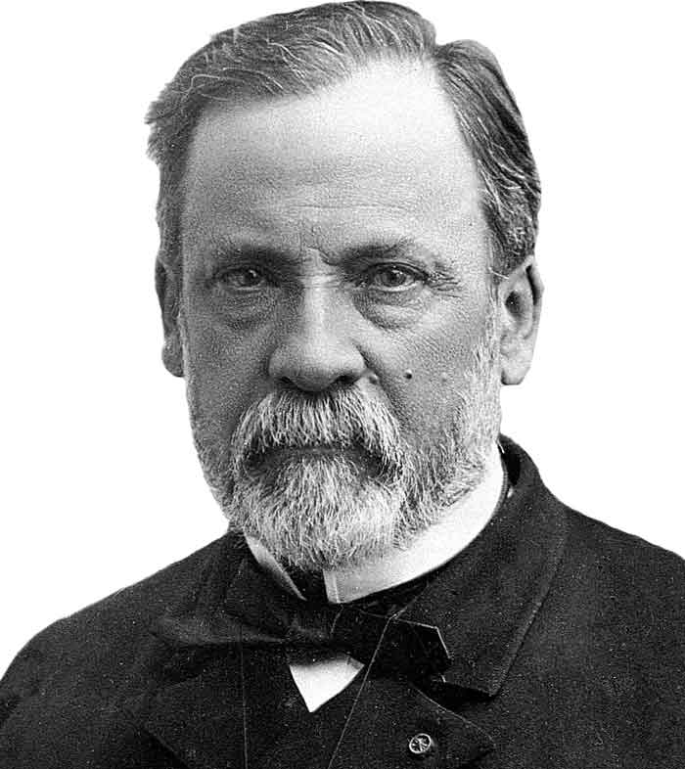
Wellness bias
underpreparation
poor outcomes
Stabilization of pediatric emergencies and early transfer for definitive care are critical
“Chance favors the prepared mind”
Notes:
This is a paraphrase of Pasteur’s original statement
If we encounter a rare, but potentially serious event in our office, the best opportunity for a good outcome for that child is when we are ready for it

Slide 6

EPP Options
Courses
PALS, APLS, BLS, PEARS
Simulation
“mock” codes
Limitations:
PALS/APLS – primarily focused on in-hospital care
BLS – important basics covered, but not enough
PEARS – more info, but not as relevant to pediatric-trained clinicians
Simulation – a valuable tool, but needs something more
Notes:
What currently makes up the components of preparing for emergencies in your office? (1 - courses and 2 – sim)
However, there are limitations to what is offered…

Slide 7

Searching for “Just Right”
There is currently no ideal option to help us successfully manage the critically ill child in the outpatient setting
Notes:
So it turns out that some options are too much, and some offer too little
We need something that’s just right
Unfortunately there is currently no ideal option to help us successfully manage the critically ill child in the outpatient setting
We are hoping that we can change that

Slide 8
The Evolution of Our Staffing Model
2005
Initially staffed almost exclusively w/PEM physicians
2010
“Can our offices be staffed by anyone other than a PEM physician?”
2012
1st ever pediatric urgent care physician fellowship program created
Present Day
Multiple provider types (gen peds/FP physicians & APPs) with varied levels of experience/training
Notes:
Let’s take a step back so I can explain to you how our plan for managing office emergencies came about.
Allow me to walk you through the evolution of our staffing model

Slide 9
How do we impart non-acute care-trained providers with the skills & knowledge to manage an office emergency?
Simulation program
Low-medium fidelity manikin
Management of common office emergencies
Knowing our medication & equipment
Team dynamics, full- vs minimal-staffing

Slide 10
Where do PALS & BLS fit into this?
BLS certification required of ALL staff- UCA requirement
Providers and nurses were previously required to maintain PALS certification

Slide 11

When we attempted to use knowledge/skills acquired from PALS to manage patients in our simulation scenarios, there was a disconnect
Scope of practice was often not relevant
PALS was not reflective of equipment, medications, personnel in our office
We propose a novel course that is relevant to our setting, higher yield, and shorter/less time-intensive
Notes:
The above taken into account, We propose….

Slide 12
Novel Course
Simulation
“mock” codes

Slide 13
RESCUE
Emergency Preparedness Course

Slide 14
What is RESCUE?
RE
suscitation and
S
tabilization of
C
hildren in the
U
rgent care
E
nvironment

Slide 15
Course Description
Target audience:
Pediatric & non-pediatric physicians, APPs & nurses, EMT/Urgent Care Techs
Course content:
Blended-learning approach
Course duration: 1 day
Online modules (independent pre-coursework) – 3 hours
Instructor-led classroom training – 4 hours
Assessment:
Skills stations
Simulation-based mega-codes
Written post-test with minimum passing score of 80%

Slide 16
I⁴ RESCUE Cycle: Overview
Identify
Interact
Intervene
Initiate Early Transfer
Identify a critically ill child
Interact with staff to mobilize resources
Initiate early transfer
Interventions in the UC setting

Slide 17
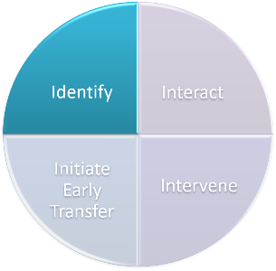
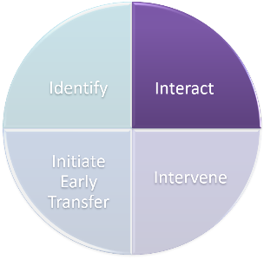
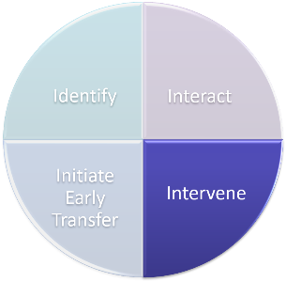

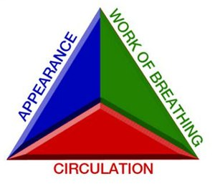
The Specifics: RESCUE Protocol
Initial Impression
PAT
Mobilize Resources
Alert provider and team
Obtain necessary equipment
Critical
Interventions
Primary Assessment (Survey) & Vitals:
Airway
Breathing
Circulation
Secondary Assessment (Survey)
Directed Interventions
For Example:
Resp
Albuterol/Ipratropium
Racemic Epinephrine
Dexamethasone
Shock
Normal Saline
Cardiac
Adenosine
Epinephrine

Slide 18

I⁴ RESCUE Cycle

Slide 19


Front Desk is the Front Line
Front desk screens patient
Parental/
Patient concern
If positive screen, alert clinical staff
Click Me

Slide 20
RESCUE Protocol
Initial Impression
PAT

Slide 21


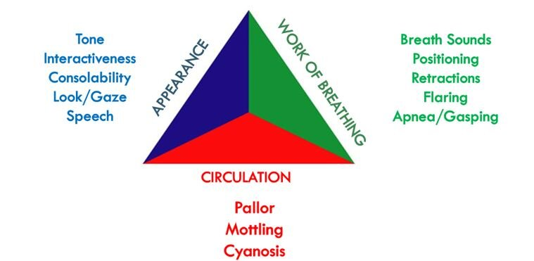
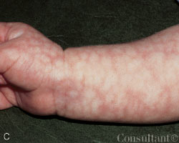
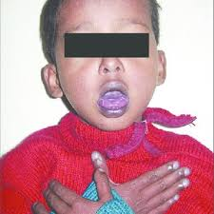
Pediatric Assessment Triangle
A
B
C

Slide 22
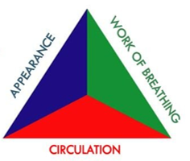
PAT Cues
Click
Me
Click
Me
STABLE
RESPIRATORY DISTRESS
RESPIRATORY FAILURE
Click
Me
Click
Me
Click
Me
CNS/METABOLIC
SHOCK
CARDIOPULMONARY
FAILURE

Slide 23
I⁴ RESCUE Cycle
Identify
Initiate Early Transfer
Intervene
Interact

Slide 24

Team Roles in the Urgent Care Setting
Click
Roles
Full Team Roles
Small Team Roles
Knowing roles is crucial to minimizing errors and anxiety

Slide 25
RESCUE Protocol
Initial Impression
PAT
Mobilize Resources
Alert provider and team
Obtain necessary equipment

Slide 26
Mobilize Personnel
Provider
Directing care
History and exam
MA
Check vitals
Obtain equipment
Crowd control
XRT
Obtain equipment
Records
Receptionist
Initiate EMS
Crowd control
Nurse/UC Tech
IV/IO access
Draw up and administer medication
Efficient Management of a Critically Ill Child

Slide 27
Mobilize Personnel
Provider
Directing care
History and exam
Nurse/UCT tasks assumed by provider if not present
Efficient Management of a Critically Ill Child
Nurse/UC Tech
IV/IO access
Draw up and administer medication
MA
Check vitals
Obtain equipment
Records
Initiate EMS
Crowd control
XRT
Receptionist
Crowd Control
Initiate EMS

Slide 28
Mobilize Equipment
Vitals Cart
Glucometer
Consider IV pole, manual BP cuff, portable pulse oximeter, rectal thermometer, as needed
Code Cart
AED
Suction
Critical Care Guide
Consider Anaphylaxis Kit, EKG, if appropriate
Oxygen Supplies
Oxygen tank
BVM
Oxygen masks, nasal cannula
Consider nebulizer, if needed

Slide 29
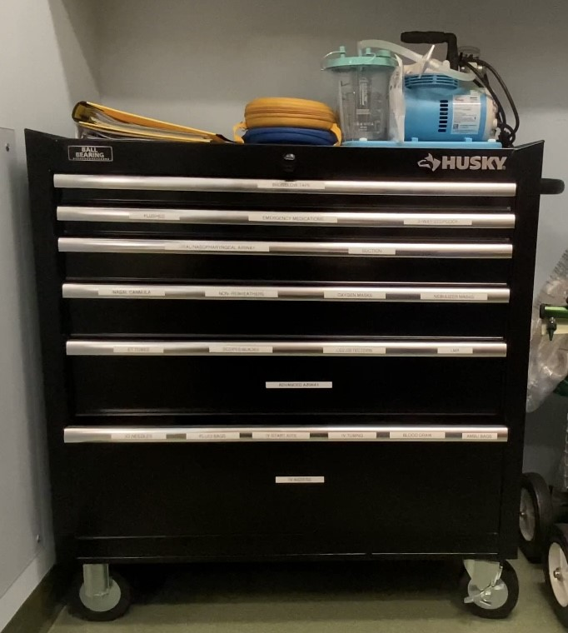
Examples of Crash Cart Contents
Click
Stars

Slide 30
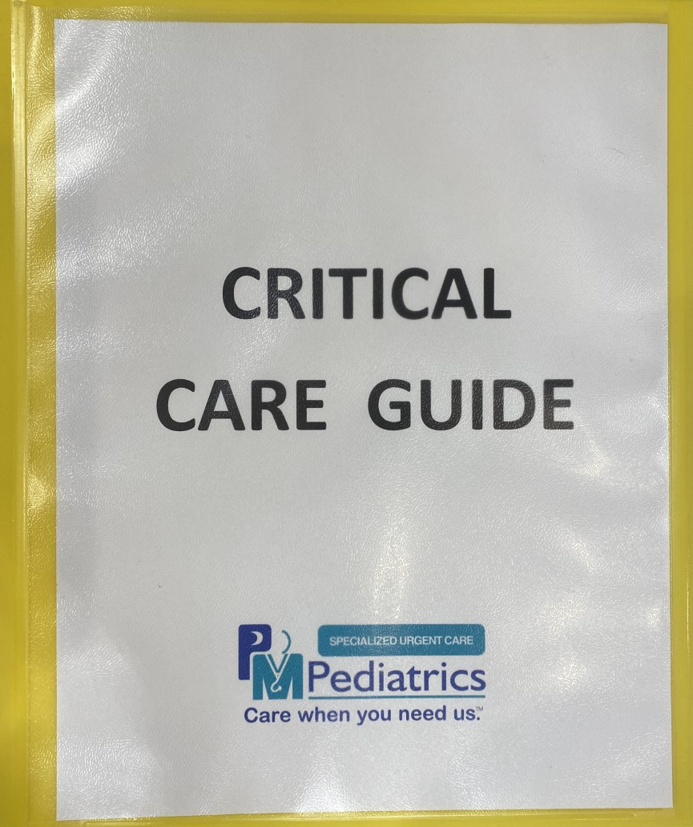
Intro to the Critical Care Guide

Slide 31

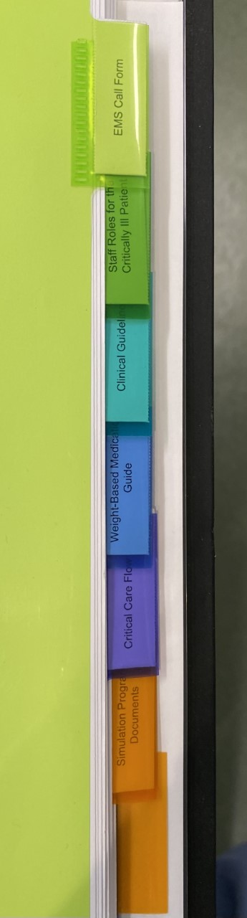
Click on each for a glimpse into each section
EMS Call Form
Staff Roles for the Critically Ill Patient
Clinical Guidelines
Weight-Based Medication Guide
Critical Care Flow Sheet
Simulation Program Documents

Slide 32
Mobilize Patients
The Patient
Transfer to procedure room
Other Patients
Remove from procedure room, if occupied
Front Desk
Inform other patients of office emergency & possible care delay, “crowd control”
Ready to activate EMS

Slide 33
I⁴ RESCUE Cycle
Identify
Interact
Intervene
Initiate Early Transfer

Slide 34

RESCUE Protocol
Initial Impression
PAT
Mobilize Resources
Alert provider and team
Obtain necessary equipment
Critical
Interventions
Primary Assessment (Survey) & Vitals:
Airway
Breathing
Circulation
Secondary Assessment (Survey)

Slide 35
Critical Interventions: ABCs
Critical priorities that MUST happen first:
Airway
Position, suction, OPA/NPA/LMA
Breathing
O₂ via NC, simple FM, NRB, BVM
Circulation
IV/IO access, fluid resuscitation

Slide 36
Secondary Assessment: Obtain Focused History
S
Signs and symptoms
A
Allergies
M
Medications
P
Past medical history
L
Last meal
E
Events leading up to incident

Slide 37

RESCUE Protocol
Initial Impression
PAT
Mobilize Resources
Alert provider and team
Obtain necessary equipment
Critical
Interventions
Primary Assessment (Survey) & Vitals:
Airway
Breathing
Circulation
Secondary Assessment (Survey)

Slide 38
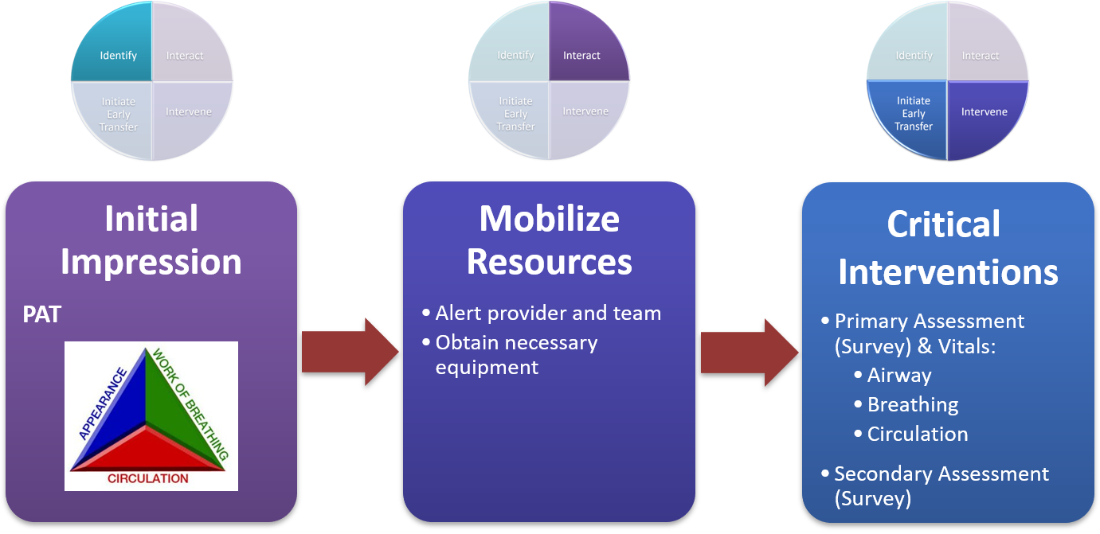
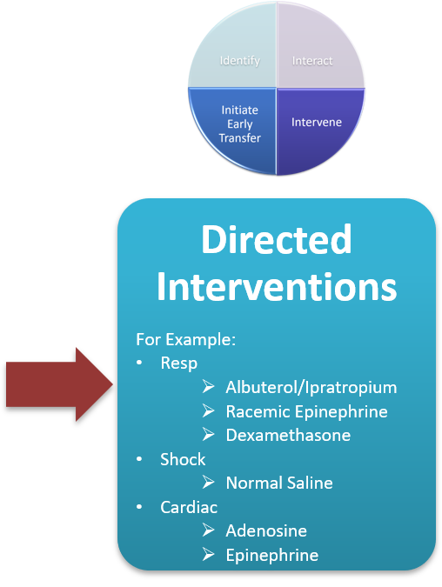
RESCUE Protocol
These first 3 steps will be the same for all critically ill children, regardless of etiology
At this stage, the underlying cause may become apparent & directed interventions should be initiated

Slide 39
Directed Interventions
Directed interventions for specific etiologies are discussed in detail in their corresponding modules
Respiratory
Shock
Cardiac
Unresponsive/Seizure Patient

Slide 40

Hypovolemic Shock
Consider CMP, CBC, D-stick
NS bolus (20cc/kg, max 1L) wide open, consider Zofran, dextrose bolus PRN
Repeat vitals and reassess frequently (q5-15 min); repeat NS bolus (up to 3x) until improved vitals/exam
INITIATE EARLY TRANSFER
if hypotensive shock or poor response to above
Shock
↑HR
+/- ↓BP
+/- ↑ cap refill
+/- AMS, pallor
hx of v/d, poor po, trauma
Distributive Shock
Consider CMP, CBC, D-stick, cultures if sepsis suspected
NS bolus (20mL/kg) wide open max of 80mL/kg
If sepsis, IV/IM ceftriaxone (50mg/kg, max, give EARLY)
If anaphylaxis, Epi IM (0.15mg<30kg, 0.3mg if >30kg)
Repeat vitals and reassess frequently (q5-15 min); repeat bolus (up to 3X) until improved, antipyretics PRN
TRANSFER
if no improvement or if anaphylaxis requiring repeat Epi
allergic rxn, bounding pulses, fever, warm
Cardiogenic Shock
If SVT suspected, vagal maneuvers (ice, bearing down, etc.)
Adenosine (0.1mg/kg, max 6mg, 2nd /3rd dose PRN 0.2mg/kg, max 12mg)
NS bolus (10mL/kg) over 30 min – LOW AND SLOW
Repeat vitals and reassess frequently (q5-15 min); repeat bolus (up to 3X) until improved vitals/exam
INITIATE EARLY TRANSFER
possible ↑ respiratory effort, ↑↑ HR, cold, mottled, palpable liver edge, JVD, crackles, murmur
Absent BS, muffled heart sounds, ↑ respiratory effort, chest pain, +/- tracheal deviation, h/o trauma
Obstructive Shock
If tracheal deviation, needle decompression, O₂ & IV/IO access
Unless stable, do not attempt CXR
NS bolus 20mL/kg
IMMEDIATE TRANSFER

Slide 41
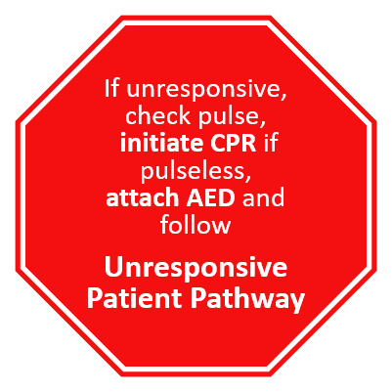
Cardiac Arrhythmia
Stable Bradycardia
EKG
Nl EKG= No intervention
Mobitz II or 3rd degree heart-block = TRANSFER
Any other EKG = Cardiology f/u
no sx
↓ HR
Unstable Bradycardia
HR <60, ↓BP, ↓ SpO₂ with AMS = Initiate CPR and attach AED
Epinephrine 0.01 mg/kg (0.1 mg/mL) q3-5min
H’s and T’s
TRANSFER
+ sx +/-AMS/
syncope, ↑ CR
<180 (<220 infant)
c/w hx
Likely Sinus Tachycardia
(non-cardiac etiology)
Intervene accordingly & reassess
>180 (>220 infant)
no distress, nl perfusion
Possible Stable SVT
(vs Stable Ventricular Tachycardia)
Obtain EKG
See SVT management
INITIATE TRANSFER
↑ HR
+/- distress
+/- AMS/syncope
Unstable Tachycardia
Consider EKG
If SVT, vagal maneuvers/adenosine
IMMEDIATE TRANSFER

Slide 42
Unresponsive Patient
No RR
No pulse
+ RR
+ pulse
No RR
+ pulse
START CPR
ATTACH AED
No
RR
No pulse
NO
SHOCK
ADVISED
No RR
No pulse
SHOCK
ADVISED
H + T’s
(hypoglycemia, ingestion, seizing or post-ictal, etc.)
ABC’S + TRANSFER
Follow
Respiratory Pathway
ABC’S + TRANSFER
Likely PEA/Asystole:
Continue CPR, AED
+ epinephrine
ABC’S + TRANSFER
Likely V-Fib, Pulseless V-Tach:
Continue CPR, AED
+ epinephrine
ABC’S + TRANSFER
Notes:
Before we start these intervention algorithms, please note for unresponsive patients…

Slide 43
I⁴ RESCUE Cycle
Identify
Interact
Intervene
Initiate Early Transfer

Slide 44

Determine disposition in a timely manner
Better outcomes with early transfer
Activate early, especially for signs of impending cardiorespiratory failure
Reassessment
Improved appearance? Improved effort? Improved vitals?
Key questions to ask yourself
What is the likelihood that I will be able to fix this patient & send them home?
Just because I can manage this patient, does it mean I should?
When in doubt, send them out!

Slide 45
Determine disposition in a timely manner
Immediate transfer if:
Any red flags are present
or
Any key interventions for specific conditions are repeated
Examples:
>1 racemic epi for croup
>1 epi for anaphylaxis
Asthma/croup presenting with significant hypoxia
Altered mental status
Neurovascular compromise
Seizures (unless simple febrile)
Early transfer to advanced care can be crucial to successful management of the critically ill child

Slide 46
Choose Appropriate Transport Modality
EMS: ALS vs BLS
Hospital transport team
Private transport companies
Personal vehicle

Slide 47
I⁴ RESCUE Cycle
Identify
Interact
Intervene
Initiate Early Transfer

Slide 48
Course Site Map
BLS
Shock
Cardiac Arrhythmias
Unresponsive Patient
Crisis Resource Management
Respiratory

Slide 49


Advantages of RESCUE
Far more relevant to the outpatient setting
More practical, simplified approach
All course content is reinforced through regular simulations
ONE day course (only ½ day of in-person instruction)
Less expensive to teach & to run
Less time commitment for teachers & students
Notes:
Less expensive for both teaching the course as well as for participants

Slide 50
What’s next for RESCUE…
Course buildout on LMS platform
Company-wide rollout
“Working out the kinks” phase
Obtain eventual certification thru accrediting body
Offer Instructor and Provider courses externally

Slide 51

Questions?

Slide 52
References
American Academy of Pediatrics Committee on Pediatric Emergency Medicine, Frush K. Preparation for emergencies in the offices of pediatricians and pediatric primary care providers. Pediatrics. 2007 Jul;120(1):200-12. doi: 10.1542/peds.2007-1109. PMID: 17606580.
Abulebda K, et al; Improving Pediatric Acute Care Through Simulation (ImPACTS). Preparedness for Pediatric Office Emergencies: A Multicenter, Simulation-Based Study. Pediatrics. 2021 Sep;148(3):e2020038463. doi: 10.1542/peds.2020-038463. PMID: 34433688.
Dieckmann, RA; Brownstein, D; Gausche-Hill, M. (April 2010). The Pediatric Assessment Triangle: A novel approach for the rapid evaluation of children. Pediatric Emergency Care. 26 (4): 312-315.
Kelly, CA; Upex A; Bateman DN. (February 2005). "Comparison of consciousness level assessment in the poisoned patient using the alert/verbal/painful/unresponsive scale and the Glasgow Coma Scale". Annals of Emergency Medicine. 44 (2): 108–113
American Heart Association. (2016). Pediatric Advanced Life Support: Provider Manual. First American Heart Association Printing. USA

Slide 53
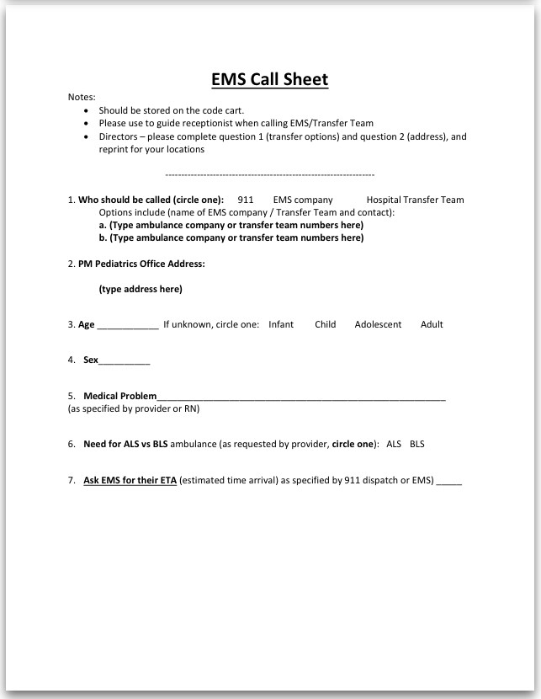

Slide 54
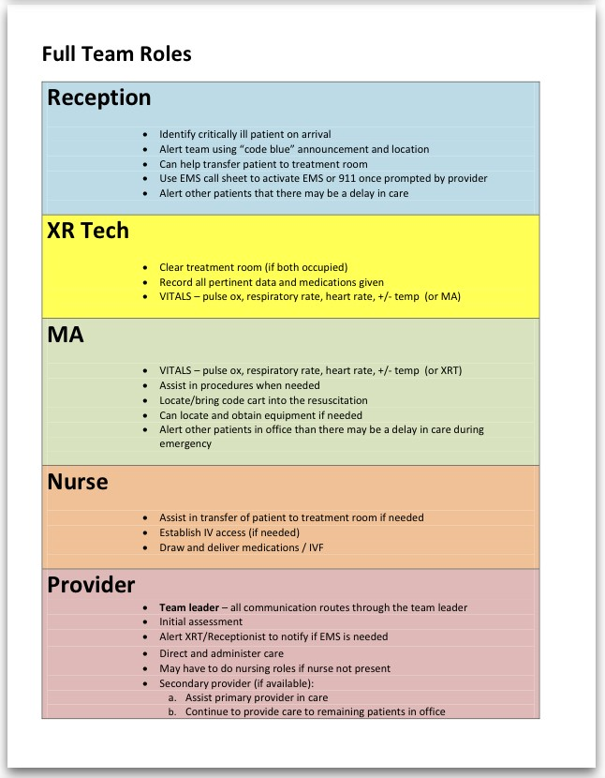
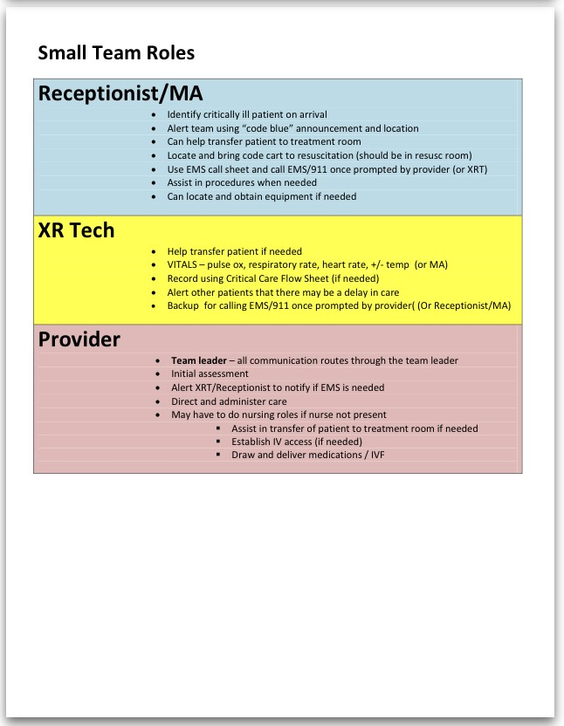

Slide 55
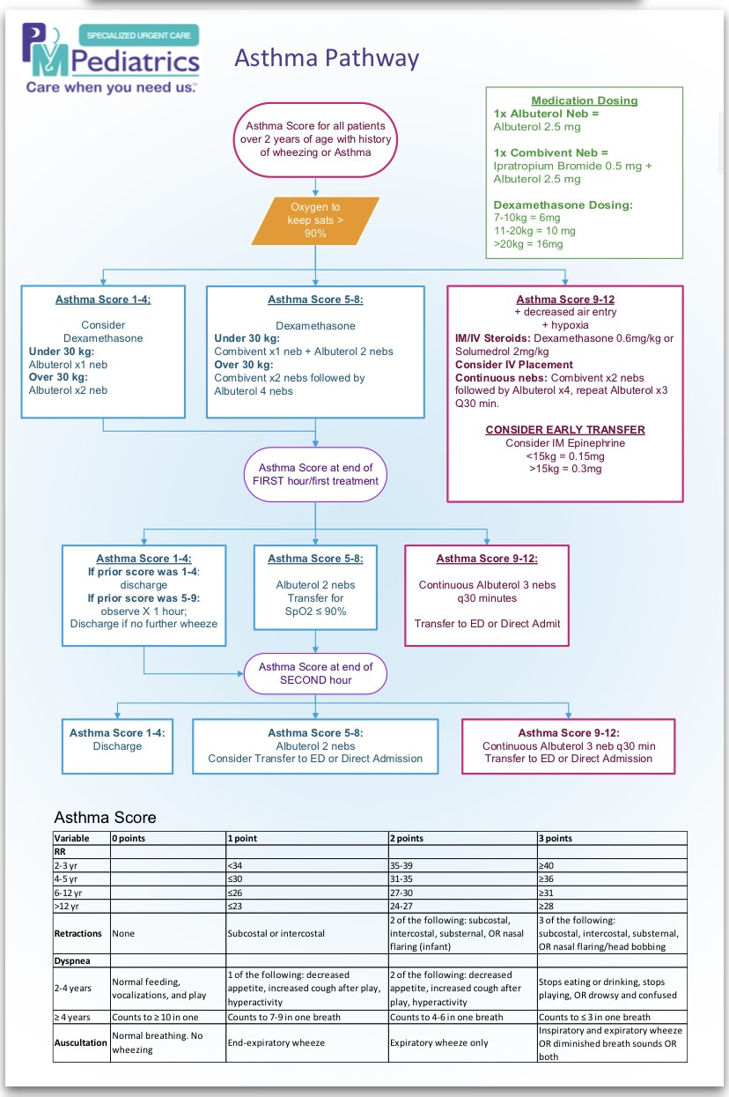
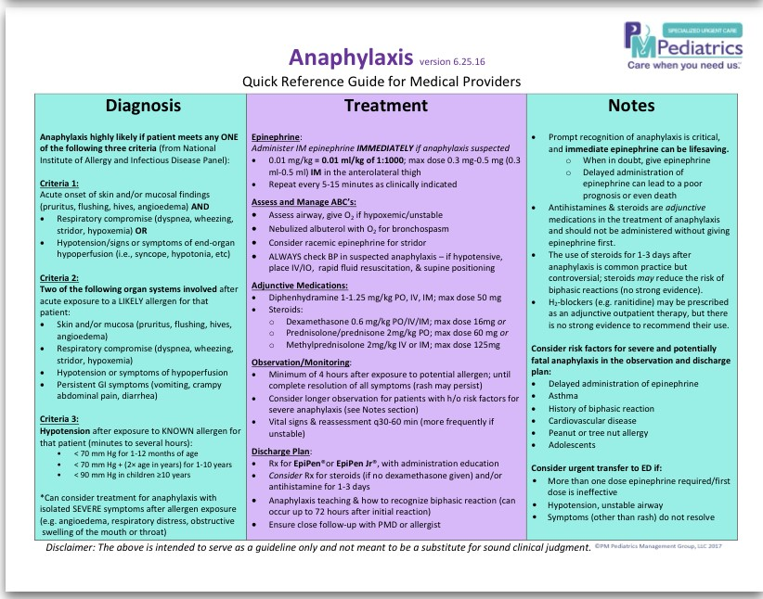
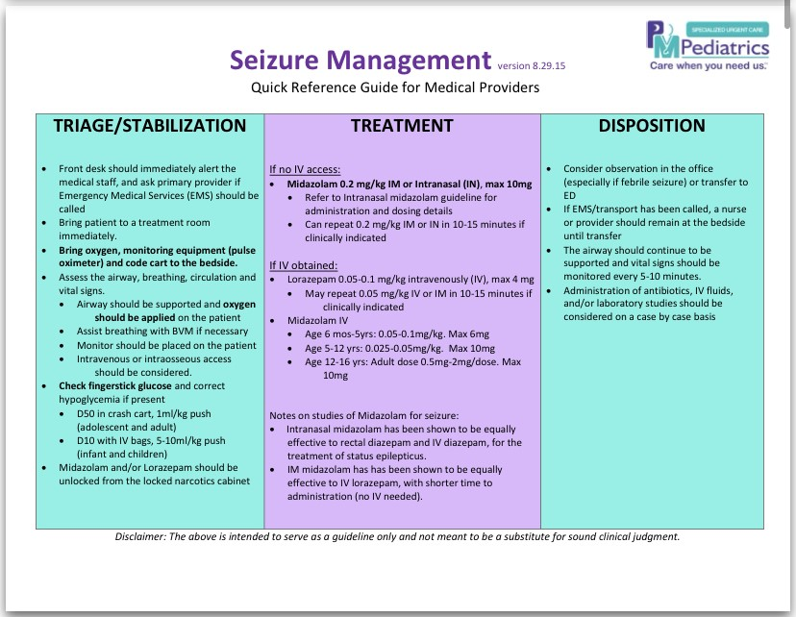

Slide 56
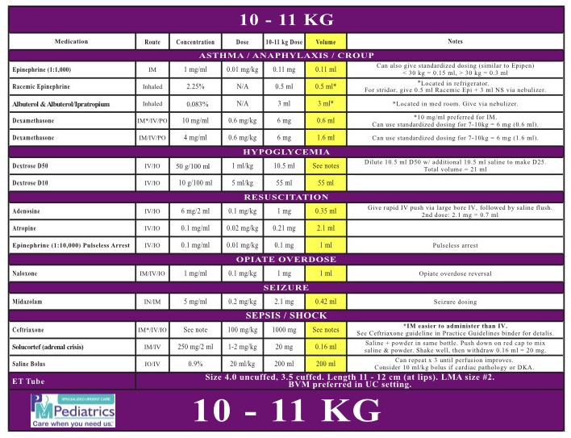

Slide 57
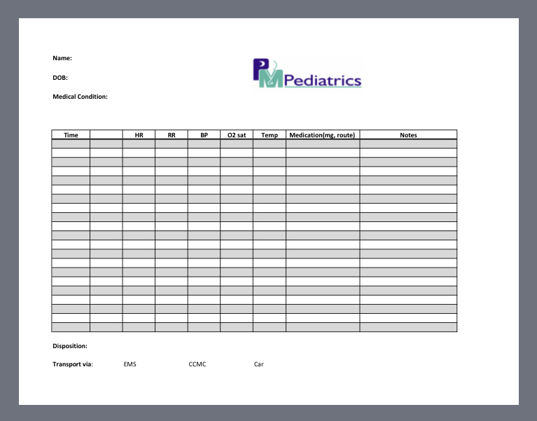

Slide 58
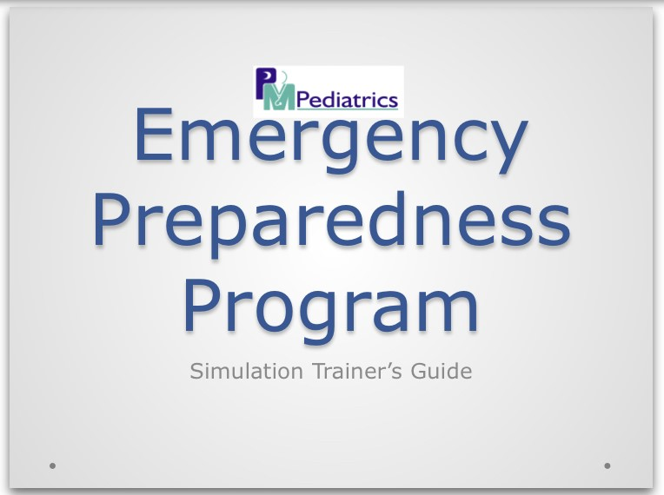

Slide 59
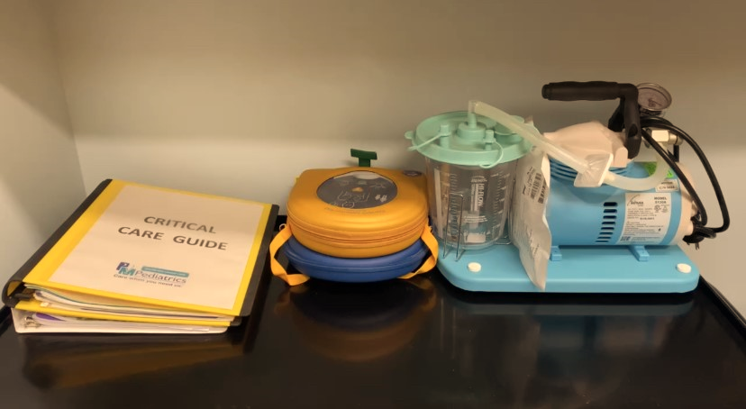
Critical Care Guide
AED
Suction machine

Slide 60
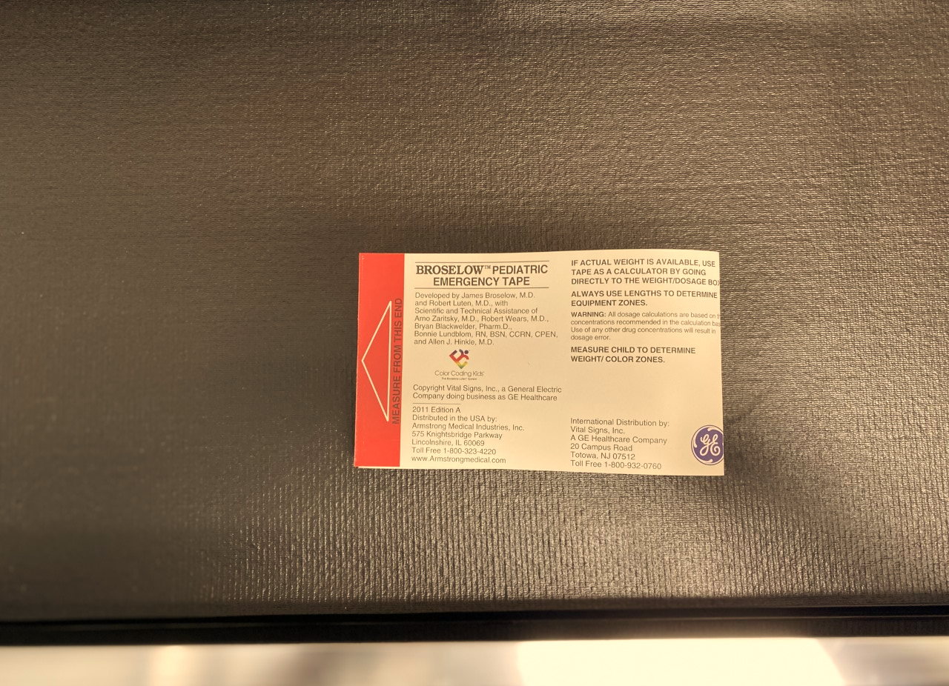
Broselow tape

Slide 61
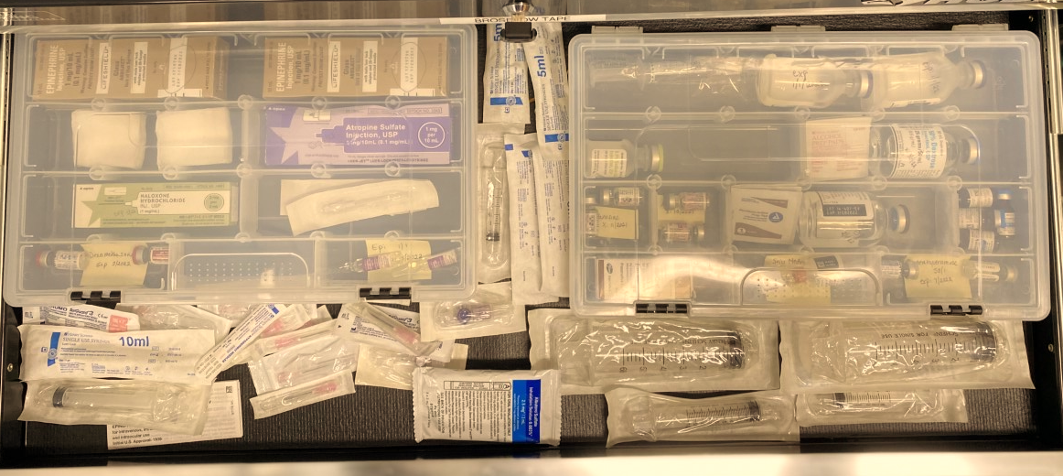
Epinephrine 0.1mg/1mL
Atropine
Naloxone
Dexamethasone
Epinephrine 1mg/1mL
18G needles
Saline flushes
D10
Adenosine
Diphenhydramine
Albuterol
3-way stop cocks

Slide 62
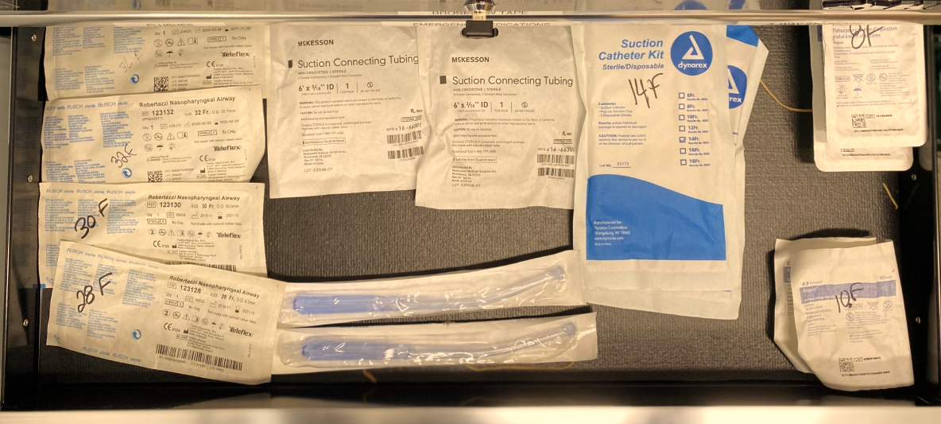
Nasopharyngeal airways
Suction connection tubing
Suction catheter kits
Yankauers
Laryngoscope blades

Slide 63
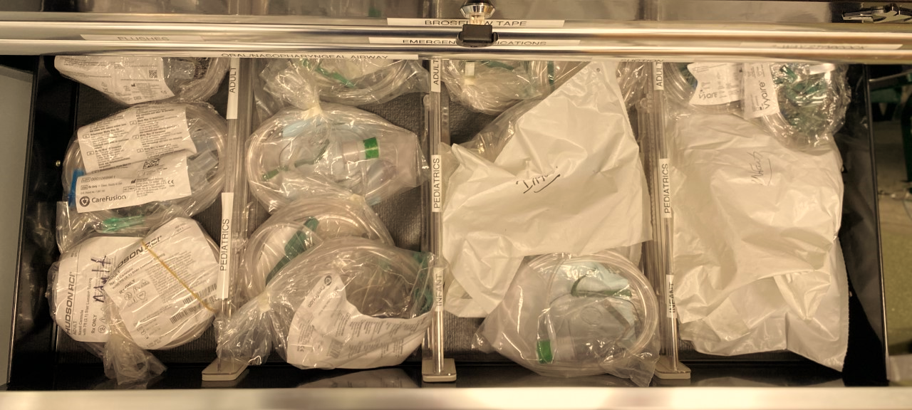
Nasal canula
Oxygen masks
Non-rebreathers
Various sizes available

Slide 64
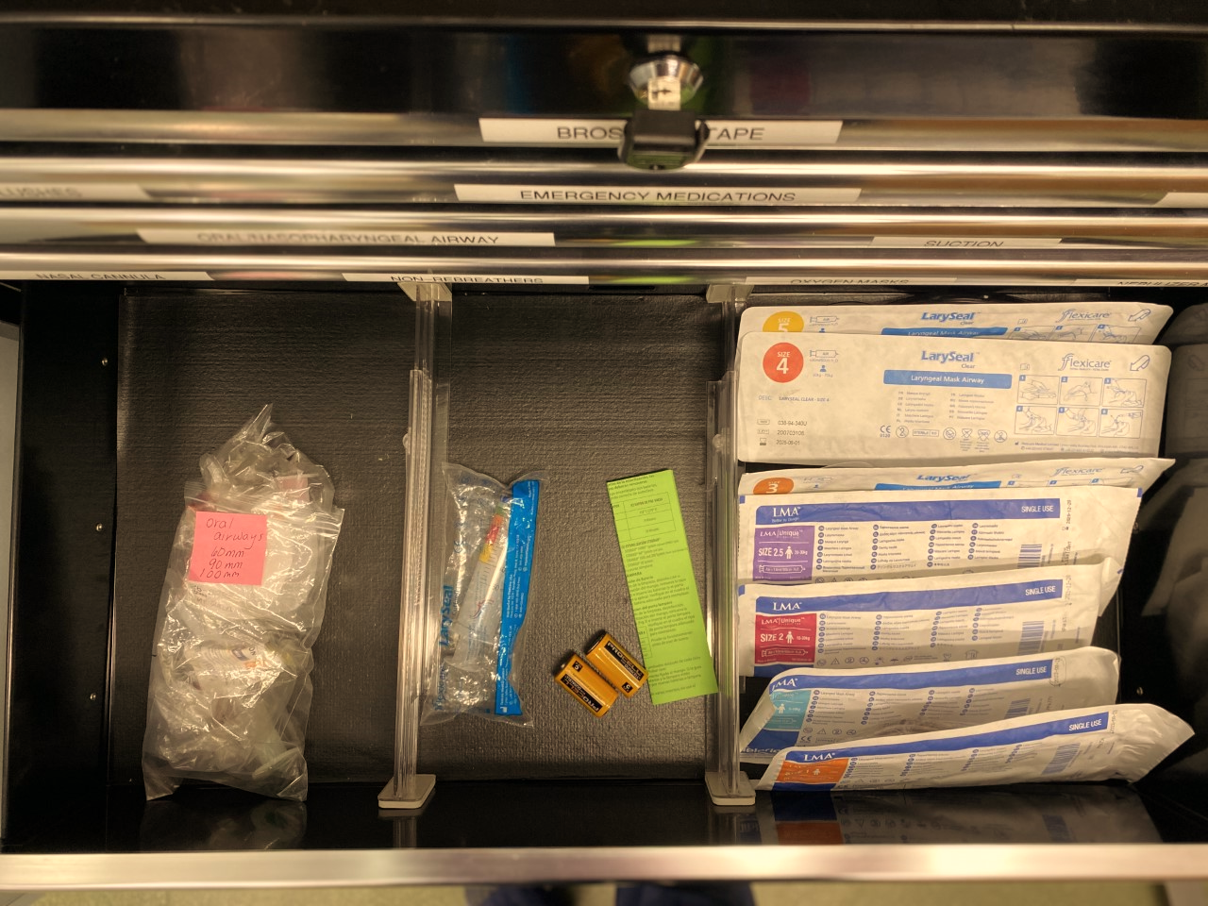
Oropharyngeal airways
Cuff inflater
LMAs
Various sizes available

Slide 65
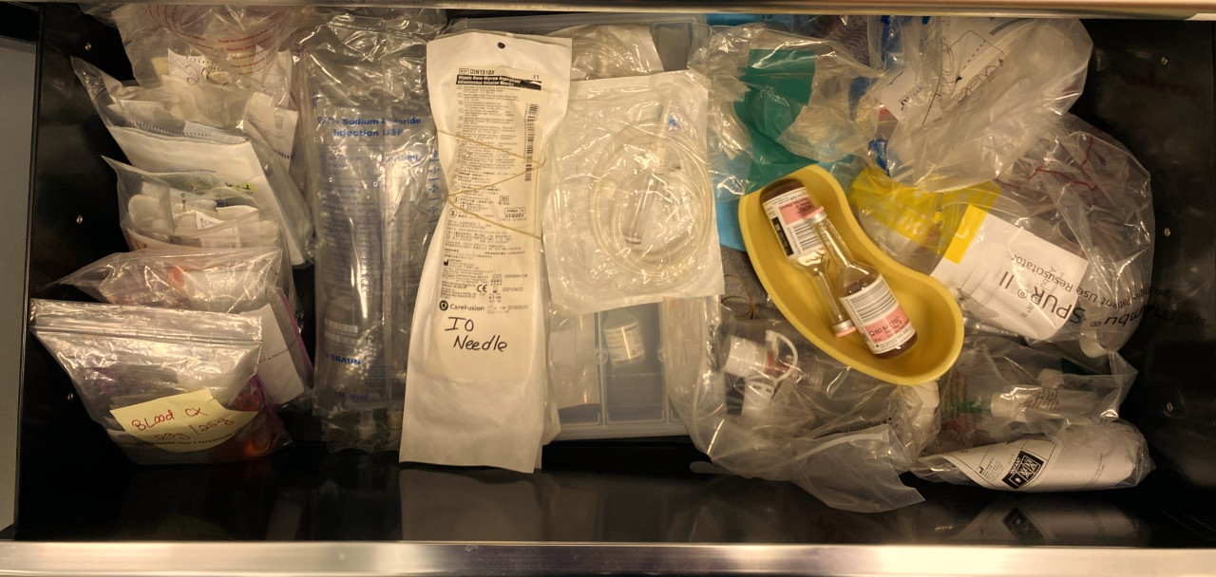
IV Start kits
1L NS bag
IV tubing
IO needles
Blood culture bottles
BVMs

Slide 66
Receptionist
Identify critically ill patient on arrival and alert team
Can help transfer patient to treatment room
Complete EMS call sheet to activate EMS or 911 once prompted by provider
Alert other patients that there may be a delay in care

Slide 67
MA
Locate and bring code cart to resuscitation
Assist in procedures when needed
Can locate and obtain equipment if needed
Alert other patients in office that there may be a delay in care during emergency
Can obtain vitals

Slide 68
Nurse/UC Tech
Assist in transfer of patient to treatment room
Establish IV access (if needed)
Draw up and deliver medications / IVF

Slide 69
XRT
Clear treatment room (if occupied)
Record all pertinent data and medications given
Can obtain vitals
Assume Reception or MA duties if one not present

Slide 70
Provider
Team leader – all communication routes through the team leader
Initial assessment and alert staff to notify if EMS is needed
Direct and administer care
Will incorporate nursing roles if nurse not present

Slide 71
Receptionist/MA/XRT
Identify and alert team to critically ill patient
Helps to transfer patient to treatment room
Notify other patients of critical patient and delay
Complete call sheet, activate EMS
Bring code cart, O₂, other equipment
Set up any necessary equipment
Can help with vitals
Complete EMS call sheet and activate EMS (or XRT)

Slide 72
Nurse/UC Tech
IV/IO Access, draw up meds
Clears treatment room if needed
Records
Obtain vitals
Can help with equipment
Complete EMS call sheet and activate EMS (or MA)

Slide 73
Provider
Team Leader – All communication routed through team leader, medical decision making and administering care
Initial Assessment – ABCs
Incorporate nursing roles if no nurse present (draw up and administer medications, direct O₂, assist with IV/IO if needed)
Alert staff to notify EMS if needed

Slide 74
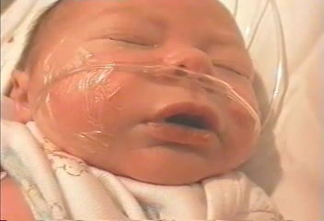

Slide 75
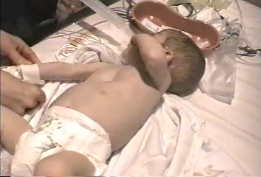

Slide 76
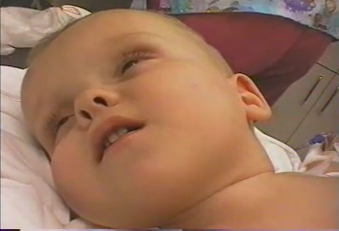

Slide 77
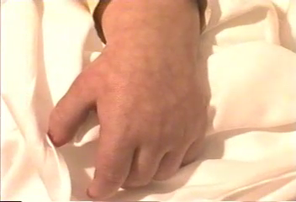

Slide 78
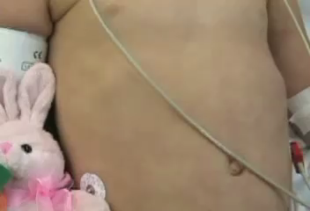

Slide 79
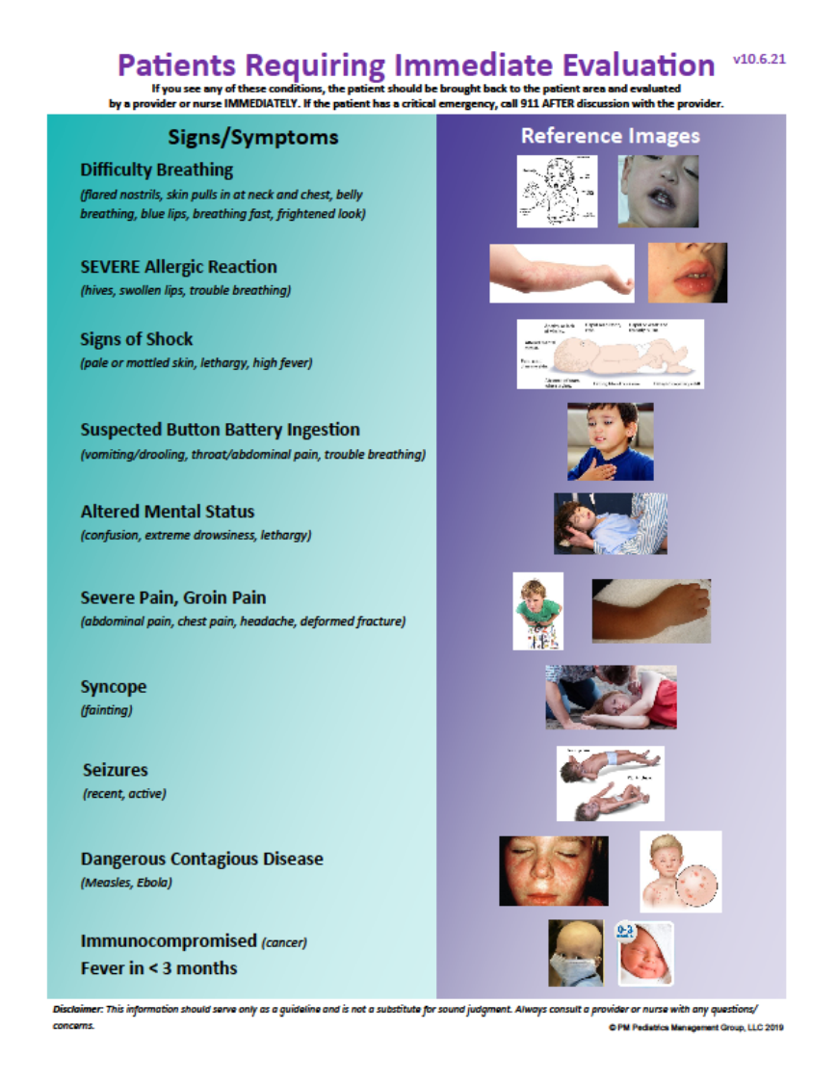

Slide 82
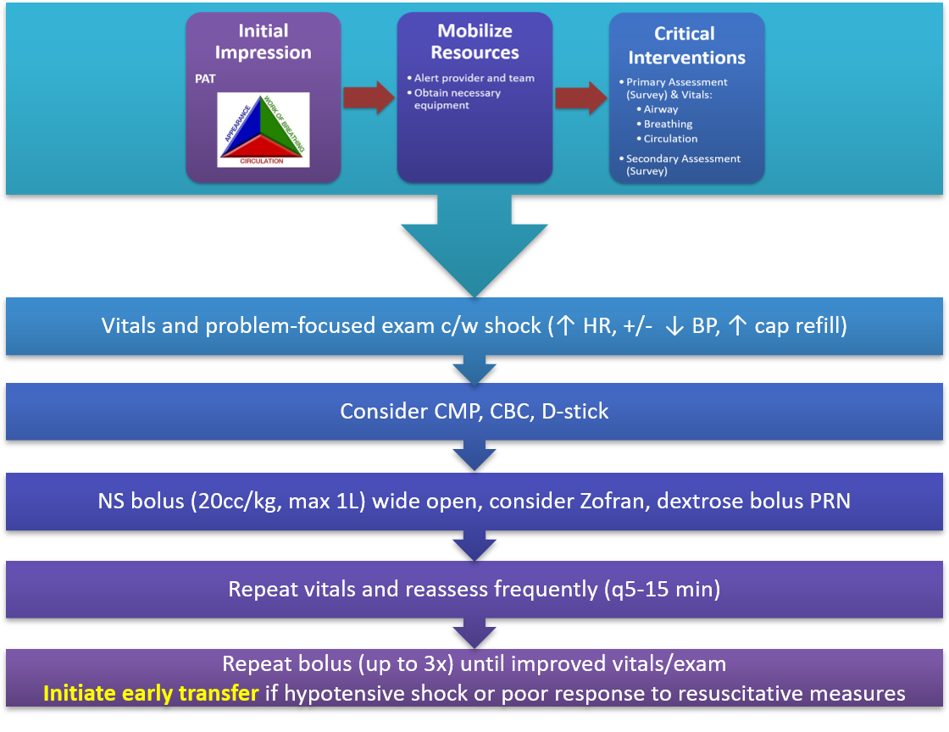
Hypovolemic Shock

Slide 84
Distributive Shock
Anaphylaxis Kit, consider CMP, CBC, D-stick, cultures if sepsis suspected
NS Bolus (20mL/kg) to max 80/kg; if sepsis, IV/IM ceftriaxone (50mg/kg, max 1g; early is key)
If anaphylaxis, Epi IM (0.15mg<30kg, 0.3mg if >30kg), antipyretics PRN
Repeat vitals and reassess frequently (q5-15 min)
Repeat bolus (up to 3x) until improved vitals/exam, transfer if no improvement
If anaphylaxis, TRANSFER if no/poor improvement, ↓ BP, or need to repeat Epi
Vitals and problem-focused exam c/w shock
(tachycardia, flash cap refill, bounding pulses, warm skin, fever, s/s of anaphylaxis)
diphenhydramine
1-1.25mg/kg, max 50mg IM/IV/PO
dexamethasone
0.6mg/kg IM/IV/PO; max 16mg
cetirizine
10mg >6yo, 5mg <5yo
Only if able to take PO
Nebulizer treatment
Racemic epinephrine (0.5mg in 3mL NS) if stridor
Albuterol (2.5mg/3mL) if wheezing
Adjunctive Anaphylaxis Interventions
**Low BP in context of anaphylaxis can be ominous – watch closely**

Slide 86
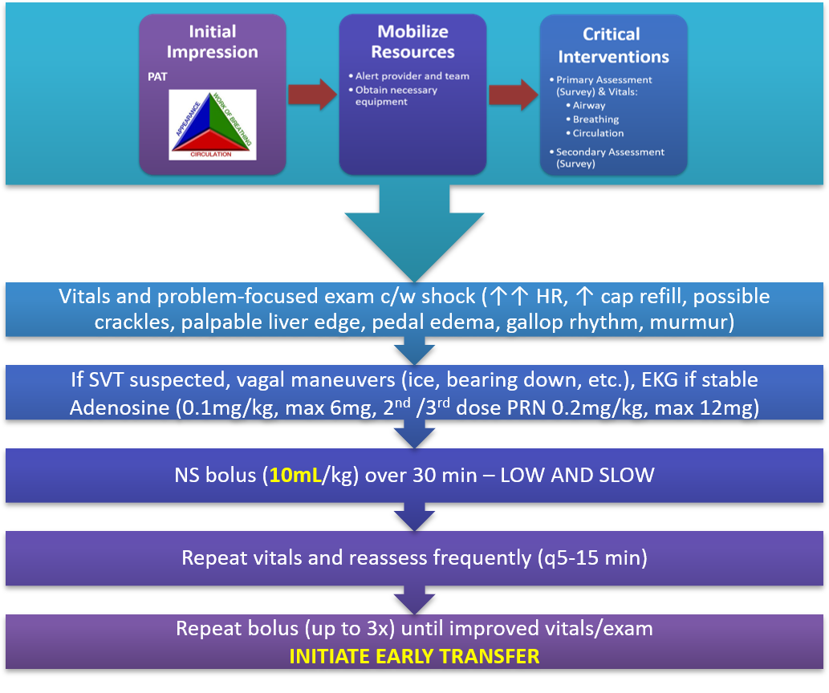
Cardiogenic Shock

Slide 88
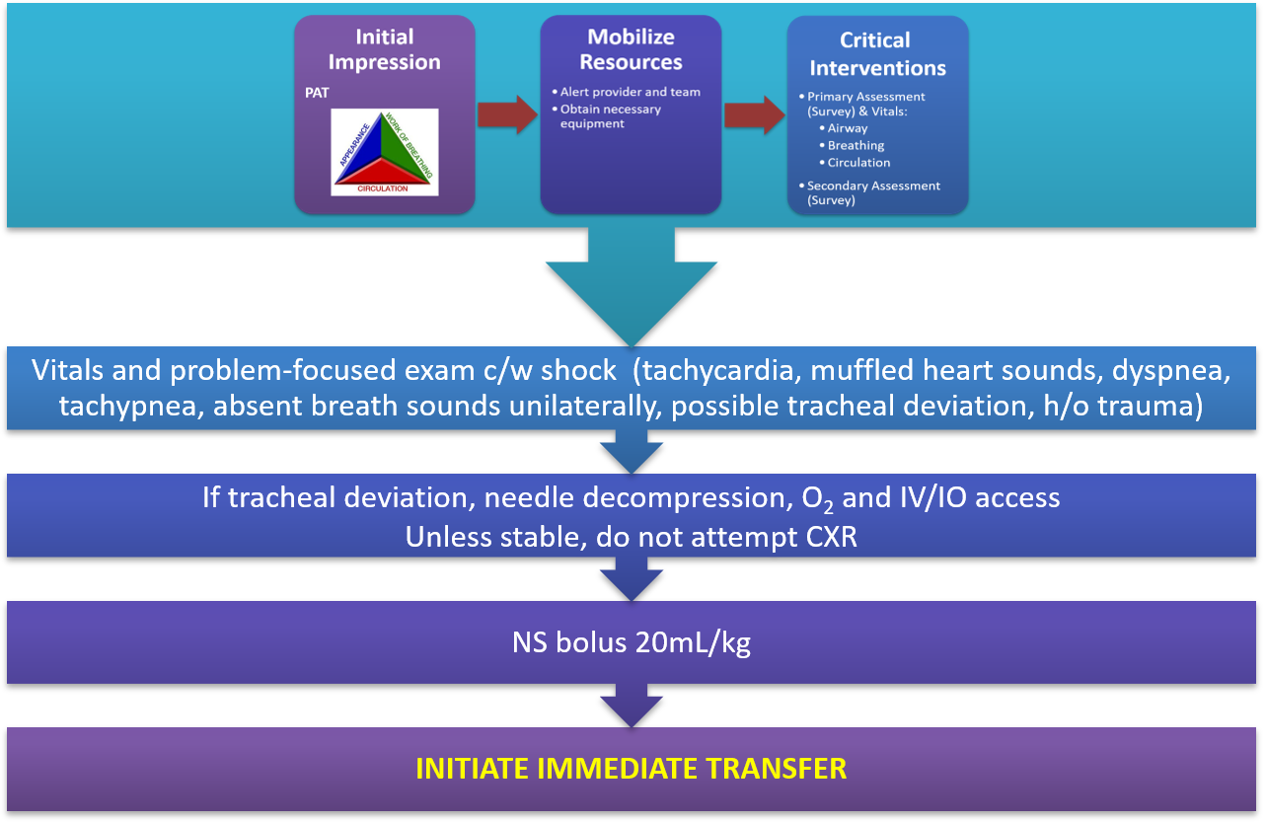
Obstructive Shock

Slide 90
Stable Bradycardia
If symptomatic and/or other abnormal vitals, follow
Unstable Bradycardia Pathway
Problem-based exam & obtain EKG. If Mobitz II or 3rd degree heart-block,
initiate transfer
If nl EKG, healthy, and asymptomatic with nl exam, then no intervention

Slide 92
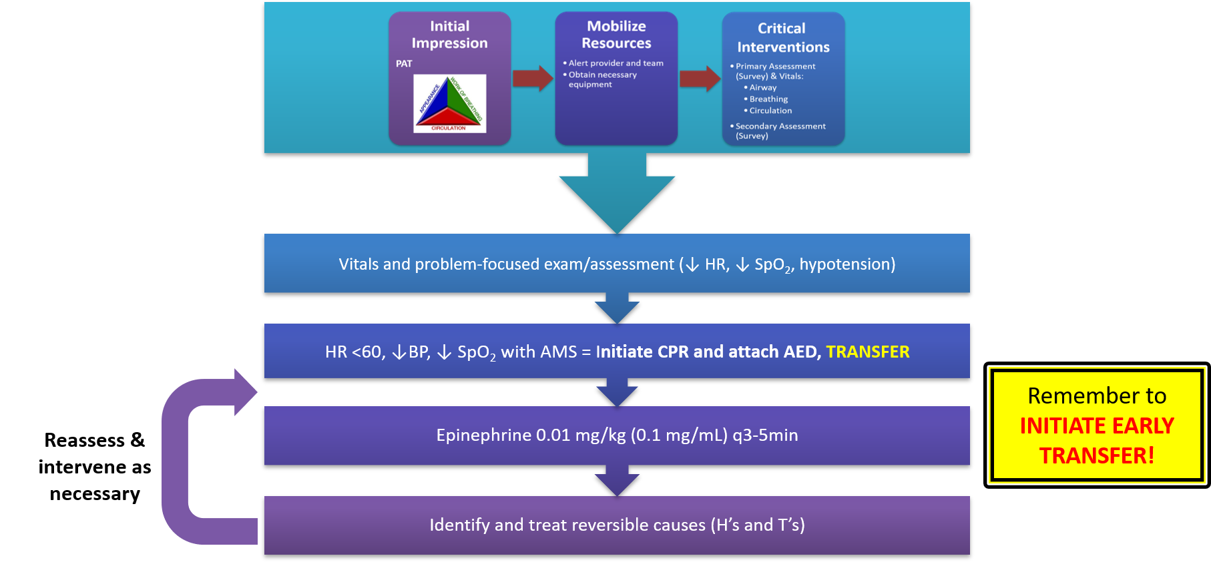
Unstable Bradycardia
Reassess & intervene as necessary

Slide 94
Stable Tachycardia
If symptomatic and/or other abnormal vitals, follow
Unstable Tachycardia Pathway
Problem-focused exam/assessment
If no distress or impaired perfusion and HR > 180 (>220 if infant) consider stable SVT (see SVT Management) or stable ventricular tachycardia
Obtain EKG
If HR <180 (<220 if infant) and history c/w
non-cardiac cause of tachycardia
(e.g., fever, pain, dehydration, anxiety),
probable sinus tachycardia
Intervene accordingly and reassess
INITIATE TRANSFER
If SVT, perform vagal maneuvers, establish antecubital IV access,
and attach 3-way stop-cock for adenosine
Identify and treat reversible causes (H’s & T’s)
If stable ventricular tachycardia, immediate transfer

Slide 96
Unstable Tachycardia
Immediate Transfer
Vitals and problem-focused exam/assessment (↑ HR, ↓ BP)
Once airway and breathing secured, consider EKG.
If SVT, perform vagal maneuvers and administer adenosine (per SVT Management)
Identify and treat reversible causes (H’s & T’s)
If unresponsive, check pulse,
initiate CPR if pulseless,
attach AED and follow
Unresponsive Patient Pathway

Slide 98
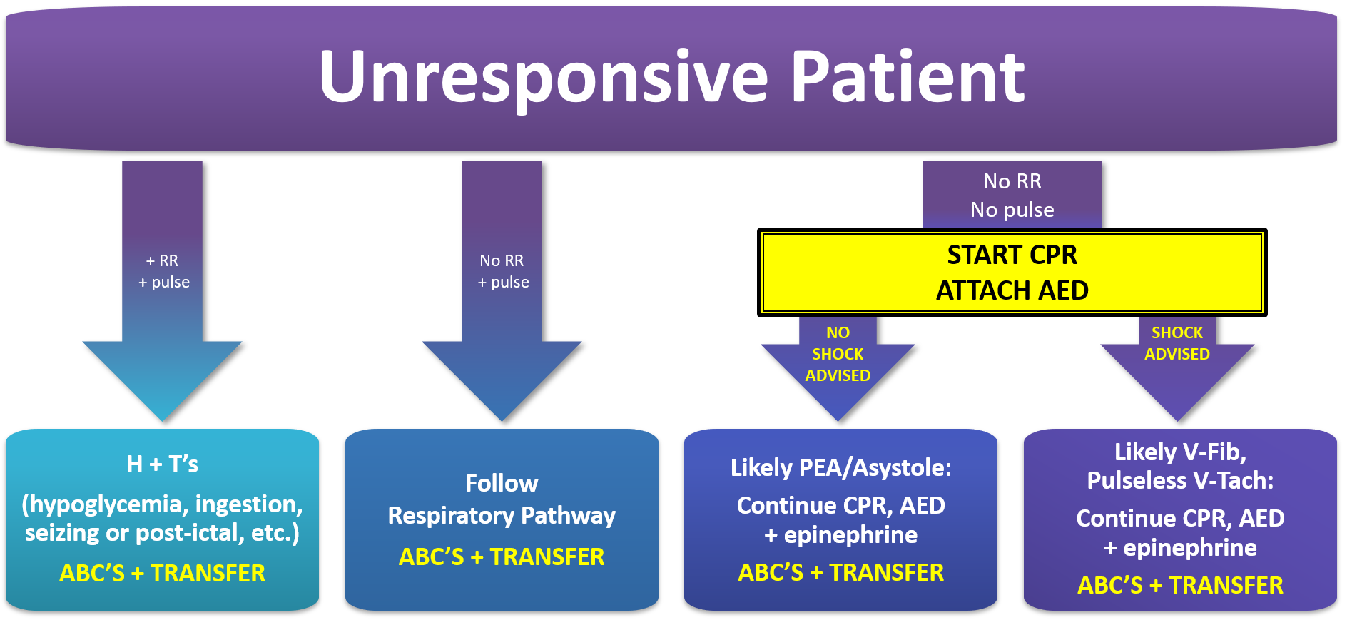

Slide 99
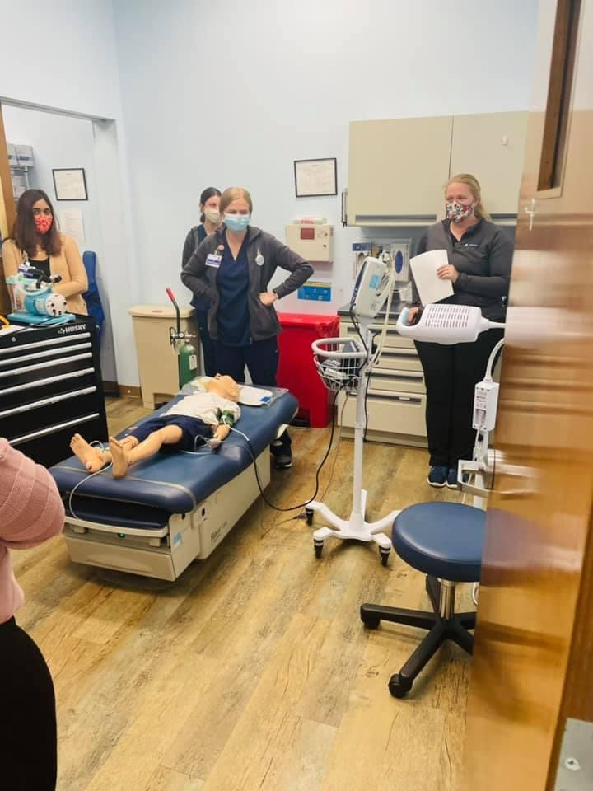
Simulation Program at PMPC
The impetus
Framework of the simulation program
Purpose:
Familiarize staff with their roles, medications,& equipment used in our setting
Reinforce PALS and BLS skills
Problem:
Palpable disconnect between PALS skills & simulations

Slide 100
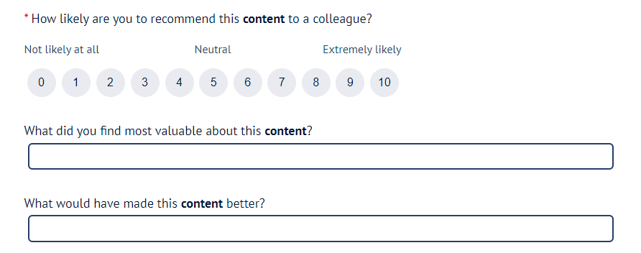
Session Evaluation
Your feedback is valuable, take a moment to complete the survey for this session.
To claim CME, you must complete a separate survey available after the convention.

Slide 101
Questions? nshah@pmpediatrics.com

