Slide 1

Pediatric X-rays you can’t afford to miss
Mark Bittman, MD

Slide 2
Financial Disclosures
I have no financial disclosures

Slide 3
Learning Objectives After completing this activity the participant should be able to:
Understand the imaging work-up of a limping child
Understand the Salter Harris classification of fractures and sequela of physeal injury
Distinguish a supracondylar humeral fracture from lateral condylar fracture
Be familiar with the imaging work-up for suspected non-accidental trauma

Slide 4
Case 1

Slide 5
Clinical Presentation: 18 month old boy refusing to bear weight and crying. Nonlocalizable symptoms.
Notes:
Our first case is an 18 month old boy refusing to bear weight and crying.

Slide 6
The most appropriate next step is:
X-ray pelvis, legs and feet
X ray tibia/fibula
US hip
X ray foot
Xray lumbar spine

Slide 7
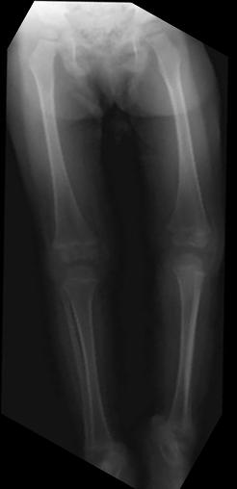
“PAIN”
X
Notes:
Does anyone think this is the right answer?

Slide 8
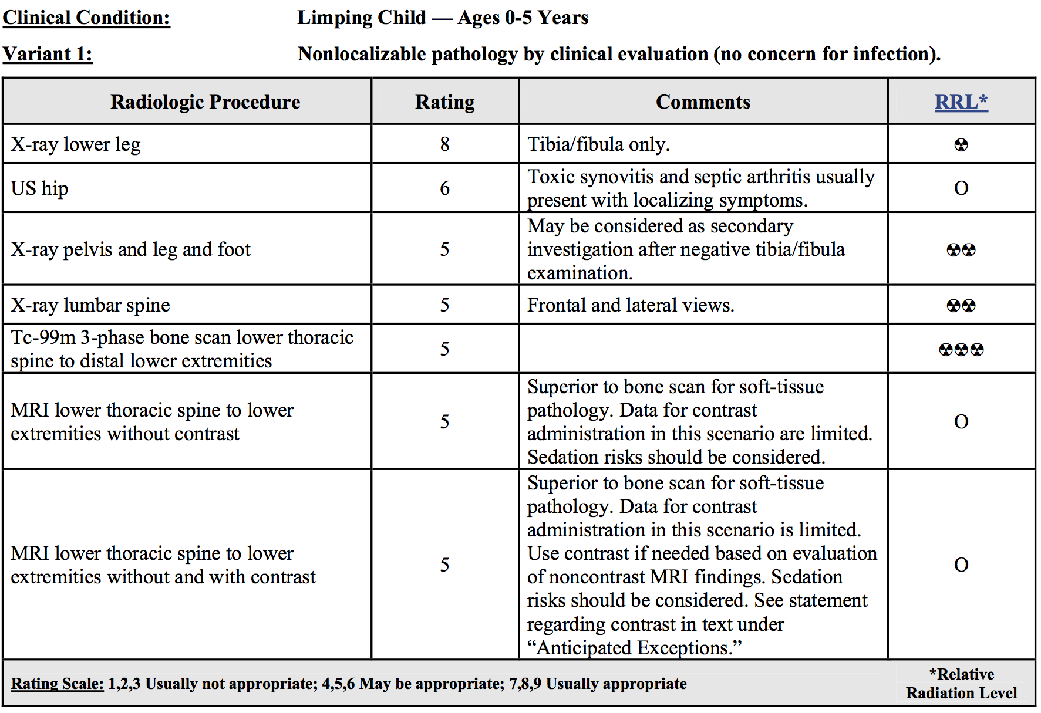
ACR Appropriateness Criteria: Limping child 0-5 years
Milla S, Coley BD, Karmazyn B et al ACR Appropriateness Criteria® Limping Child – Ages 0-5. Available at http://www.acr.org/Quality-Safety/Appropriateness-Criteria. American College of Radiology. Accessed August 31, 2015
Notes:
If we look at the ACR appropriateness criteria for a limping child, ages 0-5 with non localizable pathology, the most appropriate imaging is radiographs of the tibia and fibula only.

Slide 9
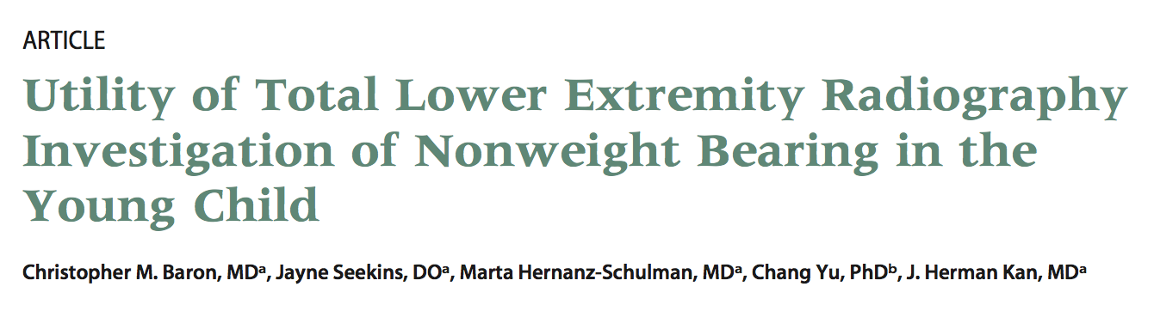
Notes:
Literature that supports this ACR criteria includes an article pubished in Pediatrics in 2008, where Baron et al looked at 133 patients with nonweight bearing patients; 100% of all fractures were found in the tibia.

Slide 10
The most appropriate next step is:
X-ray pelvis, legs and feet
X ray tibia/fibula
US hip
X ray foot
Xray lumbar spine

Slide 11
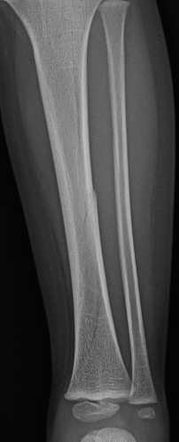
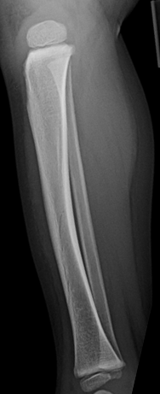
Toddler’s Fracture
Canal for nutrient artery
Notes:
Here are AP and lateral views of the tibial and fibula in our patient.
We see a curvilinear lucency in the mid to distal tibial diaphysis compatible with a non displaced fracture. This fracture is often referred to as a toddlers fracture as we often see them in early walkers, who fall with rotation.
There is an additional lucency seen in the proximal tibia is a nutrient foramen, commoonly seen in the location and not to be mistaken for a fracture.

Slide 12
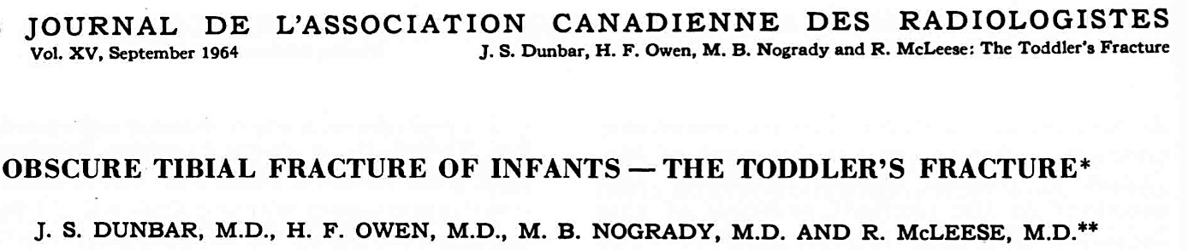
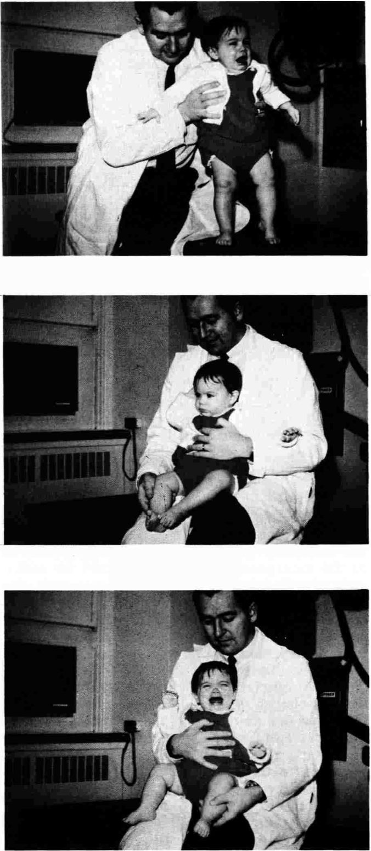
Toddler’s Fracture
Notes:
Inability to bear weight cardinal sign of toddler fracture; sensitive but not specific
Fibula resilient enough to remain intact
Typical mechanism: jumping or falling onto extended lower extremity
Stable fx due to intact periosteal sleeve
Abuse fractures proximal tibia and corner fractures
Presumptive diagnosis of toddlers fx given despite negative radiographs in appropriate clinical setting of acute limp, no fever

Slide 13
Toddler’s Fracture
Spiral fx distal 2/3 tibia
Stable fracture
Heals without treatment
Not suspicious for abuse in an ambulatory child
Often occult
Internal oblique radiograph may show fracture
Treatment with long leg cast
Canal for nutrient artery
Notes:
Fractures are typically located in the distal 2/3 of the tibia.
There are not suspicious for abuse in an ambulatory child.
These fractures can often be occults, and patients are typically casted

Slide 14
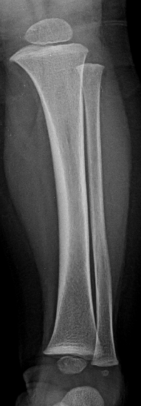
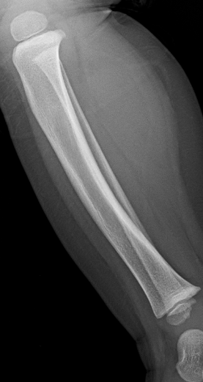
Toddler’s Fracture
Canal for nutrient artery
Notes:
Here’s another patient with a limp and nonlocalizable pain, no fever.
We again see the nutrient foramen, but no fracture.

Slide 15
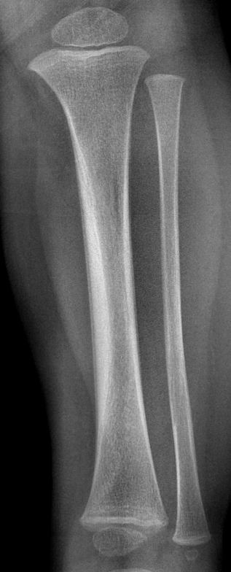
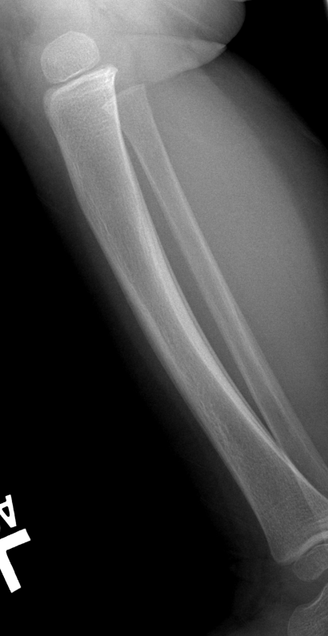
Toddler’s Fracture
Periosteal Reaction
2 weeks later: healing occult toddler’s fracture
Notes:
The patient returns two weeks later, and we can see periosteal reaction compatible with a healing non displaced spiral fracture of the tibia.

Slide 16
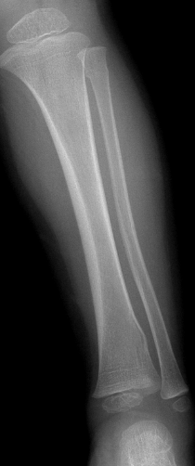
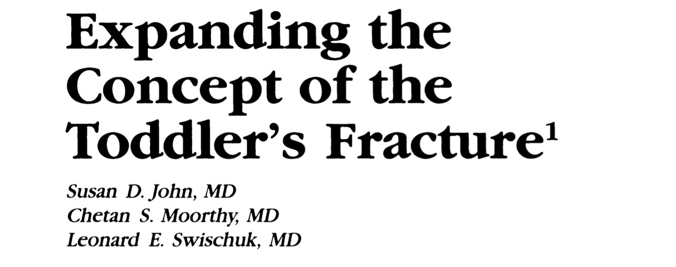

Toddler Fracture Spectrum
Includes variety of often subtle fractures
Fibula
Proximal and distal tibia
Cuboid
Calcaneus
Metatarsals
Buckle fracture
Plastic
bowing fx
Buckle fracture
Notes:
Included in the Toddlers fracture spectrum are also other subtle fractures of the lower extremity. Here is an example of a patient with a proximal fibular buckle fracture, distal tibial buckle fracture and a plastic bowing fracture of the fibula.

Slide 17
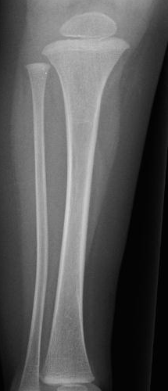
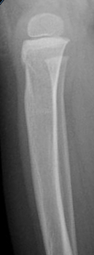
Toddler Fracture Spectrum
Proximal Tibial Fx:
Hyperextension force
Buckle fx anterior tibia
Anterior tilting physis
Increased “scooping” of tubercular notch
Notes:
And finally, here is an example of a proximal tibial Toddlers fracture, often secondary to hyperextension injury. Findings include buckle of the anterior tibial cortex, tilting of the anterior aspect of the physis

Slide 18
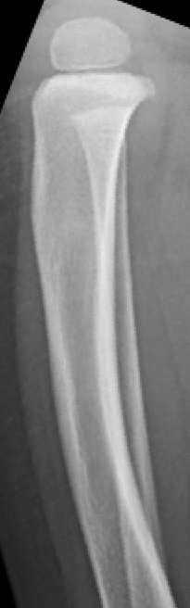
Toddler Fracture Spectrum
Proximal Tibial Fx:
Hyperextension force
Buckle fx anterior tibia
Anterior tilting physis
Increased “scooping” of tubercular notch
Normal
Notes:
Findings that can be missed if we don’t have a contralateral comparison radiograph

Slide 19
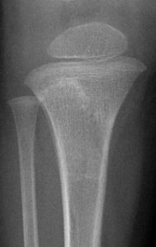
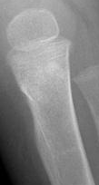
Toddler Fracture Spectrum
Proximal Tibial Fx:
Hyperextension force
Buckle fx anterior tibia
Anterior tilting physis
Increased “scooping” of tubercular notch
10 days later
Notes:
Here is another example of a missed tibial toddler fracture, where we see sclerosis and increased scopping of the tubercular notch

Slide 20
Case 2

Slide 21
Clinical Scenario: 3 yo girl with limp; swelling over dorsum of foot
Notes:
Our next case is a 3 yo girl with limp. She has swelling over the dorsum of her foot.

Slide 22
The most appropriate next step is:
X-ray pelvis, legs and feet
X ray tibia/fibula
US hip
X ray foot
Xray lumbar spine

Slide 23
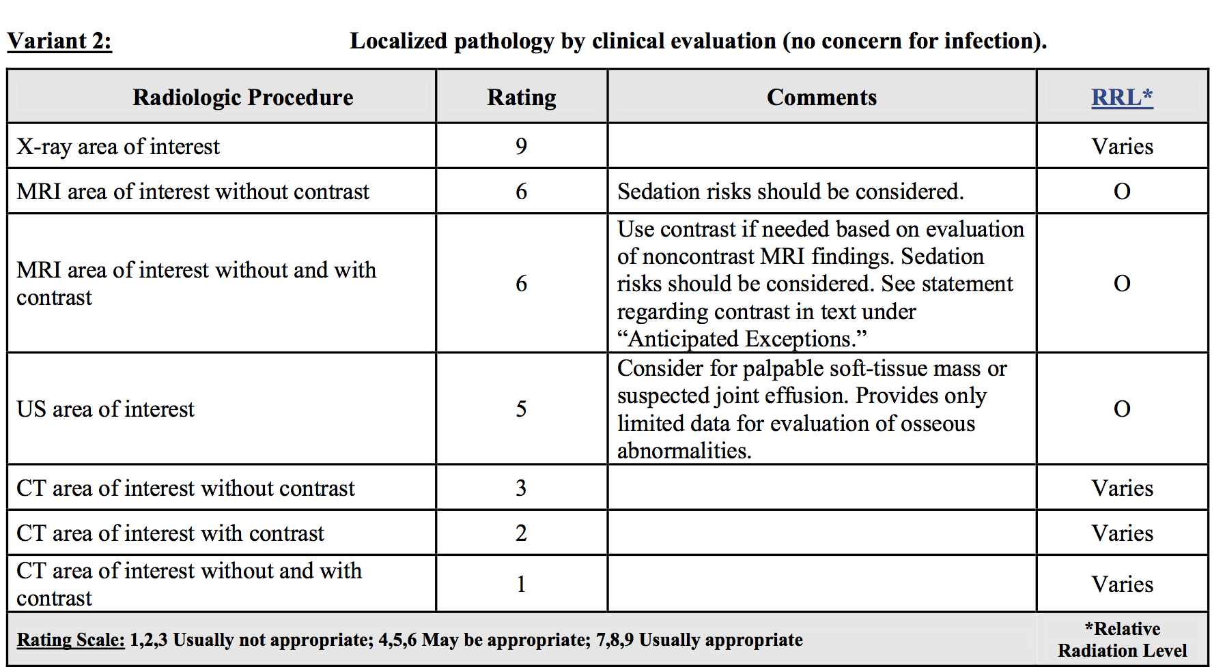
ACR Appropriateness Criteria: Limping child 0-5 years
acr.org/~/media/ACR/Documents/AppCriteria/Diagnostic/LimpingChildAges0To5Years.pdf
Notes:
If we look at the ACR appropriateness criteria for a limping child with localizable symptoms, the best step is obtain radiographs of the area of interest.

Slide 24
The most appropriate next step is:
X-ray pelvis, legs and feet
X ray tibia/fibula
US hip
X ray foot
Xray lumbar spine
Notes:
So in our case, the most appropriate next step is to obtain radiographs of the foot.

Slide 25
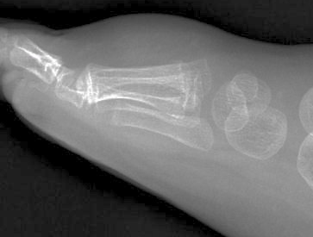
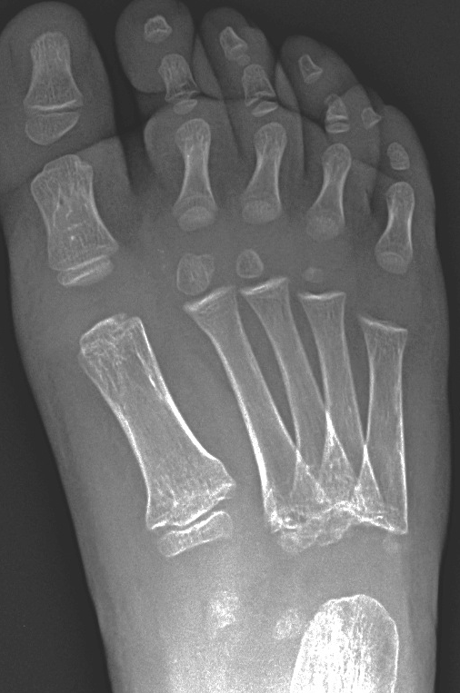
Notes:
On lateral and oblique radiogrpahs of the foot, there is marked dorsal soft tissue swelling. We also see undulation of the lateral cortex of the first metatarsal metaphysis.

Slide 26
1st Metatarsal Buckle Fracture
Notes:
Compatible with a 1st metatarsal buckle fracture.

Slide 27
1st Metatarsal Fracture
Compressive axial loading
Notes:
These fractures are often due to compressive axial loadings

Slide 28
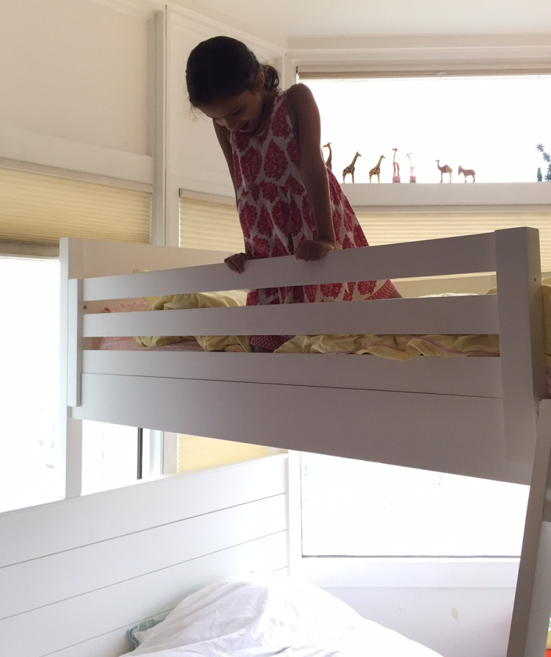
1st Metatarsal Fracture
Compressive axial loading
“Bunk bed” fracture
Notes:
And are sometimes called bunkbed fractures, because as I am sure you all know, children lobe jumping off their bunkbeds and sometmes when they landVery common; often occult but ok because heal without treatment. Because they are typically hairline spiral fxs they are not seen on AP or lat and internal oblique view may demonstrate fx.

Slide 29
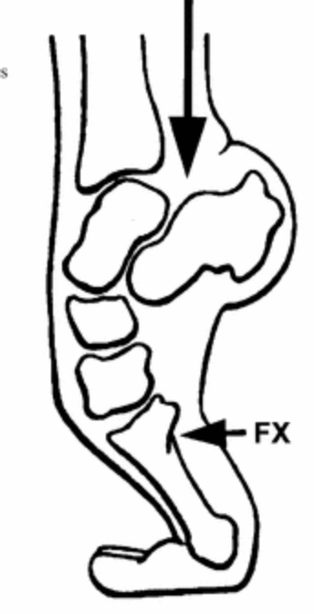

1st Metatarsal Fracture
Compressive axial loading
“Bunk bed” fracture
Notes:
They land on their toes, and the force from the impaction is translated posteriorly resulting in a fracture of the first metatarsal. Very common; often occult but ok because heal without treatment. Because they are typically hairline spiral fxs they are not seen on AP or lat and internal oblique view may demonstrate fx.

Slide 30
1st Metatarsal Buckle Fracture
Compressive axial loading
Radiographs
Undulation of cortex
Hairline spiral fracture
Not seen on AP or lateral
Seen only on internal oblique radiograph
Notes:
On radiographs you will typically see undulation of the cortex. Or a fine spiral fracture, that is usually only seen on the oblique radiograph. Because they are typically hairline spiral fxs they are not seen on AP or lat and internal oblique view may demonstrate fx.

Slide 31
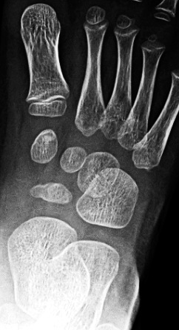
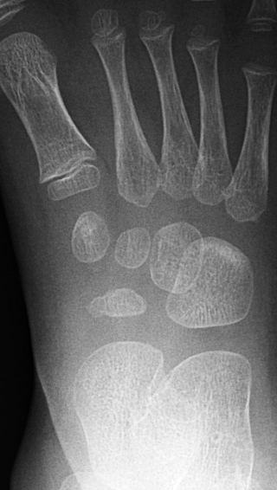
Cuboid Fracture
Second “bunk bed” fx
Same mechanism
Impaction injury of cuboid
Band of sclerosis confirms healing occult fracture
2 weeks later
Notes:
Another type of so called bunkbed fracture a cuboid fracture. The mechanism for the cuboid fracture is the same – its secondary to axial compressive loading.
Usually no fracture line in these cuboid fractures, and they are often not seen at the time of presentation. Here is an example of a cuboid fracture – not seen on the initial radiograph but becoming evident on the follow-up radiograph as a band of sclerosis.

Slide 32
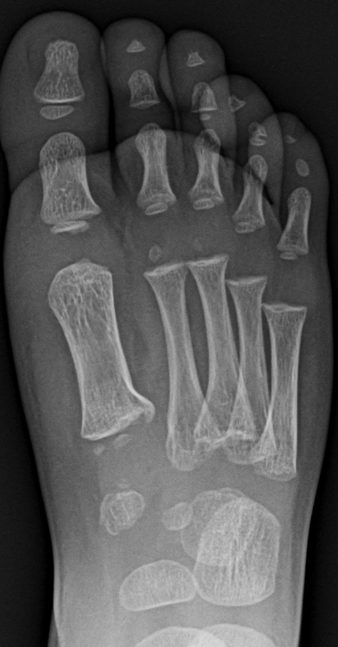
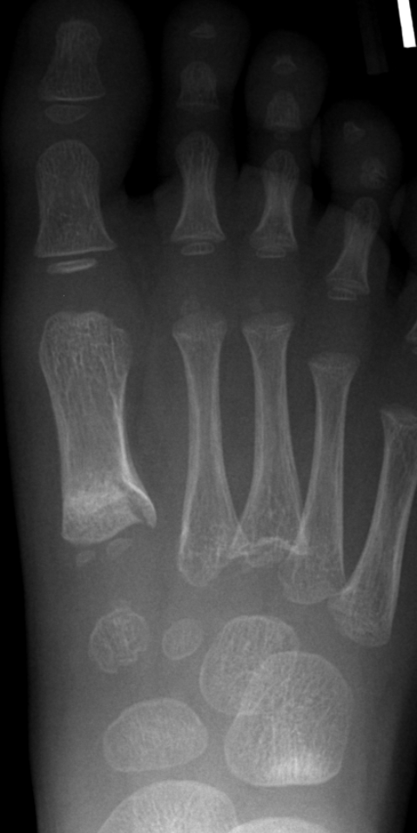
Cuboid Fracture
2 weeks later
Second “bunk bed” fx
Same mechanism
Impaction injury of cuboid
Band of sclerosis confirms healing occult fracture
Notes:
Finally here is a patient with a spiral fracture of the first metatarsal. On a two week follow up we see sclerosis of the first metatarsal consistent with healing. We also see a band of sclerosis in the cuboid proximally, compatible with a healing compression fracutre.

Slide 33
Case 3

Slide 34
Clinical Scenario: 13 year old boy, s/p fall playing soccer. He was kicking a ball and fell back, twisting his right ankle.
Notes:
Next case is a 13 year old boy, s/p fall playing soccer.

Slide 35
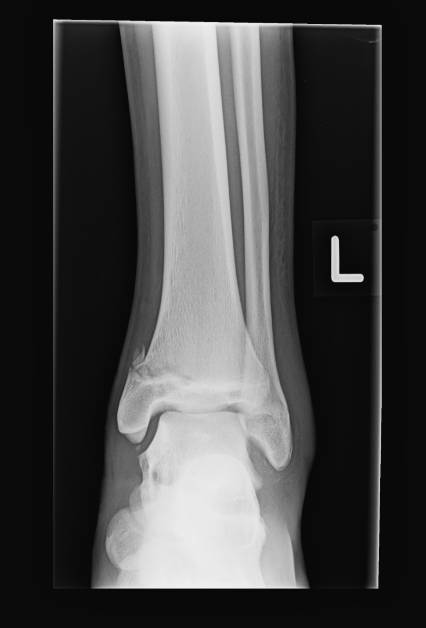
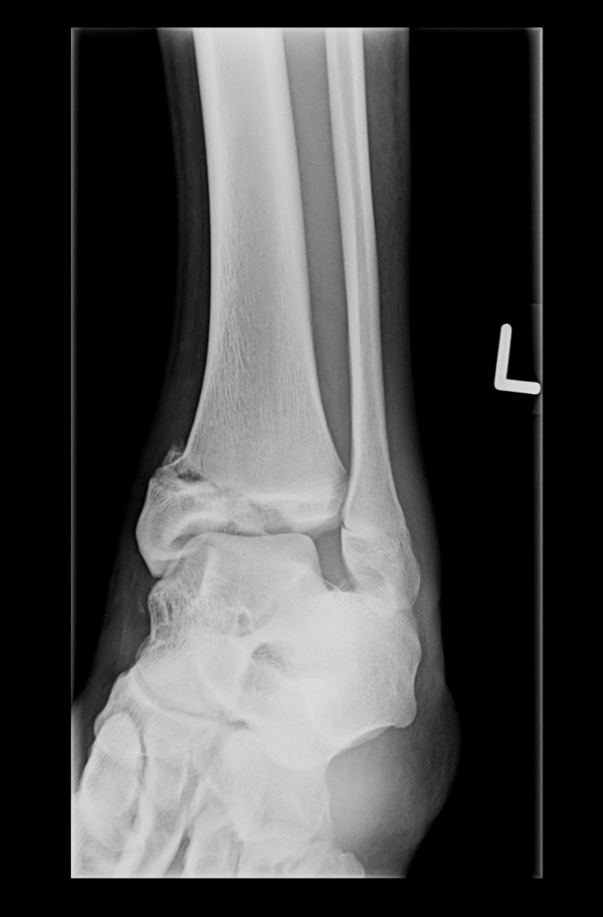
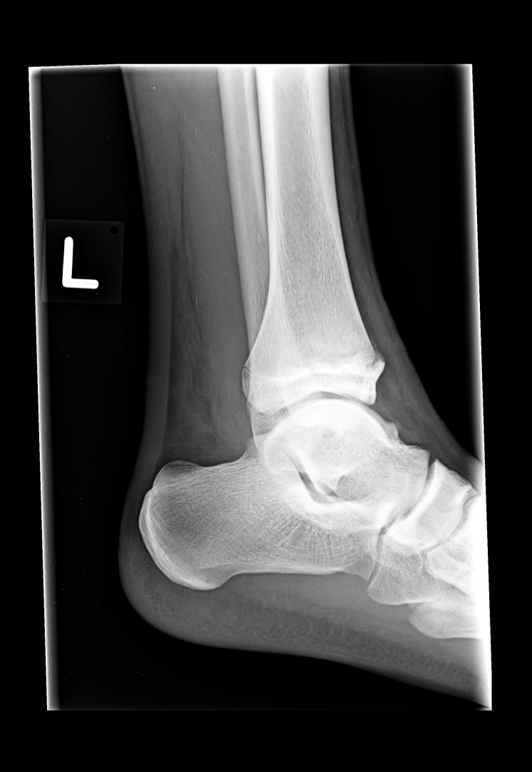
Notes:
And here are his three views of the left ankle.

Slide 36

What is the correct Salter Harris classification of this fracture?
Salter Harris type I
Salter Harris type II
Salter Harris type III
Salter Harris type IV
Notes:
So lets quickly review the Salter Harrris classification.

Slide 37
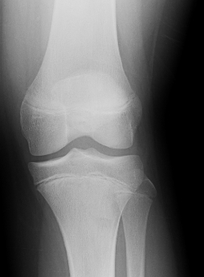
Salter Harris Fractures
Salter I
Fracture through physis
5-7%
Notes:
A Salter I frct

Slide 38
Salter Harris Fractures
Salter II
Fracture through metaphysis and physis
75%
Notes:
These are the most common fractures that we see.

Slide 39
Salter Harris Fractures
Salter III
Fracture through epiphysis and physis
7-10%

Slide 40
Salter Harris Fractures
Salter IV
Fracture through physis
10%

Slide 41
Salter Harris Fractures
Salter V
Fracture through physis
<1%

Slide 42
What is the correct Salter Harris classification of this fracture?
Salter Harris type I
Salter Harris type II
Salter Harris type III
Salter Harris type IV
Notes:
So lets quickly review the Salter Harrris classification.

Slide 44
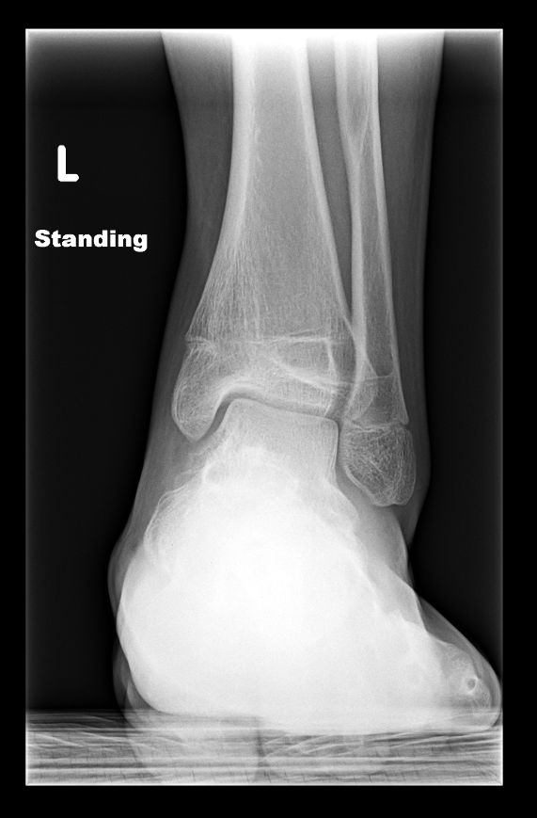
Complications of Physeal Injuries
Premature fusion physis
SH III and IV fractures
Growth disturbance
Abnormal length
Abnormal angulation
Notes:
This is our patient one year later. Although the fracture has healed, we see tethering at the physis known complication of physeal injury is a premature physeal fusion.
Premature physeal is more often seen in Salter III and IV fractures, and it can result is significant growth disturbances, resulting in abnormal leg length and abnormal angulation

Slide 45
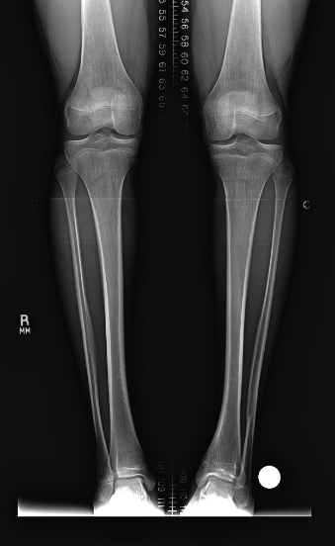
Complications of Physeal Injuries
Premature fusion physis
SH III and IV fractures
Growth disturbance
Abnormal length
Abnormal angulation
Tibiotalar Valgus
Notes:
Radiographs of both extremities show mildl valgus slant of the left, affected ankle

Slide 46
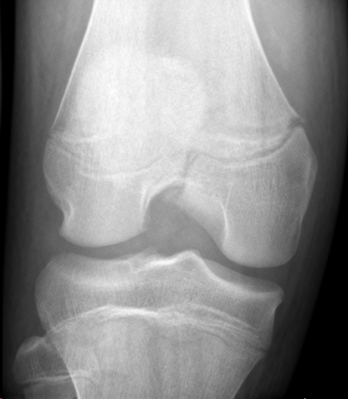
Complications of Physeal Injuries
Premature fusion physis
SH III and IV fractures
Growth disturbance
Abnormal length
Abnormal angulation
Notes:
And heres an example of a Salter IV fracture of the distal femur.

Slide 47
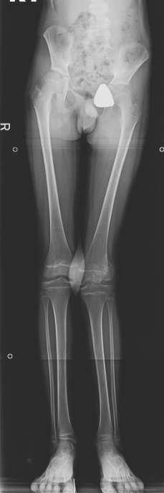
Complications of Physeal Injuries
Premature fusion physis
SH III and IV fractures
Growth disturbance
Abnormal length
Abnormal angulation
Genu valgum and leg length discrepancy
Notes:
And this patient went on to develop left genu valgum and a leg length discrepancy with a pelvis tilt.

Slide 48
Case 4

Slide 49
Clinical Scenario: 9 yo obese female with one month of left hip pain.

Slide 50
The most appropriate next step is:
AP radiograph of the right hip
AP and frog leg view of the right hip
AP and frog leg view of the pelvis
MRI of pelvis

Slide 51
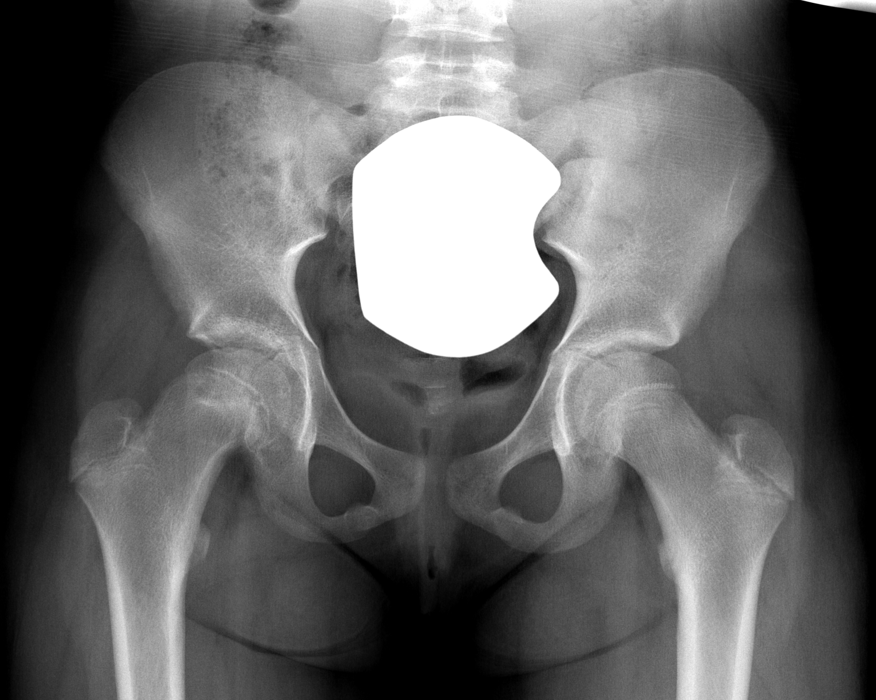
AP
Notes:
On the AP view of the pelvis, there is medial displacement of the right capital femoral epiphysis relative to the left.

Slide 52
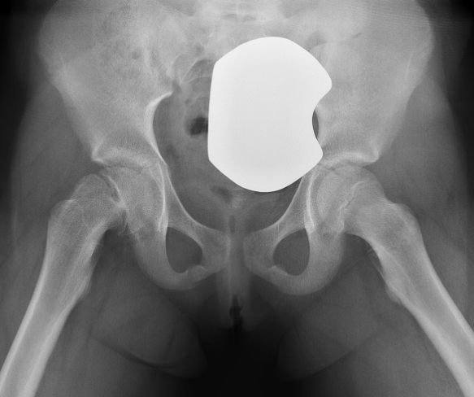
AP
Frog-Leg
Notes:
On the frog leg lateral view of pelvis, there is asymmeterical widening of the right physis relative to the left.

Slide 53
AP
Frog-Leg
Notes:
And the degree of posterior displacement also becomes evidence on the frog leg view.

Slide 54

Right slipped Capital Femoral Epiphysis
AP
AP
Frog-Leg
Notes:
These findings are most consistent with slipped capital femoral epiphysis.

Slide 55
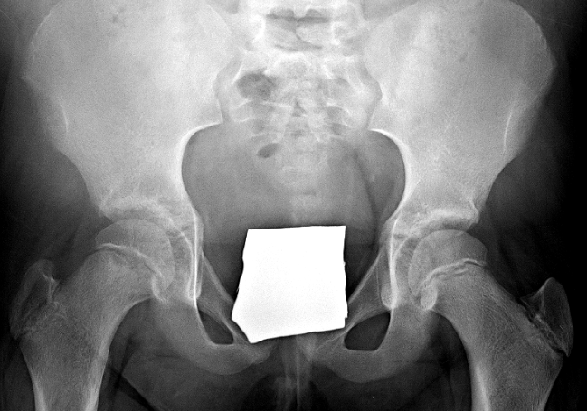
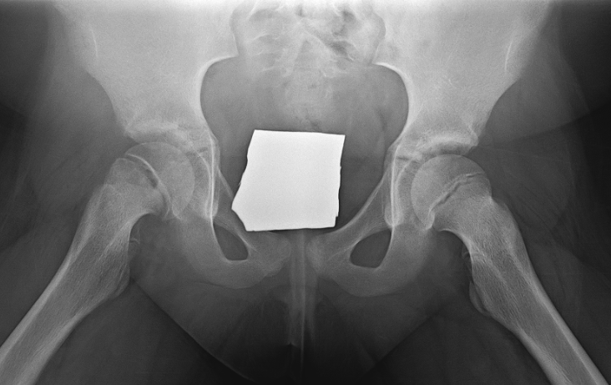
Slipped Capital Femoral Epiphysis
Displacement of epiphysis
posterior
medial
Etiology
Multifactorial
Obesity
Delayed skeletal maturity
Hypothyroidism
hypogonadism
Rickets
AP
Frog-Leg
Notes:
Slipped capital femoral epiphysis is a common disorder in children, usually presenting between ages 10-16, girls earlier than boys. It usually occurs during periods of rapid growth and puberty.
And the etiology is likely multifactorial, a combination of physical chemical factors.
Heres another example of a right slipped capital femoral epiphysis where we see the similar physeal widening, and posterior displacement of the right capital femoral epiphysis.
Goal of treatment to prevent further slip in stable SCFE and prevent complications of AVN and chondrolysis in unstable SCFE

Slide 56
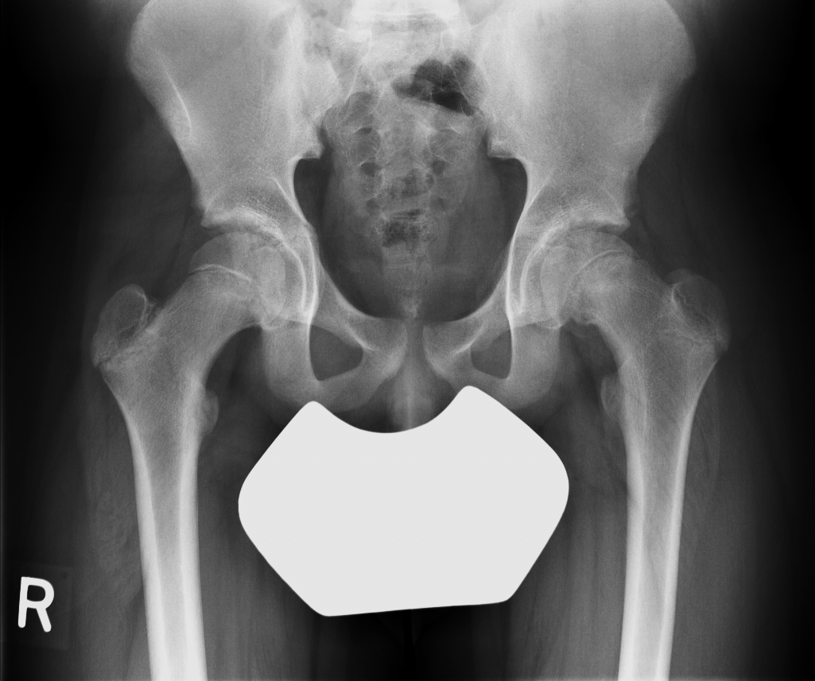
Slipped Capital Femoral Epiphysis
Clinical
Poorly localized hip/groin pain may radiate to knee
Can be bilateral
18-63%
Importance of AP/frog leg both hips and pelvis
AP
AP
Notes:
Patients may present

Slide 57
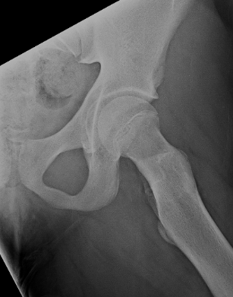
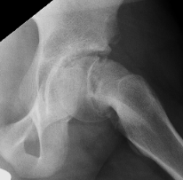
Slipped Capital Femoral Epiphysis
Clinical
Poorly localized hip/groin pain may radiate to knee
Can be bilateral
18-63%
Importance of AP/frog leg both hips and pelvis
Frog-Leg
Frog-Leg
Notes:
Slipped capital femoral epiphysis may present as groin or hip pain radiating to the knee.
This entity can be bilateral, stressing the importance of AP and frog leg views of the boths hips and pelvis.

Slide 58
The most appropriate next step is:
AP radiograph of the right hip
AP and frog leg view of the right hip
AP and frog leg view of the pelvis
MRI of pelvis
Notes:
So back to our quesio

Slide 59
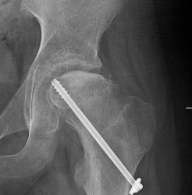
Slipped Capital Femoral Epiphysis
Clinical
Poorly localized hip/groin pain may radiate to knee
Can be bilateral
18-63%
Importance of AP/frog leg both hips and pelvis
Stable (90%) vs Unstable (10%)
Ability to bear weight
Avascular necrosis
AP
Notes:
SCFE can be characterized as unstable or stable, based on a patients abilitiy to bear weight. Unstable SCFE is at a greatest risk for developing AVN.

Slide 60
Slipped Capital Femoral Epiphysis
Clinical
Poorly localized hip/groin pain may radiate to knee
Can be bilateral
18-63%
Importance of AP/frog leg both hips and pelvis
Stable (90%) vs Unstable (10%)
Ability to bear weight
Avascular necrosis
Acute vs chronic
Symptoms <3 weeks
AP
Notes:
Treatment is typically initu pinning, but in severe unstable SCFE there may be an attempt at reduction.

Slide 61
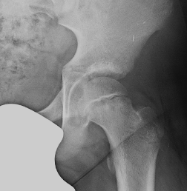
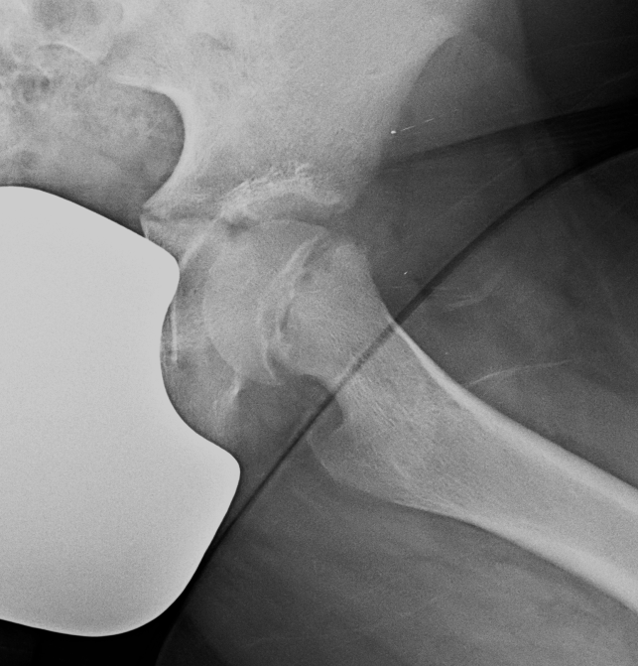
Slipped Capital Femoral Epiphysis
Radiographic findings
Physeal widening
Posterior slip
AP
Frog-Leg
Frog-Leg
Notes:
Radiographic findings again include physeal widening, posterior slippage, best appreciated on the frog leg view,

Slide 62
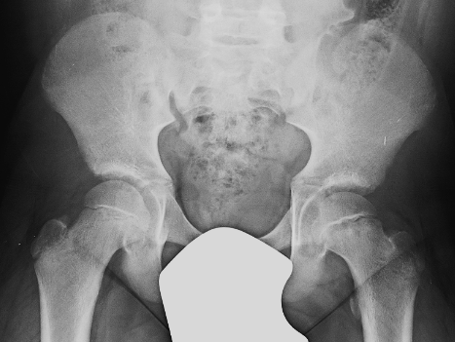
Slipped Capital Femoral Epiphysis
Radiographic findings
Physeal widening
Posterior slip
Klein’s line (AP)
AP
Notes:
WE can also draw Kleins line, which is a line along the lateral aspect of femoral metaphysis and epiphysis. In normal patients this line through the metaphysis should transect the head. If there is a medial slip, as on the left hip in in this case, the line will not intersect the epiphysis.

Slide 63
Slipped Capital Femoral Epiphysis
Radiographic findings
Physeal widening
Posterior slip
Klein’s line (AP)
>2mm ∆ from control hip
Importance of AP/frog leg both hips and pelvis
AP
Notes:
Occasionally, in more subtle cases of medial slippage in SCFE, Kleins line may still intersect the medially slipped epiphsysis. In these cases, it also important to look at the contralateral unaffected side. If the width of epiphysis lateral to Kleins line on the affected side is more than 2mm less than unaffected side, this also suggests medial slippage in SCFE.

Slide 64
Slipped Capital Femoral Epiphysis
Radiographic findings
Physeal widening
Posterior slip
Klein’s line (AP)
>2mm ∆ from control hip
Importance of AP/frog leg both hips and pelvis
Decreased height of epiphysis
AP
Notes:
Radiographs may also show a decreased height of the affects epiphysis due to posterior displacement

Slide 65
Slipped Capital Femoral Epiphysis
Radiographic findings
Physeal widening
Posterior slip
Klein’s line (AP)
>2mm ∆ from control hip
Importance of AP/frog leg both hips and pelvis
Decreased height of epiphysis
Metaphyseal blanch sign
AP
Notes:
And finally, you may see what is known as the metaphyseal blanch sign representing the overlap between the posteriorly slipped epiphysis and the metaphysis.

Slide 66
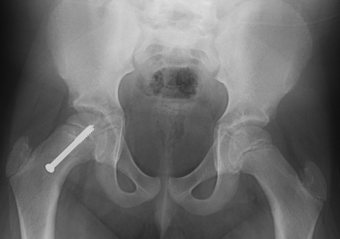
AP
13 yo boy with decreased internal rotation left hip, no pain

Slide 67
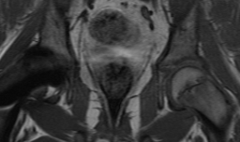
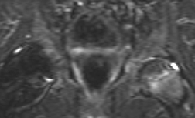
Pre-slip Left SCFE
Clinical
Hip pain with normal radiographs
Subtle findings on physical exam
MRI Findings:
Mild periphyseal edema
Early physeal changes prior to slip

Slide 68
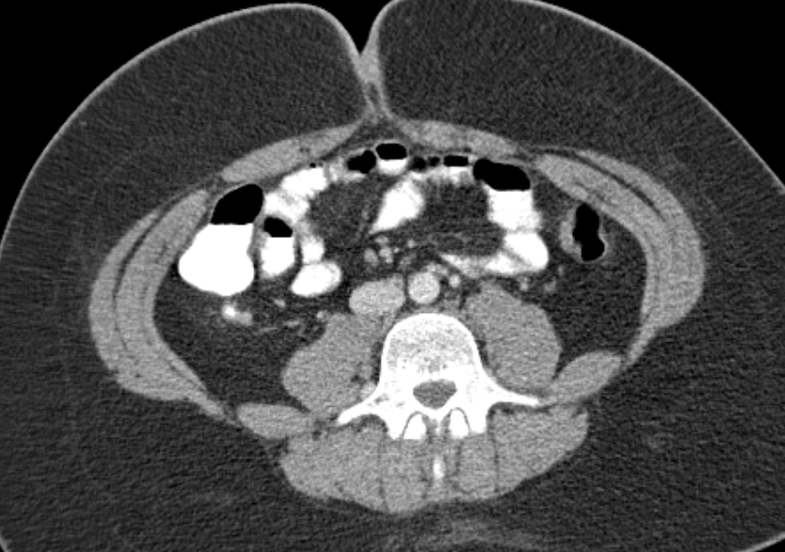


12 yo Rt hip pain, r/o RLQ pathology including mass or appendicitis

Slide 69


12 yo Rt hip pain, r/o RLQ pathology including mass or appendicitis

Slide 70
Case 5

Slide 71
Clinical Scenario: 9 yo female with back pain for 2 weeks. Two months of left wrist pain and swelling.

Slide 72


PA
Lateral

Slide 73

Normal
Demineralization

Slide 74

Multiple vertebral compression fractures
Normal

Slide 75
Compression fractures
Trauma
Steroids
Osteogenesis imperfecta
Leukemia/lymphoma
LCH
Metastasis
Multiple vertebral compression fractures

Slide 76
Her mom reports no history of an underlying medical condition. There is no history or trauma. She does not take any medications.

Slide 77
Leukemia
Musculoskeletal symptoms
20-50% pts
Sinigaglia et al (2008)
Pain
Functional impairment
Limping
Swelling
Joint effusion

Slide 78


Leukemia
Musculoskeletal symptoms
20-50% pts
Radiographic manifestations
Generalized osteopenia
Metaphyseal lucent band
Periosteal reaction
Osteosclerosis
Osteolysis
Pathologic fracture
Permeative bone lesion

Slide 79
The most common osseous manifestation of leukemia is:
Pathologic fractures
Metaphyseal lucent bands
Osteoporosis
Lytic lesion

Slide 80
The most common osseous manifestation of leukemia is:
Pathologic fractures
Metaphyseal lucent bands
Osteoporosis
Lytic lesion

Slide 81
Case 6

Slide 82
Clinical Scenario: 1 month old male presenting with cough.

Slide 83


Slide 84
What is the next best step:
Tc-99m bone scan
Discharge home with supportive care
Skeletal survey
Admit for IV antibiotics

Slide 85
Healing posterior rib fractures

Slide 86


Slide 87
Child abuse – rib fractures
One of most common and specific injuries in abused childnre; PPV up to 95% in children < 3yo
No known association with birth trauma
Other high specificity for abuse fractures:
Classic metaphyseal lesion, aka corner/bucket handle fx
“S” fractures: sternum, spinous process, scapula
https://radiologyassistant.com

Slide 88
Case 7

Slide 89
Clinical Scenario: 13 yo female presenting with right knee pain, swelling, and ecchymosis after twisting her knee while jumping rope. She cannot actively extend her knee.

Slide 90
What is the next best step?
Radiographs of the left knee
MRI of the left knee
Ultrasound of the left knee
CT of the left knee

Slide 91

ACR Appropriateness Criteria: Acute Knee Pain

Slide 92
What is the next best step?
Radiographs of the left knee
MRI of the left knee
Ultrasound of the left knee
CT of the left knee

Slide 93


AP
Lateral

Slide 94

Normal

Slide 95

Tibial Tuberosity Avulsion
Adolescents approaching skeletal maturity
14-17yrs of age
Mechanism
Vigorous quadriceps contraction
Jumping sports
17 yo boy w/ injury following a jump while playing basketball

Slide 96

Tibial Tuberosity Avulsion
Quadriceps tendon
Adolescents approaching skeletal maturity
14-17yrs of age
Mechanism
Vigorous quadriceps contraction
Jumping sports
Patella
Patellar tendon
Tibial tubercle

Slide 97

Tibial Tuberosity Avulsion
Adolescents approaching skeletal maturity
14-17yrs of age
Mechanism
Vigorous quadriceps contraction
Jumping sports
Treatment
Displacement
Comminution
Intra-articular extension
Shital N. Parikh et al. J Bone Joint Surg Am 2010;92:2947-2958

Slide 98

Non displaced avulsion fracture?

Slide 99

Normal variant

Slide 100


4 Stages of Development of the Tibial Tubercle
Cartilaginous
Girls: < 8yrs
Boys: <9yrs

Slide 101

4 Stages of Development of the Tibial Tubercle
Apophyseal
Girls: 8-12yrs
Boys: 9-14yrs

Slide 102

4 Stages of Development of the Tibial Tubercle
Epiphyseal
Girls: 10-15yrs
Boys: 11-17yrs

Slide 103

4 Stages of Development of the Tibial Tubercle
Bony
Girls: 15yrs
Boys: 17yrs

Slide 104

Osgood Schlatter Disease
Common cause of anterior knee pain
Overuse injury
repetitive traction of the patellar tendon upon the tibial tubercle
Age 10-15
30% bilateral

Slide 105
Osgood Schlatter Disease
Radiographic findings
13 year old female volleyball player with knee pain

Slide 106
How you can drive change:
In a limping toddler with non-localizable symptoms, obtain radiographs of the tibia/fibula prior to obtaining other films.
In the setting of elbow trauma, consider ordering an internal oblique radiographs of the elbow for diagnosis of lateral condylar fracture and displacement of lateral condylar fracture
If there is concern for slipped capital femoral epiphysis, obtain an AP and frog leg view of the pelvis.

Slide 107

Session Evaluation
Your feedback is valuable, take a moment to complete the survey for this session.
To claim CME, you must complete a separate survey available after the convention.

Slide 108
References
Milla S, Coley BD, Karmazyn B et al ACR Appropriateness Criteria® Limping Child – Ages 0-5. Available at http://www.acr.org/Quality-Safety/Appropriateness-Criteria. American College of Radiology. Accessed August 31, 2015
Baron CM, Seekins J, Hernanz-Schulman M, Yu C, Kan JH. Utility of total lower extremity radiography investigation of nonweight bearing in the young child. Pediatrics. 2008;121(4):e817-820
John SD, Moorthy CS, Swischuk LE. Expanding the concept of the toddler's fracture. Radiographics. 1997;17(2):367-376
Iyer RS, Thapa MM, Khanna PC, Chew FS. Pediatric bone imaging: imaging elbow trauma in children--a review of acute and chronic injuries. AJR Am J Roentgenol. 2012 May;198(5):1053-68
Jacoby SM, Herman MJ, Morrison WB, Osterman AL. Pediatric elbow trauma: an orthopaedic perspective on the importance of radiographic interpretation. Semin Musculoskelet Radiol 2007; 11(1): 048-056

