Slide 1

Pediatric X-ray Zebras Crazy cases from the Archives
Mark Bittman, MD

Slide 2
Financial Disclosures
I have no financial disclosures

Slide 3
Objectives
Recognize uncommonly encountered imaging findings in pediatric patients
Understand the imaging work up of several rare diseases
Be aware of some imaging pitfalls when imaging pediatric patients in children in the urgent care setting
Case based, interactive format

Slide 4
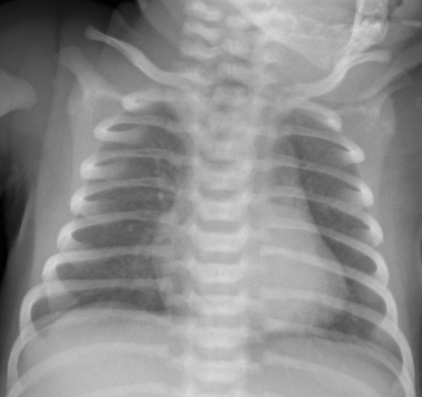
CASE 1
1 yo with fever and cough

Slide 5
Next appropriate step in management?
A. Supportive management for viral pneumonia
B. Antibiotic therapy for left lower lobe pneumonia
C. Cross sectional imaging (CT or MRI)
D. Skeletal survey for child abuse work up

Slide 6
? Bronchiolitis with LLL atelectasis or pneumonia

Slide 7
Next appropriate step in management?
A. Supportive management for viral pneumonia
B. Antibiotic therapy for left lower lobe pneumonia
C. Cross sectional imaging (CT or MRI)
D. Skeletal survey for child abuse work up

Slide 8
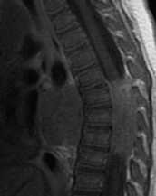
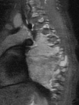
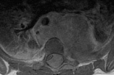
3 months later presents with signs of spinal cord compression
*
*
Thoracic neuroblastoma with intraspinal extension (*)

Slide 9
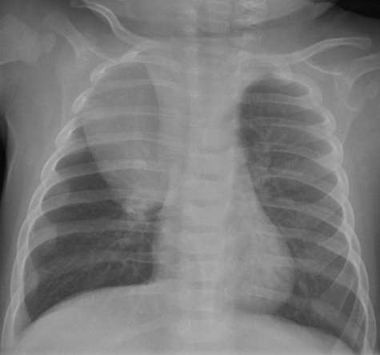
Companion case: Thoracic Neuroblastoma
Posterior mediastinal mass
Sympathetic chain and nerve sheath tumors
Neuroblastoma most common
Children < 2 yrs
10-16% neuroblastoma occurs in thoracic region
May mimic pneumonia or sequestration
Air trapping due to extrinsic bronchial compression

Slide 10
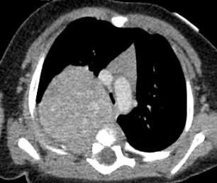
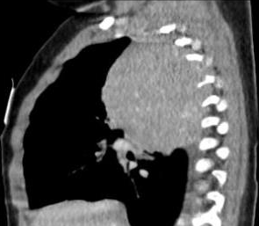
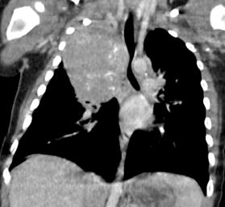
Thoracic Neuroblastoma
MRI
Best to assess intraspinal extension
CT
Variable enhancing mass
40% with speckled or curvilinear Ca++

Slide 11
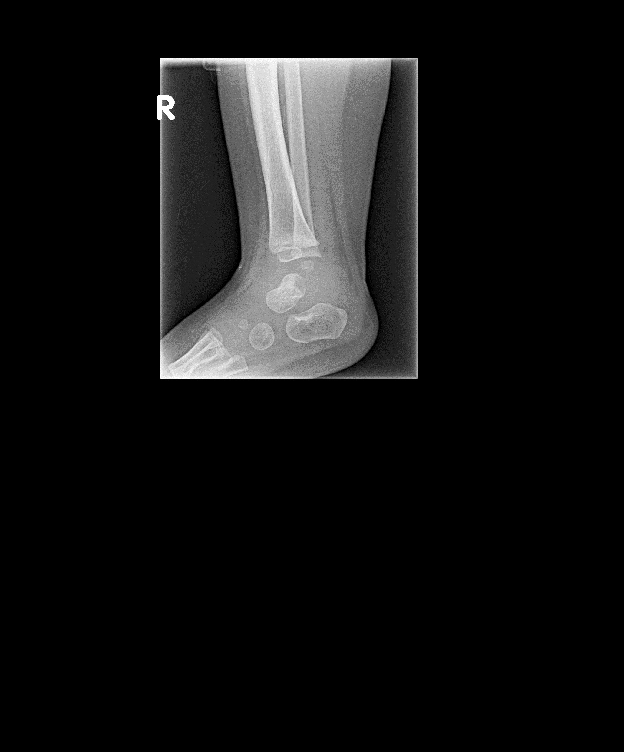
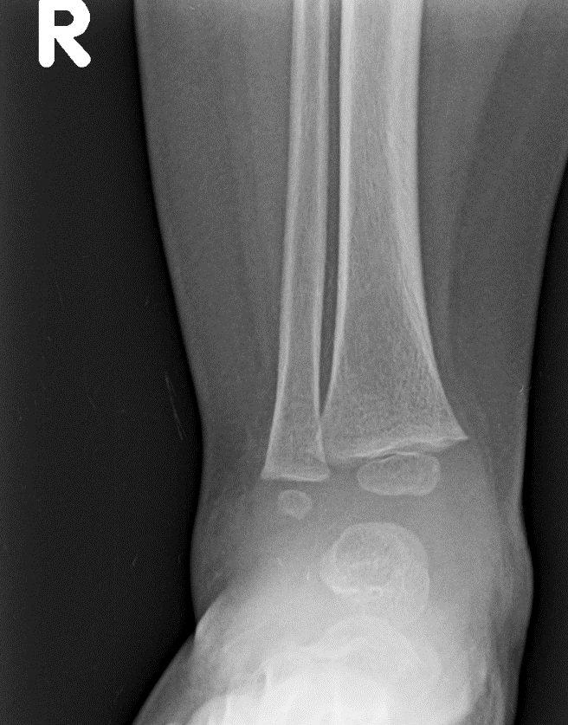
CASE 2
1 yo with lateral ankle swelling for 3 weeks

Slide 12
Which bone is abnormal?
A. Tibia
B. Fibula
C. Talus
D. Navicular
E. Cuboid

Slide 13
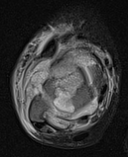
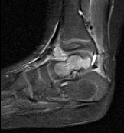

Slide 14
Which bone is abnormal?
A. Tibia
B. Fibula
C. Talus
D. Navicular
E. Cuboid

Slide 15
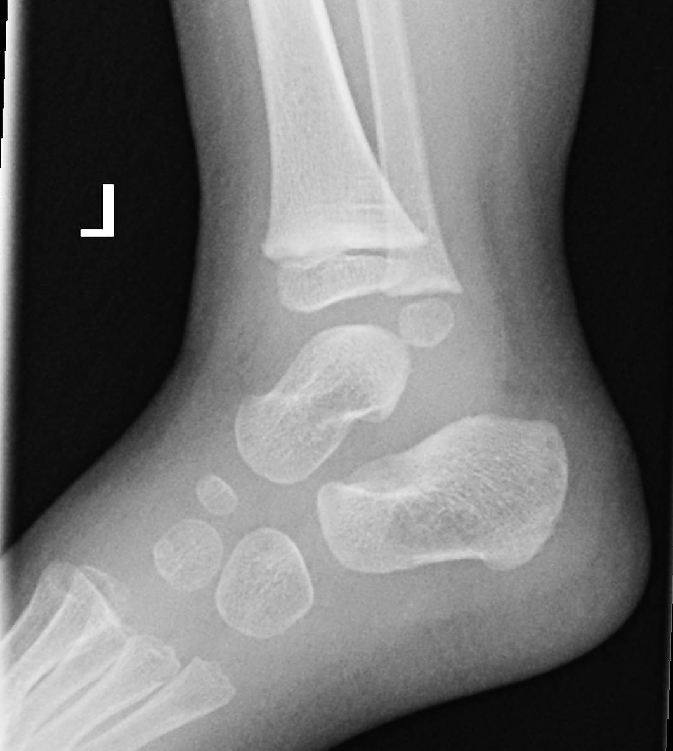

Slide 16

Epiphyseal osteomyelitis
Tarsal bones are “epiphyseal equivalents”
End of bone lesion Ddx: Chondroblastoma, osteomyelitis, Langerhans Cell Histiocytosis, Osteochondral defect (OCD)
Epiphyseal osteomyeltitis: Metaphyseal location is most common site of osteomyelitis in children due to terminal vascular configuration
Young children have vessels crossing physis; they may develop osteomyelitis in epiphysis or both locations

Slide 17
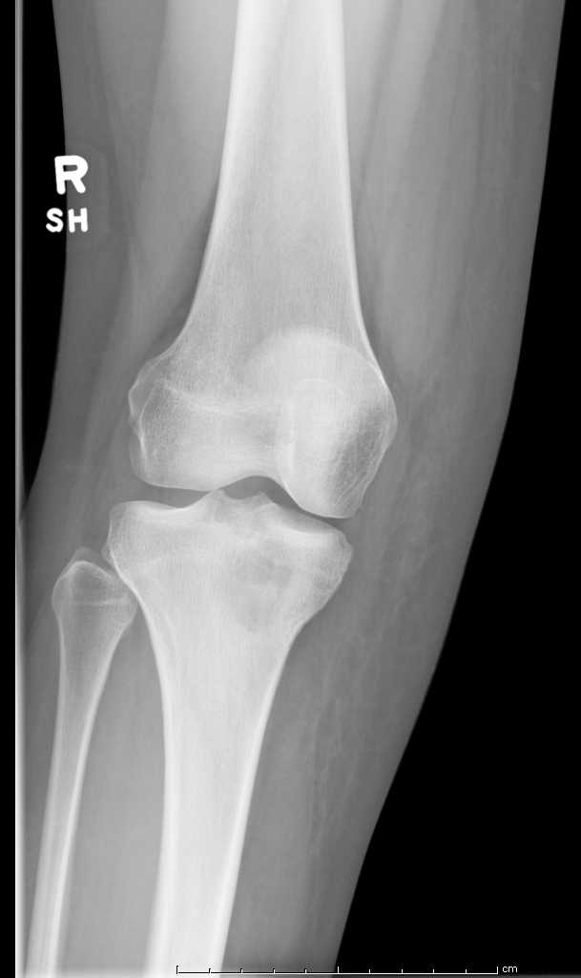
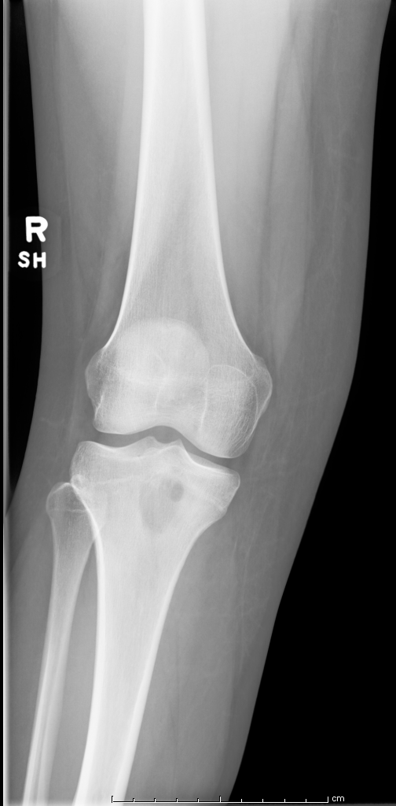
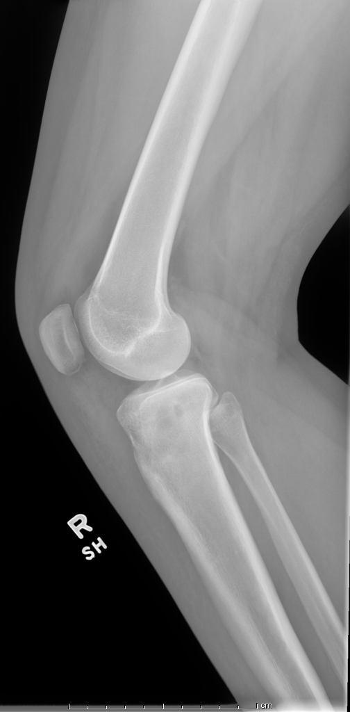
Companion case: metaphyseal osteomyelitis, Brodies abscess

Slide 18
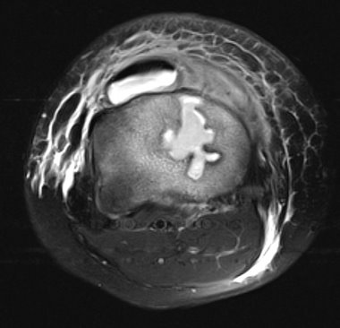
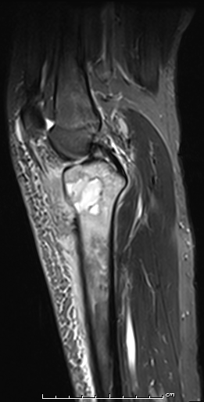
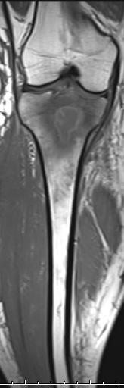
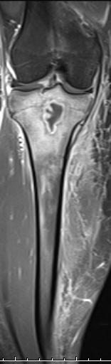
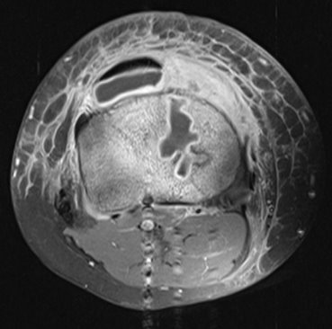

Slide 19
Osteomyelitis, brodies abscess
Geographic, lucent lesion, non sclerotic margins
Metaphyseal, juxta physeal location
Tx: surgical debridement and Abx
Goal: avoid leg length discrepancy

Slide 20
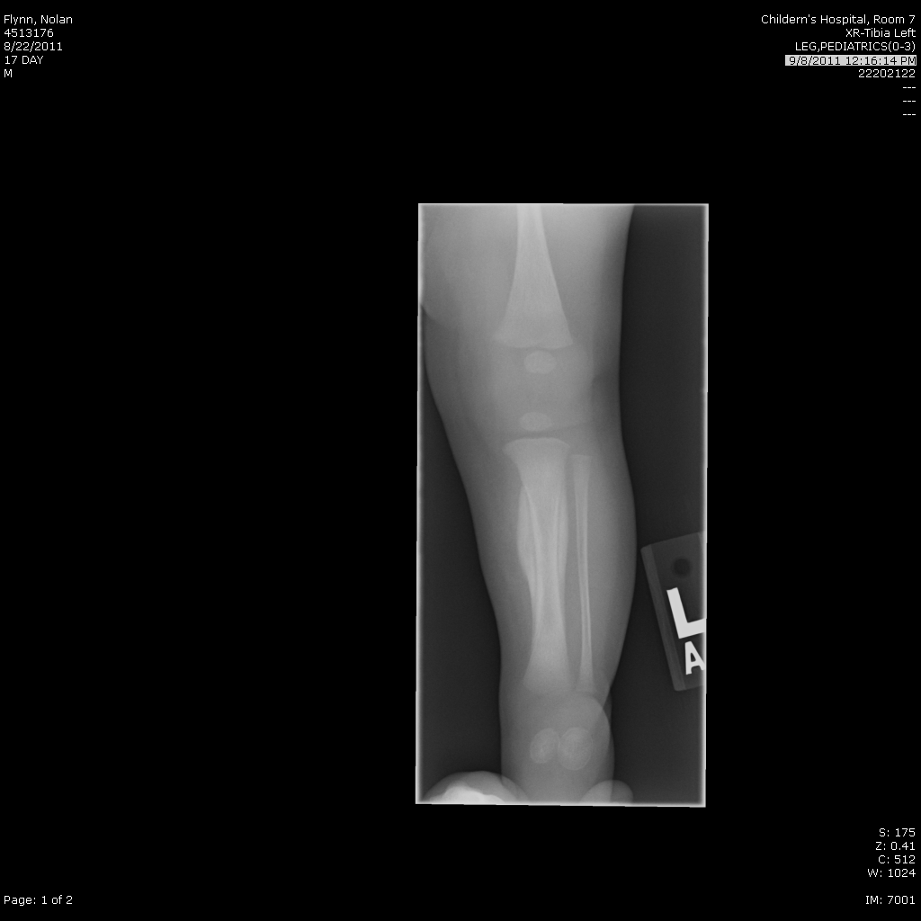
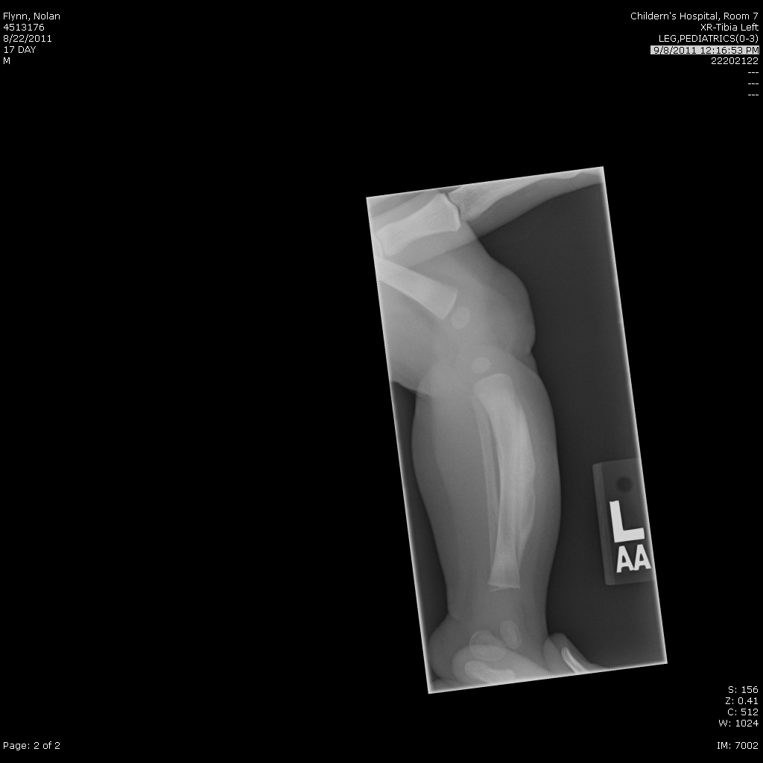
Infant with fever and irritability
CASE 3

Slide 21
The type of periosteal reaction is:
A. Benign
B. Aggressive

Slide 22
The type of periosteal reaction is:
A. Benign
B. Aggressive

Slide 23
Caffey’s = infantile cortical hyperostosis
1945 by Caffey
DeToni-Caffey
Average age = 9 weeks, almost always < 6 months
Self-limiting condition, lasting 2 weeks – 3 months
Irritability, soft tissue swelling, fever
Laboratory: mild leukocytosis, elevated estimated sedimentation rate (ESR), and alkaline phosphatase
Familial and sporadic forms
Autosomal dominant with variable penetrance
Mutations in type 1 collagen (COL1A1 gene)
Mandible (75%), clavicle and ulna most common locations

Slide 24
Caffey’s Disease
DDx for periosteal reaction:
P: physiologic, prostaglandin
E: EG/LCH
R: Rickets
I: Infantile cortical hyperostosis = Caffey’s
O: Osteomyelitis
S: Sickle cell
T: Trauma
E: Ewings sarcoma
A: Hypervitaminosis A
L: Leukemia
SOCKS: Syphilis, osteosarcoma, child abuse, kinky hair, scurvy

Slide 25
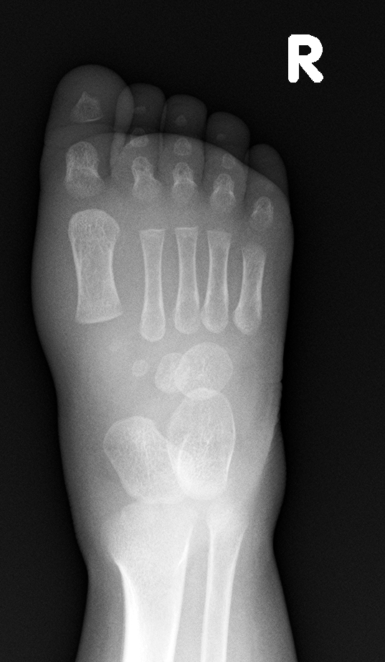
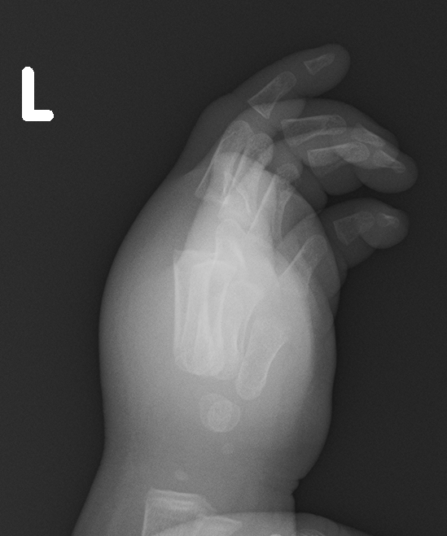
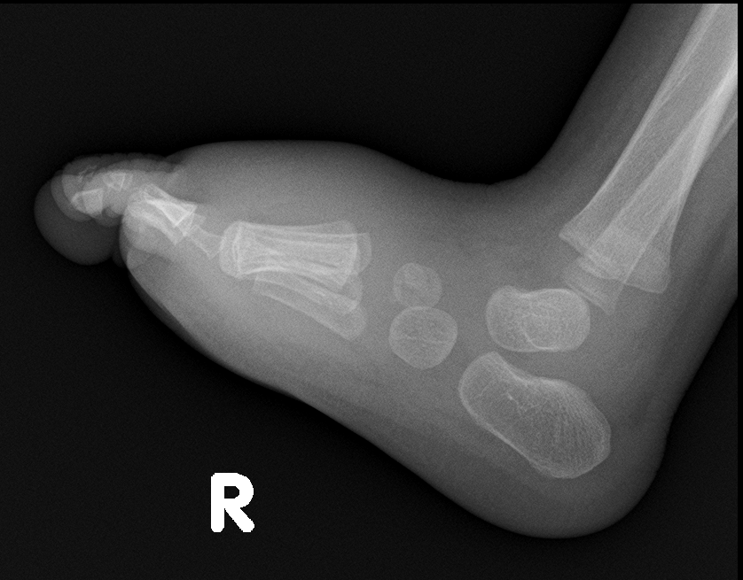
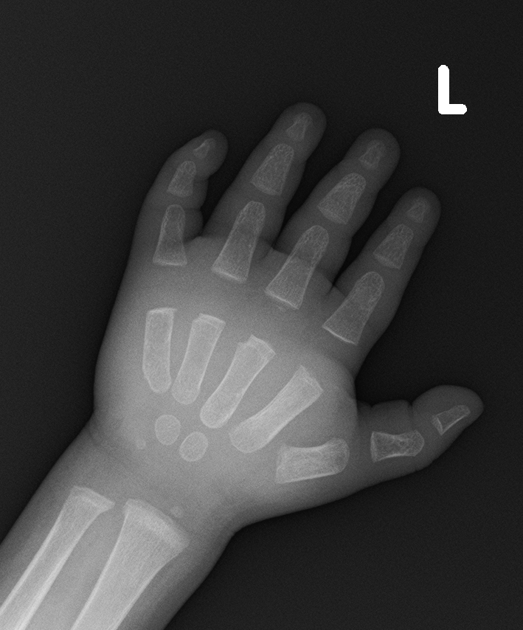
CASE 4
9 month old male with fever, Left hand & Right foot swelling, concern for osteomyelitis

Slide 26
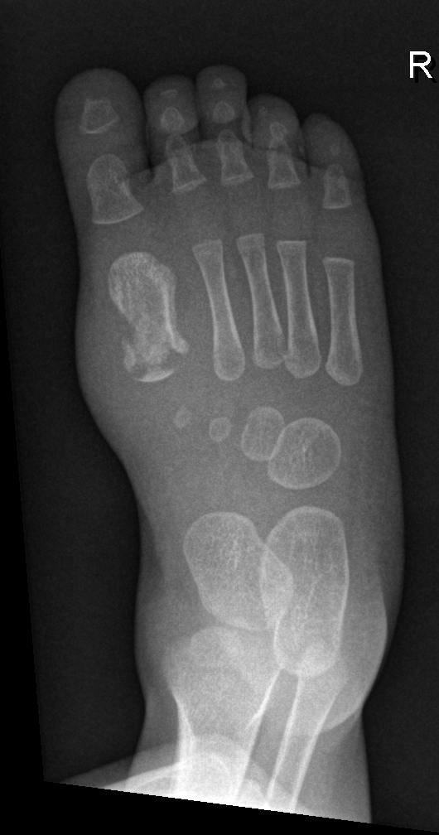
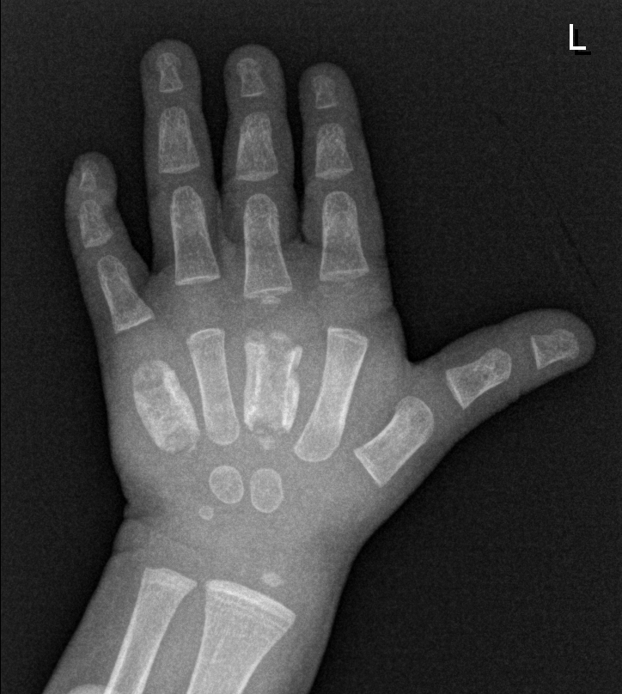
4 weeks later
Notes:
9/28

Slide 27
Sickle Cell Dactylitis
AKA Hand Foot Syndrome
Due to marrow infarction of red marrow
Infants and young children
most common 6 months – 2 years
Acute onset of symmetric hand and foot swelling, +/- fever
XR: changes seen 7-10 days after onset of symptoms
Cortical thinning, bone destruction.

Slide 28
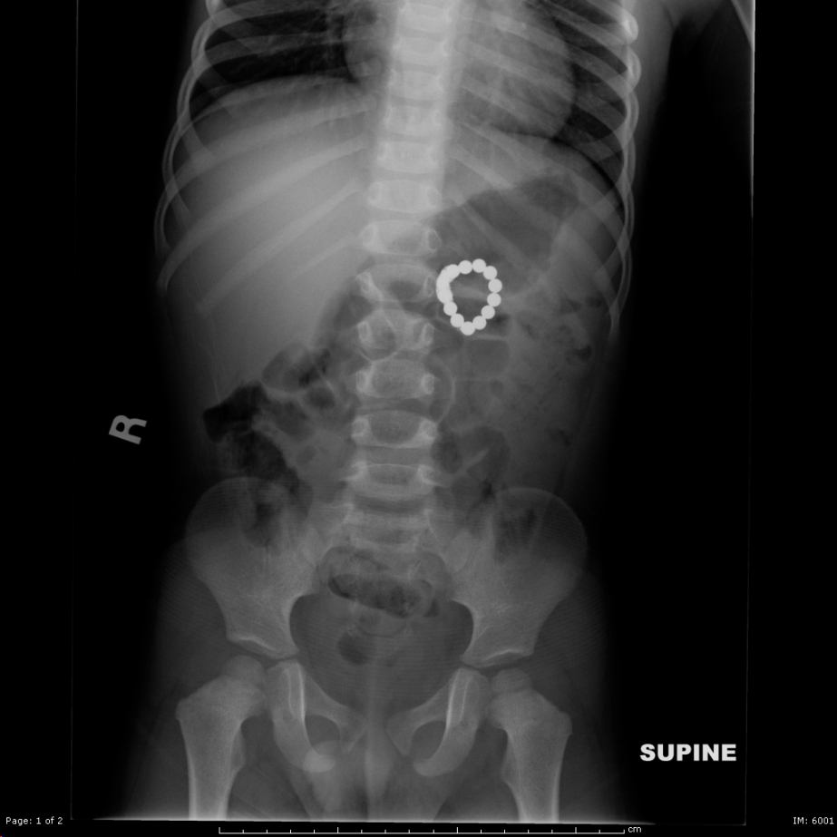
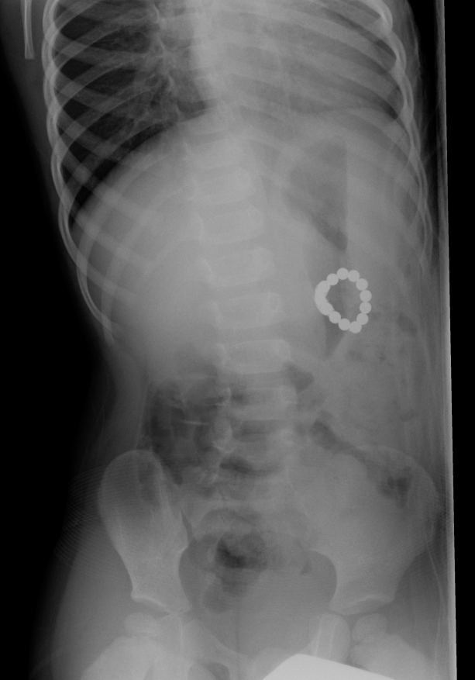
CASE 5
Foreign Body Ingestion

Slide 29
The foreign body represents:
Bracelet
B. Batteries
C. Magnets
D. Legos

Slide 30
The foreign body represents:
Bracelet
B. Batteries
C. Magnets
D. Legos

Slide 31
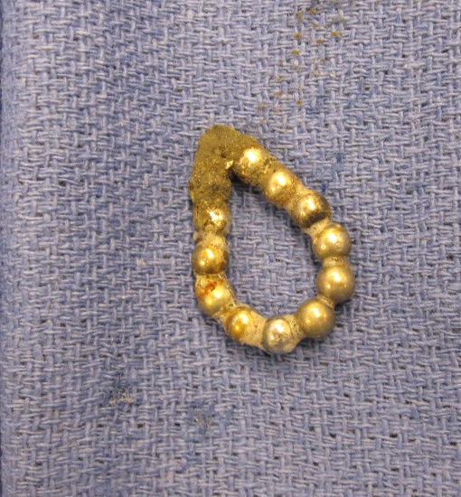
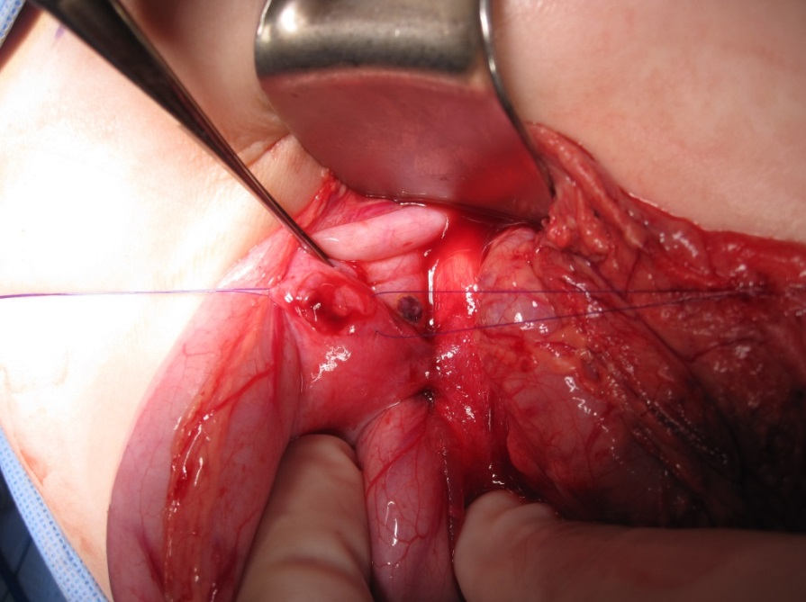
Ingestion of magnet foreign bodies → multiple bowel perforations
Ingestion of multiple magnets is an ominous scenario
Located in different bowel loops, attract each other → pressure necrosis → bowel perforation.
Notes:
Morbiditiy of FB ingestion is low <1%, when cpmplications do occur there is a high mortality rate with approximate 1500 deaths/year. Magnets are attracted across bowel walls. Ingestion is frequently unwitnessed and swallowed objects unknown, therefore radiologists should be aware of the potential presentation.
Exploratory laparotomy
Repair of gastric perforation
Repair of duodenal perforation
Repair of small intestine perforation
Retrieval of magnets using fluoroscopic guidance

Slide 32
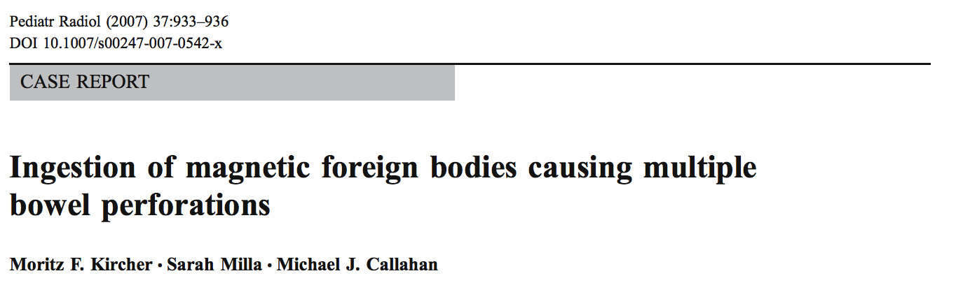
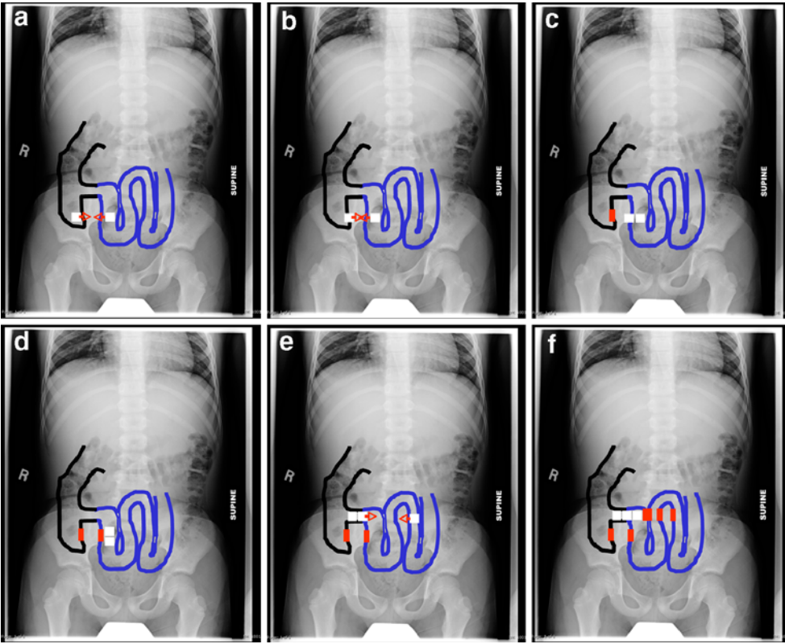
Notes:
Can attach across bowel wall, resulting in ischemic necrosis
Bowel perforation, obstruction and volvulus have been reported

Slide 33
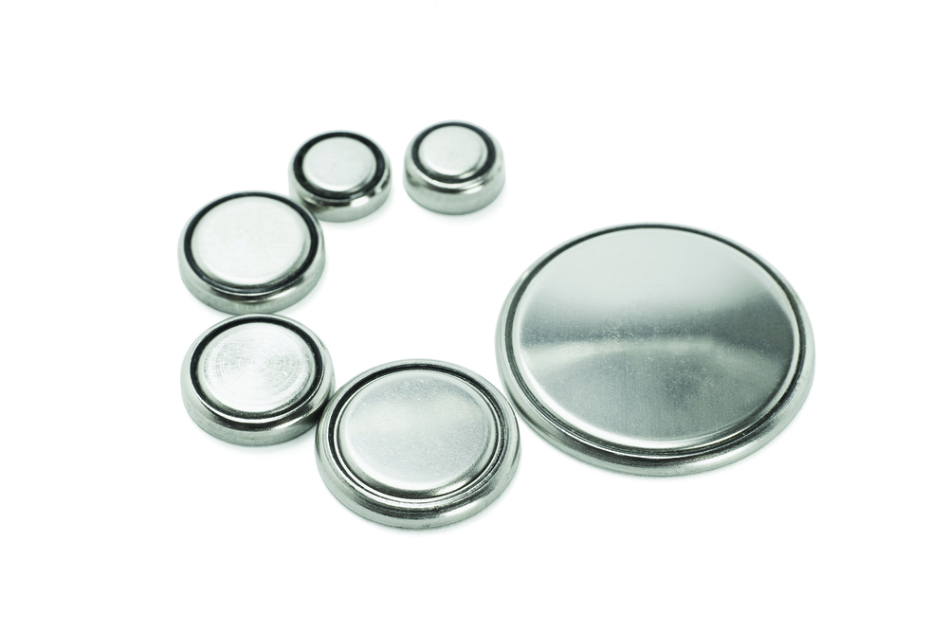
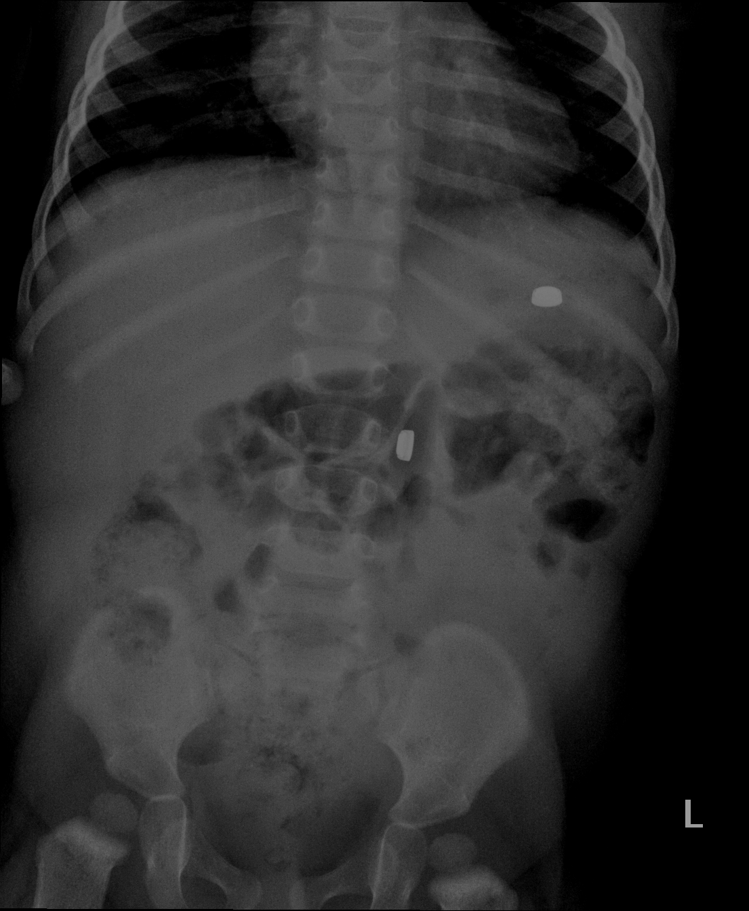
Companion case: 10 month old with foreign body ingestion

Slide 34
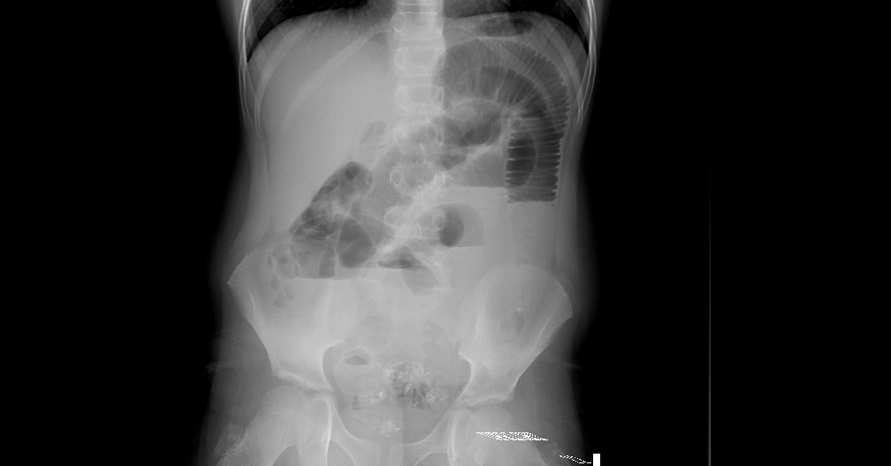
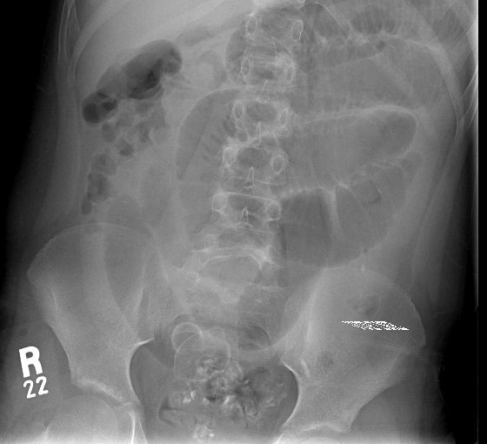
Companion case: 9 year old autistic male with emesis

Slide 35
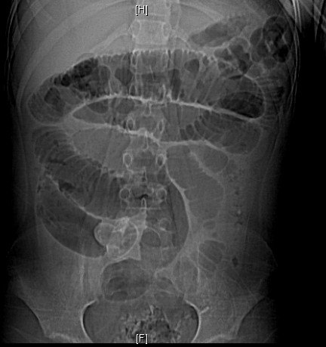
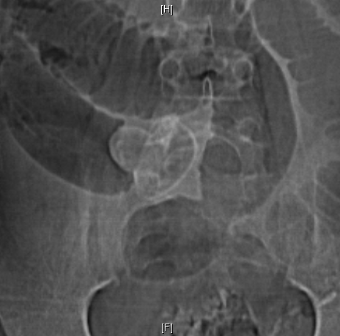
Companion case, 9 y/o autistic male with emesis
Notes:
9 yo autistic male with emesis

Slide 36
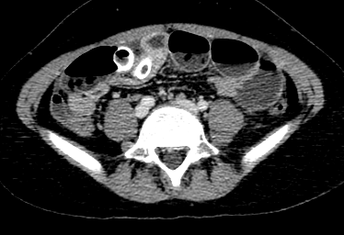
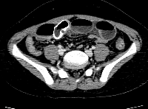


Slide 38
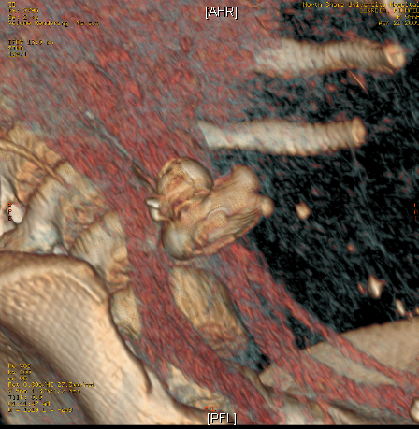
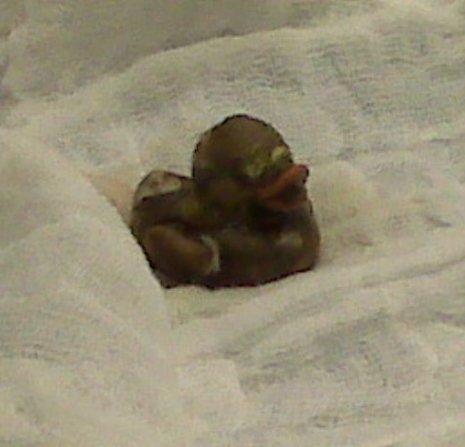
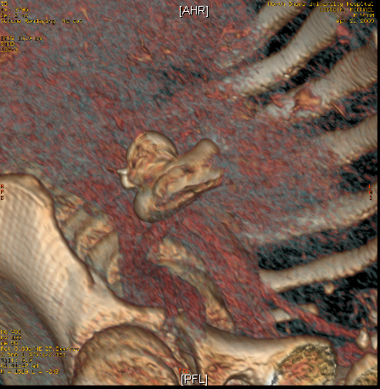

Slide 39
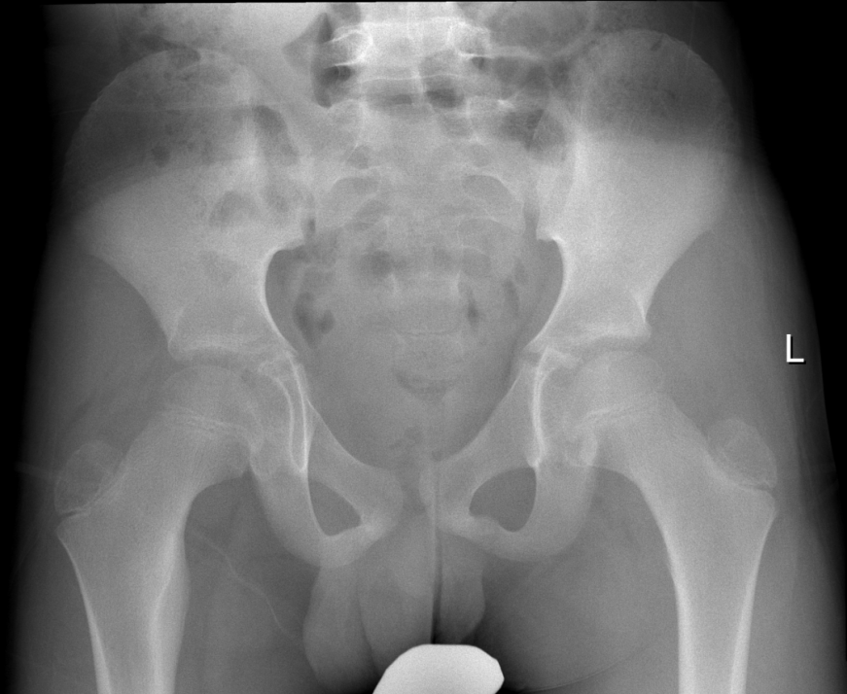
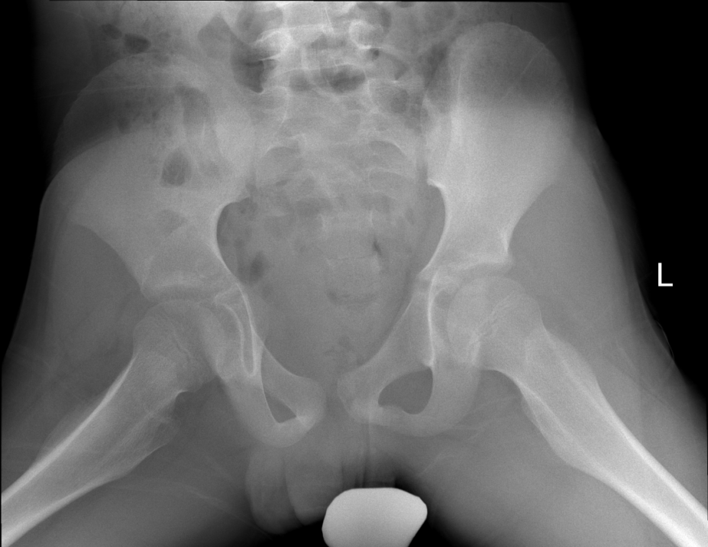
CASE 6
11 yo M with right hip pain

Slide 40
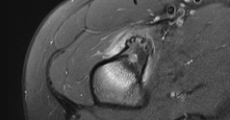
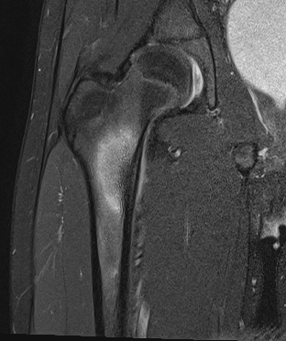


11 yo M with right hip pain

Slide 41
Osteoid Osteoma
First described in 1953, most common benign bone producing tumor
Typically small, <1cm
Nidus composed of osteoid within a vascular stroma, central mineralization
Males > females, 2-3:1
Pain, predominant at night, relieved by NSAIDS
Notes:
Pain due to the nerve endings in the tumor and the prostaglandins

Slide 42
Osteoid Osteoma Imaging Appearance
Long bones most common, spinal 10%
Cortically based diaphyseal, metaphyseal
Intramedullary, subperiosteal, epiphyseal
Increased vascularization and osteogenesis dictate its imaging appearance
XR: Small round/ovoid lucent nidus, oblong thickening of a single cortex, nidus may be occult
Bone scan: double density sign, intense uptake with surrounding halo
CT: Well-defined round or oval lucent nidus with +/- central mineralization, surrounding sclerosis, vascular grooves
MR: Sometimes fails to depict the nidus; intermediate SI on T1WI, variable T2, surrounding edema
Notes:
Intra articular OO may mimi inflammatory arthritis, growth disturbance of near growth plate, spinal can cause painful scoliosis

Slide 43


Treatment: CT guided Radiofrequency ablation

Slide 44


CASE 8
11 F with left hit pain and limp since injury 2 months ago

Slide 45
Valgus SCFE
Rare
Superolateral
Increased lateral extension of the epiphysis past Klein’s line
Underlying coxa valga
Notes:
AP suble decrease height, Kleins line misleading as there is increased lateral extension of the epiphysis last Klein’s line. Akaylah is a 11 y.o. F, accompanied by grandmother. The family's primary concern today relates to left hip pain that has been occurring for 2 months. Patient was on a school trip and and twisted left ankle and then 1 week after trip she developed left hip pain. Currently left hip is no longer painful. Grandmother reports that 1 week ago she noticed patient with a limp on the left.

Slide 46

Companion case: 10 year old Tanzanian boy hit by brother one year ago

Slide 47

Coxa Vara
Decreased neck-shaft angle
<120 degrees
Congenital or acquired
Bilateral in up to 50%
? Abnl medial physeal cartilage
Increased lateral growth
Vertical physis
Triangular inferomedial fragment
Surgical treatment

Slide 48



CASE 8
9 year old male with elbow pain and limited ROM

Slide 49

3 Years Prior
Notes:
Three years ago

Slide 50

Fishtail Deformity
Post-traumatic growth arrest/avascular necrosis of the lateral trochlea, resulting in abnormal development
Trochlear ossification center has a tenuous blood supply
Can be partial or total involvement-Type A involve lateral aspect of trochlea, Type B involvement of entire trochlea (Beaty and Kasser)
Clinically manifests several years (2-7, avg 5 years) after a distal humerus fracture
Most commonly status post supracondylar fractures
Kimball JP, Glowczewskie F, Wright TW (2007) Intraosseous blood
supply to the distal humerus. J Hand Surg [Am] 32:642–646

Slide 51

Fishtail Elbow
Limited flexion and extension
Chevron/Fishtail sign on radiographs
Subject to osteoarthritis, loose bodies, cubitus valgus deformity, proximal migration of the ulna, radial subluxation
Treatment
Variable
Conservative
Debridement with removal of loose bodies, capsulotomy, epiphysiodesis, osteotomy, ulnar nerve transposition, arthroplasty, grafting

Slide 52


Slide 53


Case 9
Adolescent male with thumb pain
Notes:
ewings

Slide 54
Ewing’s sarcoma
Aggressive, small round blue cell tumor
Central diaphyseal ill-defined lucent lesion
Permeative, moth-eaten
Aggressive periosteal reaction
Sunburst, hair-on-end, Codman triangle, onion skinning
Any bone

Slide 55

11 yo M with weakness and pain
Case 10
Notes:
Tumor-induced osteomalacia (TIO) is a paraneoplastic syndrome resulting in renal phosphate wasting and decreased bone mineralization. TIO is usually induced by small, slowly growing tumors of mesenchymal origin (phosphaturic mesenchymal tumor mixed connective tissue variant [PMTMCT]). Nonspecific symptoms including fatigue, bone pain, and musculoskeletal weakness make the diagnosis elusive and often lead to a delay in treatment. The prognosis of TIO is excellent following complete resection of the neoplasm, which leads to the rapid and complete reversal of all symptoms. If the tumor cannot be detected, treatment relies on supplementation with phosphate and active vitamin D compounds. Subsequent radiotherapy in case of incompletely resected tumors or definitive radiotherapy in unresectable tumors is an important treatment option to avoid recurrence or metastasis even though this occurs rarely. Due to the risk of recurrence or late metastases, long-term monitoring is required even in TIO patients diagnosed with a benign tumor.

Slide 56




Slide 57



Slide 58
Tumor-induced osteomalacia (oncogenic rickets)
Paraneoplastic syndrome resulting in phosphate wasting
Phosphaturic mesenchymal tumor
Tx: surgical resection, good prognosis

Slide 59

Companion case: Rickets
Vitamin D deficiency
Failure to mineralize cartilage:
Prematurity, hypophosphatasia, dietary + sunlight deficiency, liver dz, renal failure
Metaphyseal cupping, fraying and splaying
At sites of endochondral bone formation
Wide physis DDx: chronic trauma, infection, rickets, systemic illness, leukemia, skeletal dysplasia

Slide 60

Thank you!
Mark.bittman@gmail.com

Slide 61



Notes:
Multiple ossific fragments along the posterior aspect of the tibiotalar joint. Dysplasia epiphysealis hemimelica (Trevor's Disease) arising from the posterior distal tibial epiphysis is favored. Synovial osteochondromatosis is also on the differential. Recommend MRI for further evaluation. Radiographs of the left lower extremity (hip to ankle) may also be considered to exclude additional sites.

Slide 62
Trevor Fairbank Disease
Synonyms: dysplasia epiphysealis hemimelica, Trevor disease, Fairbank disease
Definition: osteochondroma involving 1 or multiple epiphyses
Localized: 1 epiphysis, usually ankle
Classic (2/3 of cases): > 1 epiphysis in same limb, usually medial knee and ankle
Generalized: entire (usually lower) extremity
Presentation
Limb length discrepancy (premature physeal closure)
Malalignment (usually varus/valgus)
Joint mass
Early osteoarthritis
Demographics
Developmental; arises in childhood
M > F (3:1)
Rare: 1/1,000,000 population

Slide 63



Slide 64
Growth Disturbance 2° to Sepsis
Meningococcemia (pneumococcal in this case)
Growth disturbances
Lower extremity > Upper
Metaphyseal cupping
Physeal bars
Leg length
Angular

Slide 65
Bowing
Bowing of the lower extremity is a common referral to pediatric orthopedic clinic
Differential Diagnosis:
Physiologic bowing
Blounts
Physeal Distrurbance (trauma, infection, etc.)
Metabolic bone disease
Skeletal dysplasia

Slide 66

LCP Mimic: Meyer’s Dysplasia
2.5 year-old with right hip abnormality seen on abdominal radiograph, asymptomatic

Slide 67
Meyer’s Dysplasia vs LCP
Meyer’s Dysplasia
Perthes
Asymptomatic irregularity, usually incidental
<4 yo
50-60% bilateral
MRI: nl signal in fragments
Good prognosis
No treatment required
Limp, pain
4-8 yo
10-20% bilateral
MRI: abnl
Prognosis depends on various factors
Notes:
MEYER DYSPLASIA (FEMORAL EPIPHYSEAL DYSPLASIA)
Meyer dysplasia is a rare but benign developmental disorder of the hip that causes asymptomatic irregularity of ossification of the proximal femoral epiphysis. It usually occurs in boys younger than 4 years, and in 70% of cases, it is discovered incidentally. The abnormality occurs bilaterally approximately 50% to 60% of the time, and it is often present in those with hip disease in the immediate family. The cause of this disease is unclear. Avascular necrosis or synovitis may complicate this dysplasia, creating symptomatic pain and limited range of motion. The prognosis of Meyer dysplasia, in contrast to that of LCP, is good, and no abnormality is clinically detected during the remainder of hip growth. Risk of early degenerative disease may be increased if the proximal femoral epiphysis on the affected side is smaller. Differential diagnosis primarily includes LCP, but if the disease is bilateral, hypothyroidism, multiple epiphyseal dysplasia, and spondyloepiphyseal dysplasia should be considered.
Radiographs of children with Meyer dysplasia show a small and irregular ossific nucleus, often with multiple ossification centers that coalesce over time (Fig. 173-6). Two to four years later, the affected proximal femoral epiphysis will have a normal or nearly normal appearance with minimal residual epiphyseal height loss or mild coxa magna deformity. In contrast to LCP, the proximal femur does not develop subchondral fracture, collapse of the head, and subluxation. The absence of symptoms and progressive healing without residual deformity also suggest the diagnosis of Meyer dysplasia. Three-phase bone scans are normal. If MRI is performed, normal signal is noted in the fragments of the proximal femoral epiphysis. No treatment is required for Meyer dysplasia.

Slide 68





LCP Mimics: Spondyloepiphyseal Dysplasia & Multiple Epiphyseal Dysplasia (MED)

Slide 69


Slide 70




Slide 71




Slide 72
What is the most common site affected by CRMO?
A. Long bone metaphyses
B. Long bone epiphyses
C. Diaphysis
D. Cervical spine
E. Lumbosacral spine

Slide 73
CRMO
Children and adolescent
Median age of 10 years, F>M
Insidious onset of pain and swelling x years
+/- systemic symptoms, skin disorder
Metaphyses of tubular long bones > clavicle > spine
multifocal
Dx of exclusion
Tx: NSAIDS, steroids, TNF alpha
Notes:
Lower extremety more common, ribs, sternum, pelvis are less common locations.

Slide 74
Chronic Recurrent Multifocal Osteomyelitis (CRMO)
DDx:
Bacterial subacute or chronic osteomyelitis
Ewings sarcoma
Leukemia or Lymphoma of bone
Notes:
Diagnosis of exclusion

Slide 75


1/2
Notes:
NF1

Slide 76



Notes:
nf1

Slide 77
NF1
Anterolateral bowing
🡪 nonunion fracture/pseudoarthrosis

Slide 78




Proximal Focal Femoral Deficiency (PFFD) &
Fibular Hemimelia (FH)
19 mo with limb length discrepancy
50% associated congenital defects of lower extremity
Up to 80% with fibular hemimelia
Agenesis of cruciate ligaments
Notes:
Associated congential defects in the lower extremity are found in more than 50% of pts with PFFD. Fibular deficiency is seen in up to 80% of cases. The left fibula is completely absent. There is shortening of the left femur and left tibia relative to the right. There is an under tubulated appearance of the left tibia which is also anteriorly bowed. There is asymmetric ossification of the capital femoral epiphyses with the left smaller than the right. No evidence of acetabular dysplasia. The left talus and calcaneus are hypoplastic relative to the right.

Slide 79


1/2
Notes:
Telangiectatic osteosarcoma

Slide 80




Slide 81
Telangiectatic osteosarcoma
Rare osteolytic variant of OS
Distal femur/prox tibia are MC
Moth-eaten, permeative, wide zone of transition, aggressive perisoteal rxn
MRI: fluid-fluid levels, heterogeneous, enhancing nodular components

Slide 82

6

Slide 83


Slide 84



Slide 85


Slide 86
Enteric Duplication Cyst
Can occur anywhere (mouth to anus), ileum is MC
Classic U/S appearance, muscular rim sign
Cx:
Intussusception
Obstruction
Volvulus
Hemorrhage
Ulceration/perforation
Malignancy (rare)
Sx treatment
Notes:
Fasle positive on meckles scan d.t extopic gastric mucosa

Slide 87

Session Evaluation
Your feedback is valuable, take a moment to complete the survey for this session.
To claim CME, you must complete a separate survey available after the convention.

